Slide 1
Who Is Hiding?
Notes:
Say, We are going to play a game today called ‘Who’s Hiding?” I am going to show you a picture, but parts of the picture are covered. I did leave a clue for you to start thinking about who could be hiding. Your job is to think about what you see.

Slide 2
Describe what you see.
Notes:
Say, We are going to play a game today called ‘Who’s Hiding?” I am going to show you a picture, but parts of the picture are covered. I did leave a clue for you to start thinking about who could be hiding. Your job is to think about what you see.

Slide 3
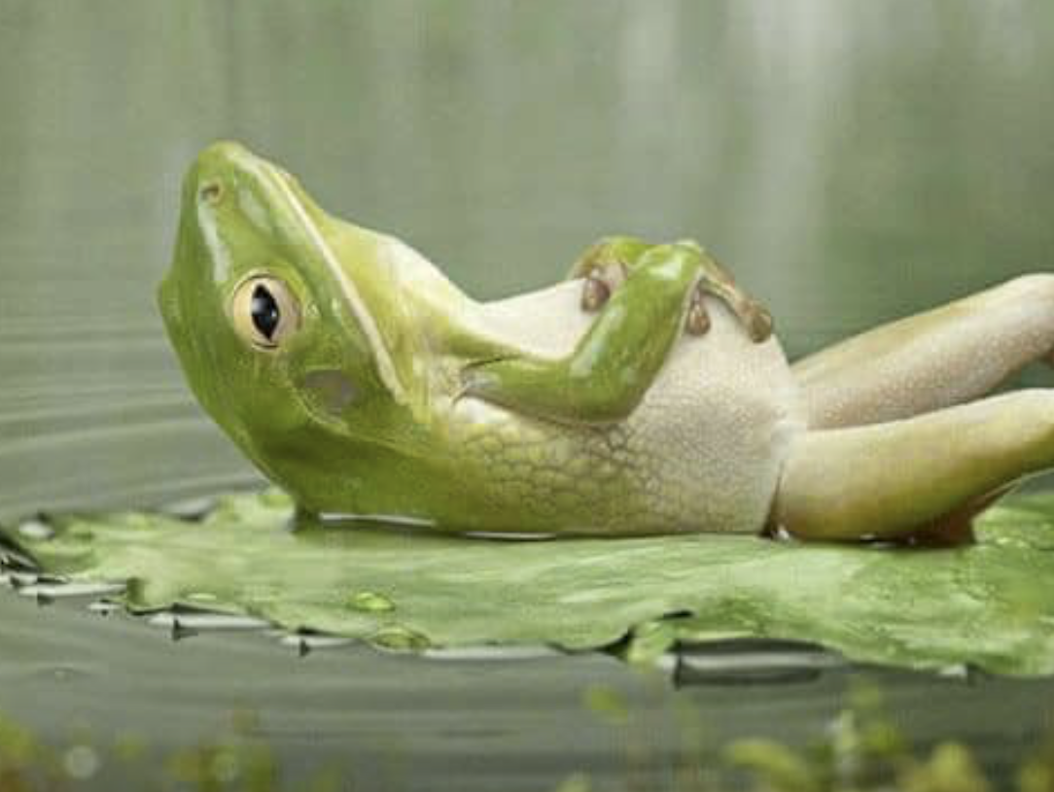
Notes:
Say, We are going to play a game today called ‘Who’s Hiding?” I am going to show you a picture, but parts of the picture are covered. I did leave a clue for you to start thinking about who could be hiding. Your job is to think about what you see.

Slide 4
Notes:
Say, We are going to play a game today called ‘Who’s Hiding?” I am going to show you a picture, but parts of the picture are covered. I did leave a clue for you to start thinking about who could be hiding. Your job is to think about what you see.

Slide 5
Notes:
Say, We are going to play a game today called ‘Who’s Hiding?” I am going to show you a picture, but parts of the picture are covered. I did leave a clue for you to start thinking about who could be hiding. Your job is to think about what you see.

Slide 6
Notes:
Say, We are going to play a game today called ‘Who’s Hiding?” I am going to show you a picture, but parts of the picture are covered. I did leave a clue for you to start thinking about who could be hiding. Your job is to think about what you see.

Slide 7
Notes:
Say, We are going to play a game today called ‘Who’s Hiding?” I am going to show you a picture, but parts of the picture are covered. I did leave a clue for you to start thinking about who could be hiding. Your job is to think about what you see.

Slide 8
Notes:
Say, We are going to play a game today called ‘Who’s Hiding?” I am going to show you a picture, but parts of the picture are covered. I did leave a clue for you to start thinking about who could be hiding. Your job is to think about what you see.

