Slide 1
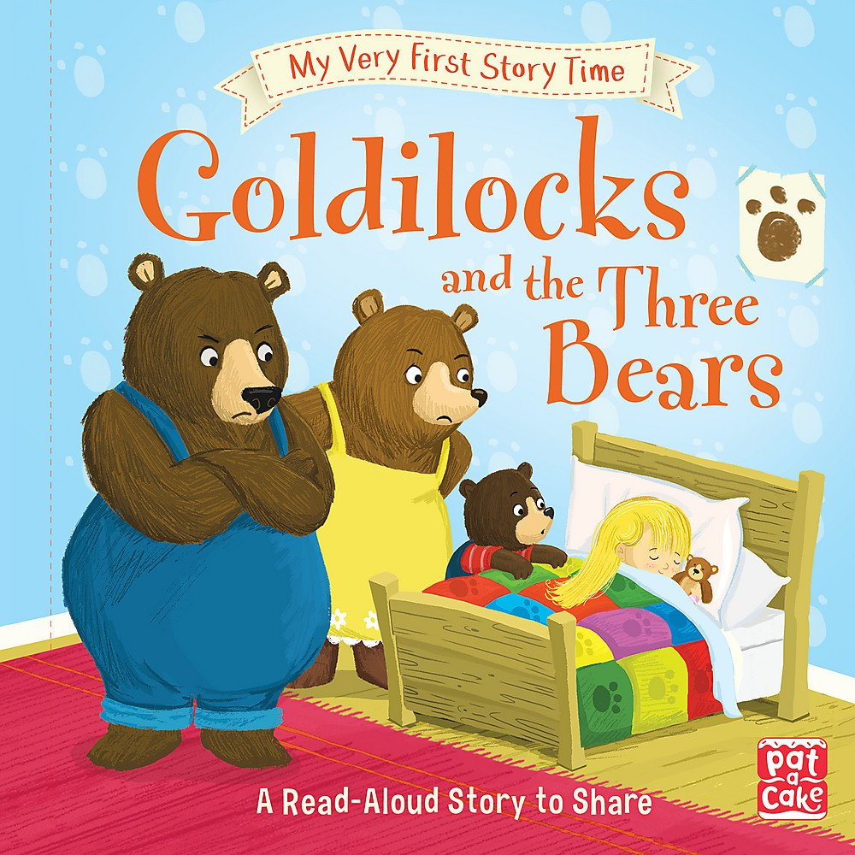
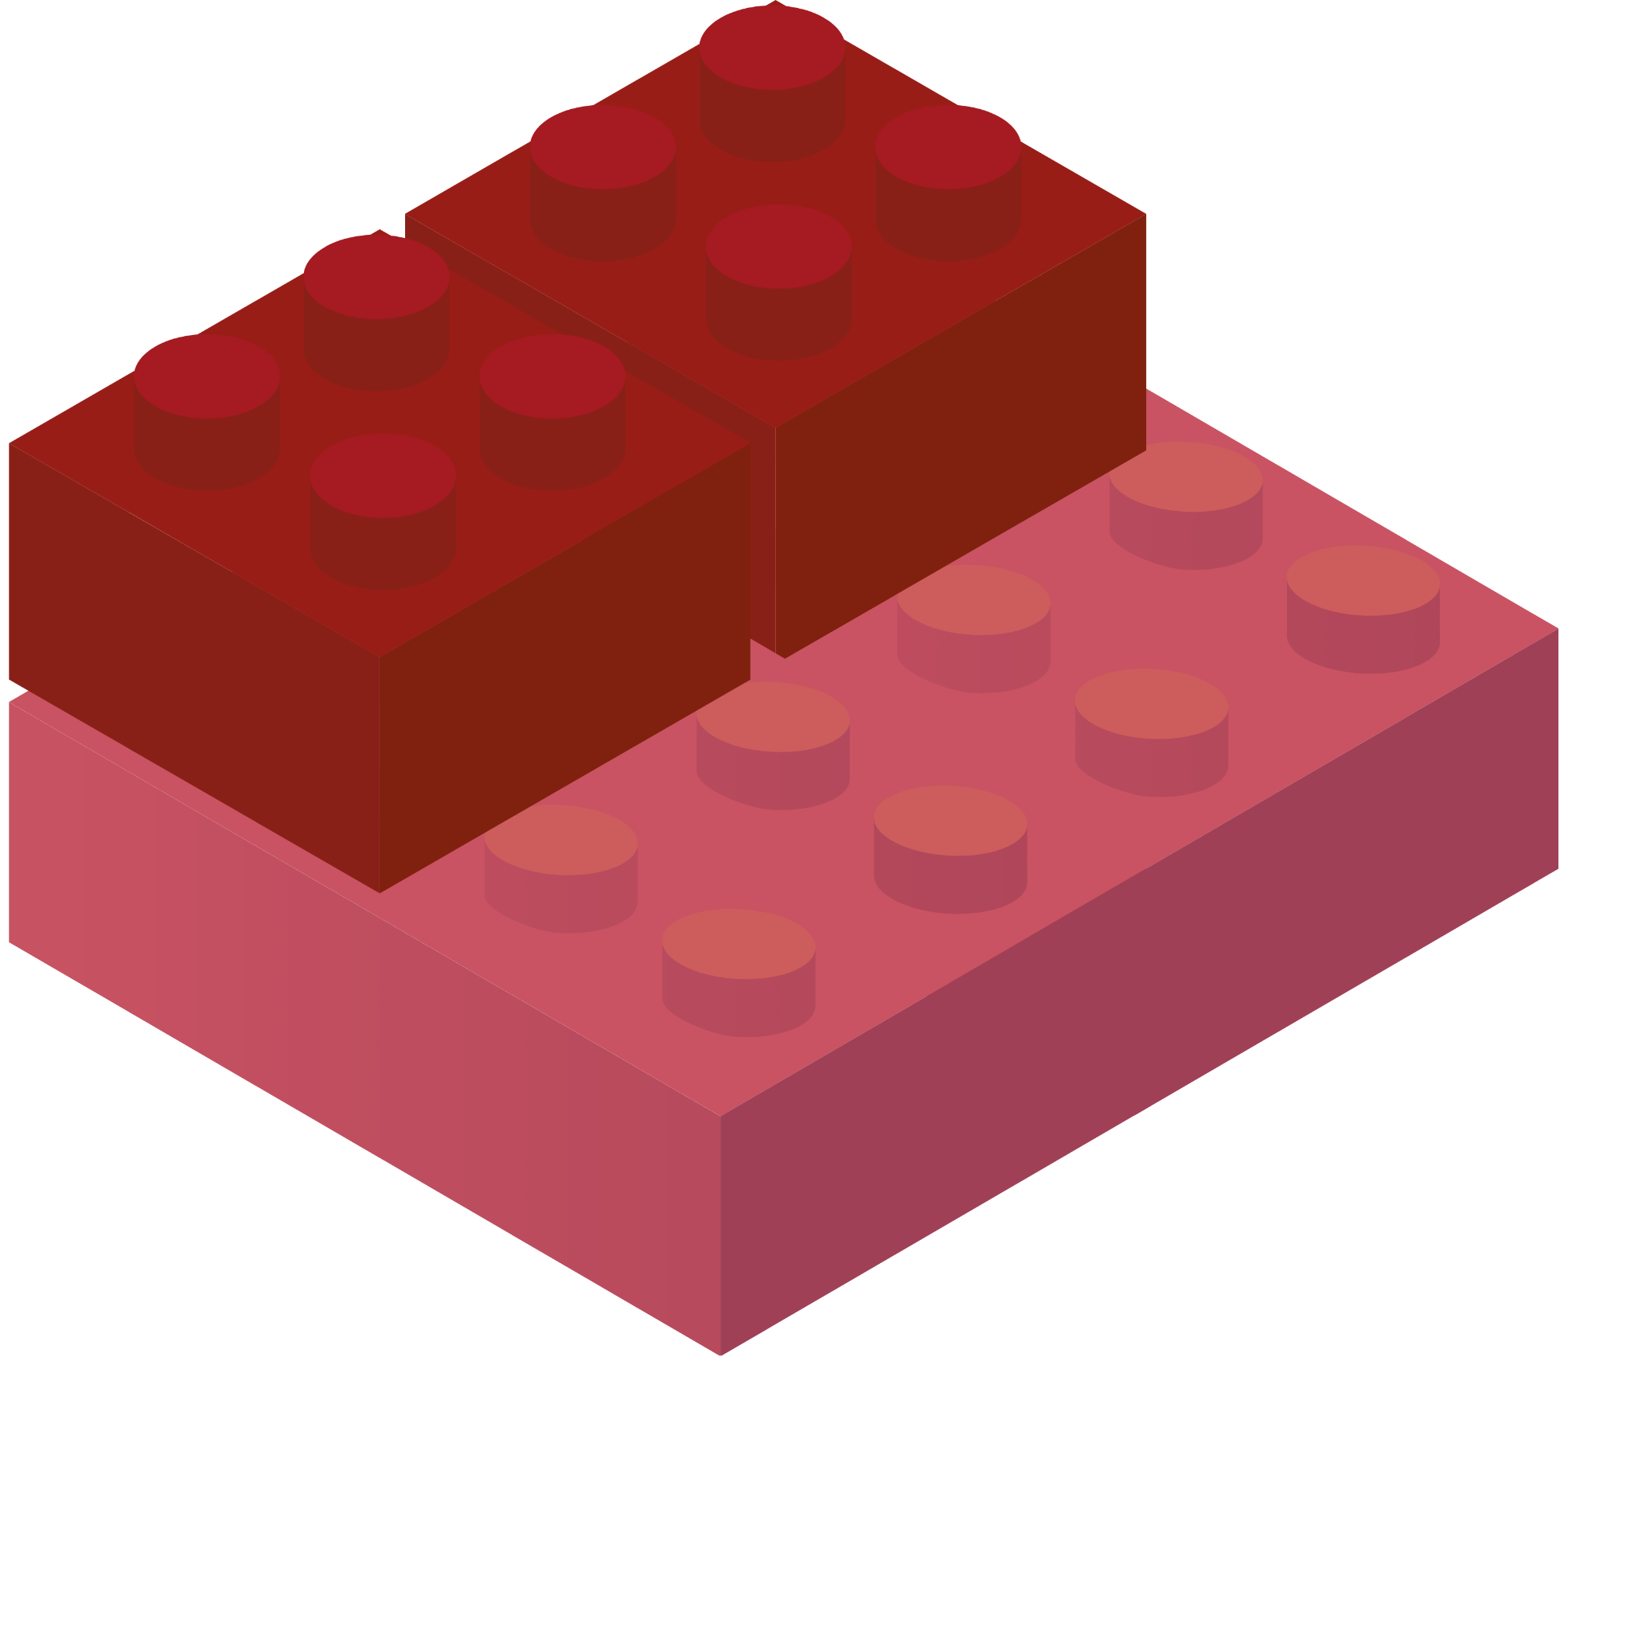
STORIES WITH
BRICKS
ALGEBRA FOUNDATIONS THROUGH PLAYFUL MATH AND LITERATURE
Aileen Rizo | Associate Director, PK-12
Bev Ford | PK-12 Coordinator

Slide 2
Let’s Start Playing
Thinking about the story of the Three Little Bears, what can you build?
Notes:
Students can share about their comprehension of the story through their building.
Additional Prompts:
What if you could only use 3 blocks? Could you make something from the story?
What is something we can count on our bricks? (circles on top of bricks, circles under the bricks, sides of bricks, faces on the bricks) This can help identify if we have the same or a different brick.

Slide 3
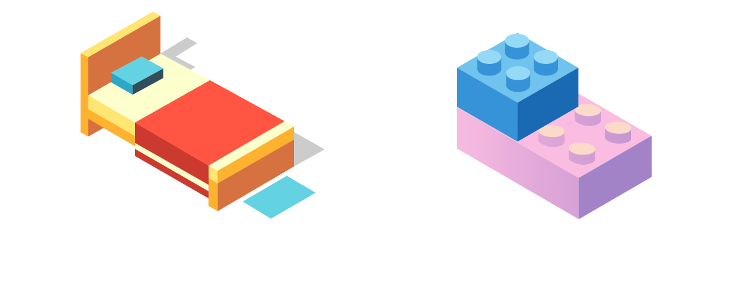
EQUALITY
Look I made one of the bear’s bed. Can you make one like mine?
Notes:
Is your bed like mine? What is the same or different?
Equality is about sameness. If I have 5 on one side I have 5 on the other side. Whether in shapes or quantity, identifying sameness builds a foundation for equality in Algebra.
4 = 4
3 + 2 = 5 - 1
3x = 6

Slide 4
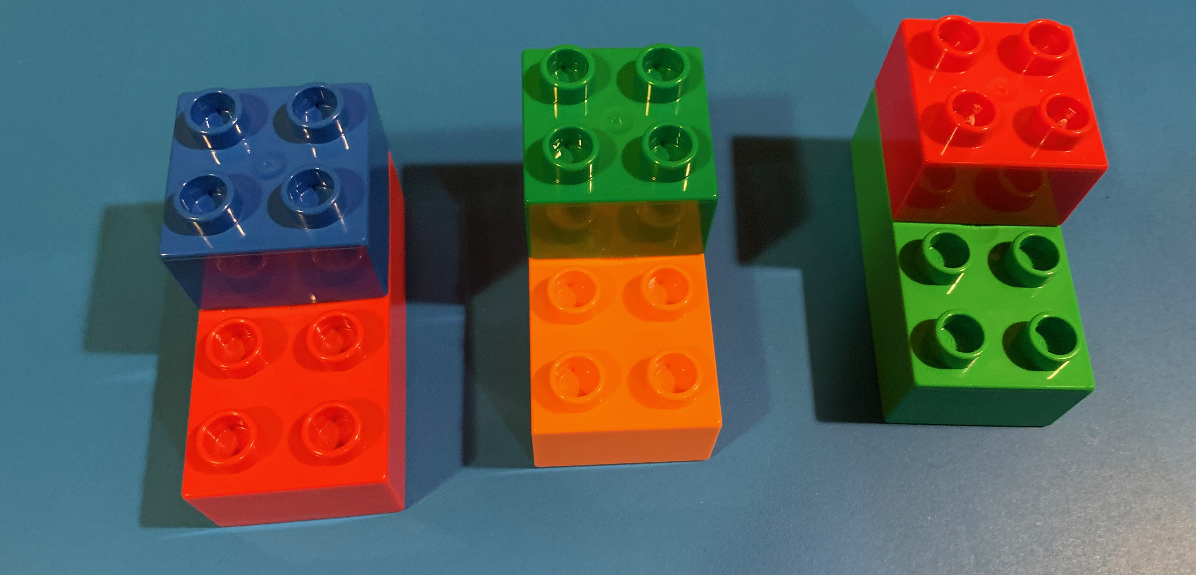
MULTIPLICITY
Can you make a bed for everyone in the bear family?
Notes:
Multiplicity is the iterations of a unit
Our unit is the bed. If we make 5 beds, we are iterating bed 5 times.
Multiplicity
4 + 4 + 4
3 groups of 4
3 x 4
3x=12

Slide 5
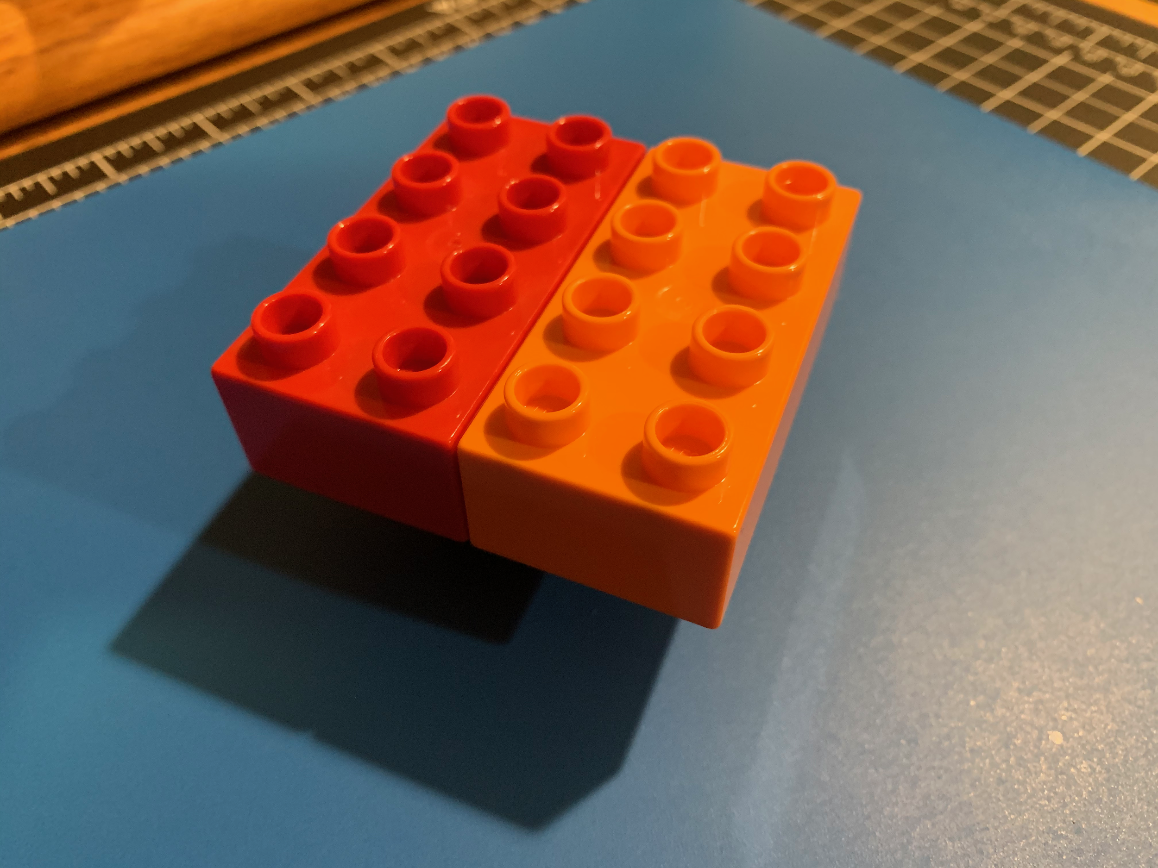
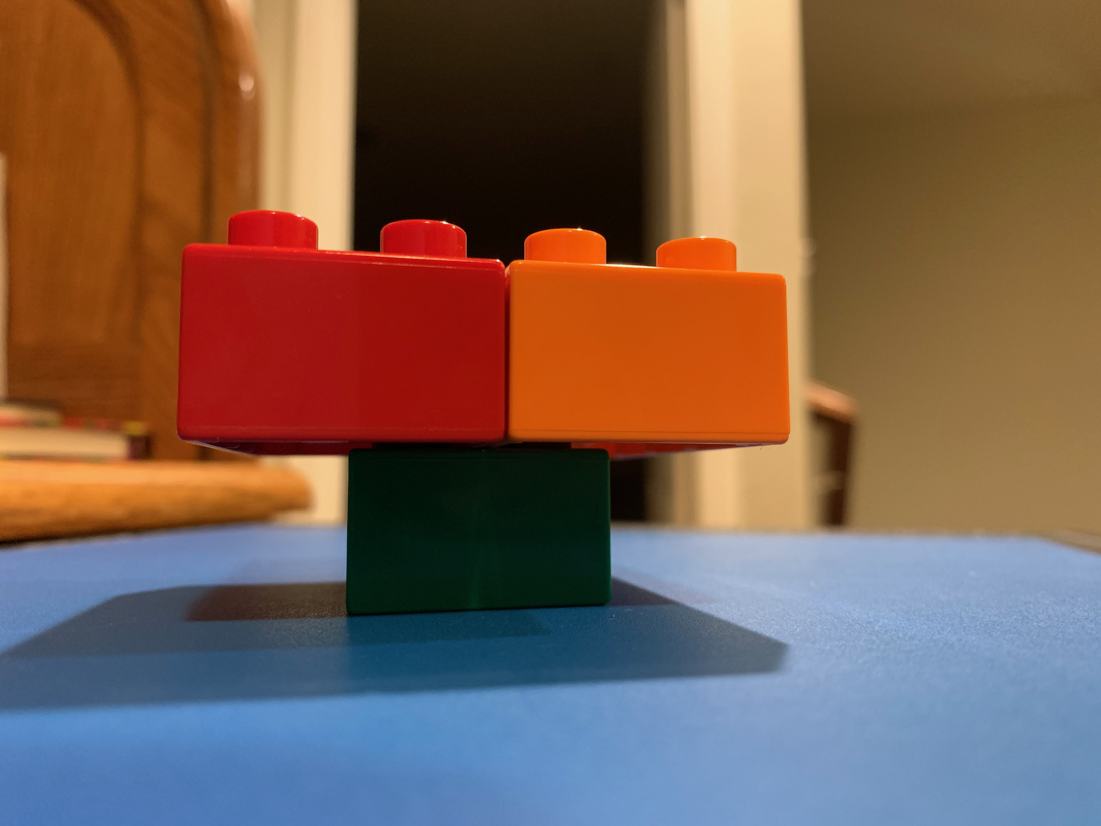
EQUALITY
Can you make a table like mine?
Notes:
Equality
4 = 4
3 + 2 = 5 - 1
3x = 6

Slide 6
SUBSTITUTION
Could we build another table just like this one but only use square bricks?
Notes:
Examples of Substitution:
Base Ten Numeration System Substitution
24-18
2 tens and 4 ones
1 ten and 14 ones
Equivalent Fraction Substitution
3 ½ + 2 ¼
Algebraic Substitution
Y = 2x + 4
3x + y = 9

Slide 7
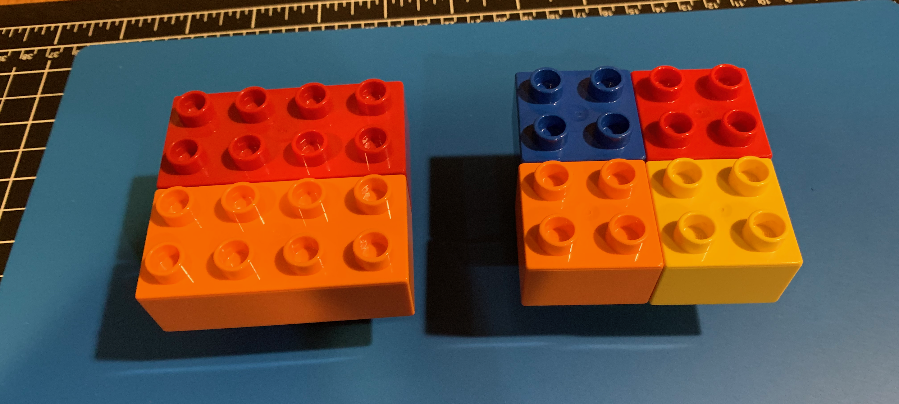
SUBSTITUTION
What is the same and different with these two tables?
Notes:
Examples of Substitution:
Base Ten Numeration System Substitution
24-18
2 tens and 4 ones
1 ten and 14 ones
Equivalent Fraction Substitution
3 ½ + 2 ¼
Algebraic Substitution
Y = 2x + 4
3x + y = 9

Slide 8
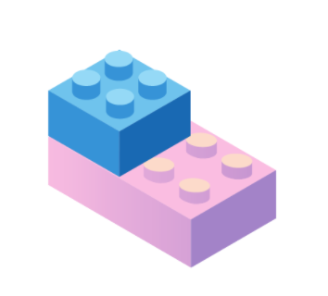
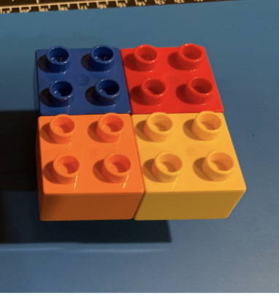
Math Concepts through Bricks
EQUALITY
MULTIPLICITY
SUBSTITUTION
Sameness in building an object.
Making iterations of the same object
Different ways to make the same brick.

Slide 9
Reflection
Good Story
Inspiring Objects
Math Concepts
What is an engaging story my children love to read?
What are some objects they can build from the story?
What math concepts can I foster through intentional questioning and play?

Slide 10
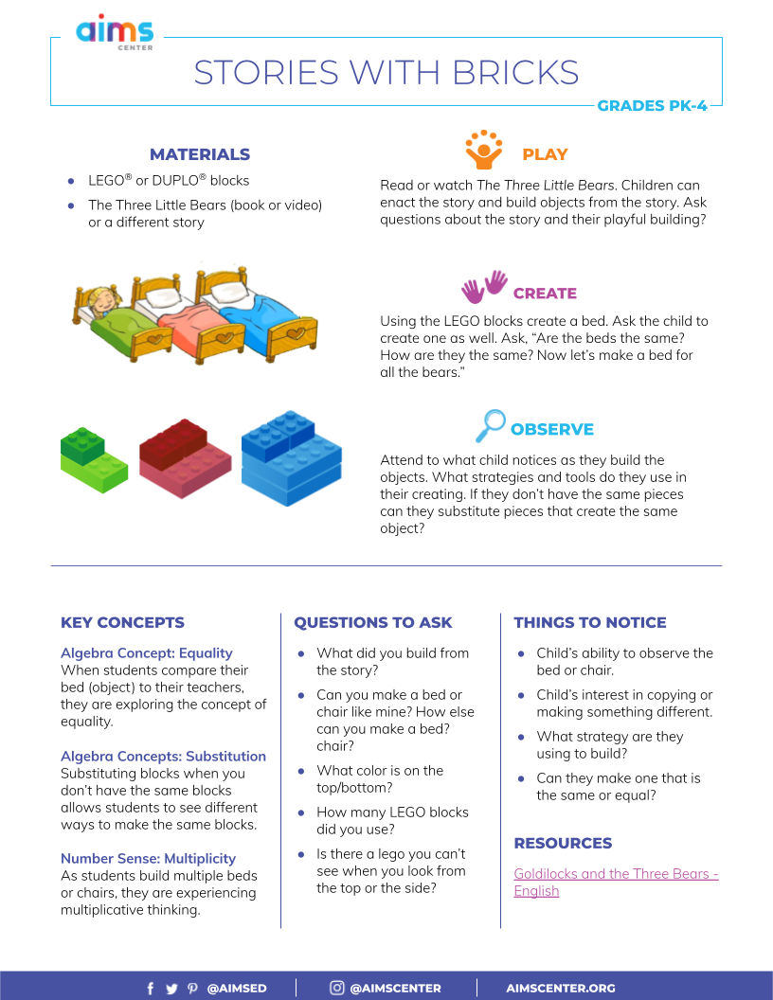
AIMS Resources

Slide 11
THANK YOU!
Aileen Rizo
Associate Director PK-12
aileen@AIMScenter.org
Bev Ford
PK-12 Coordinator
bev@AIMScenter.org
RESOURCES
AIMSCENTER.ORG
Notes:
Introduction - a bit about the AIMS Center and our current work

