Slide 1
Is It Fair?
Emilio
Martha

Slide 2
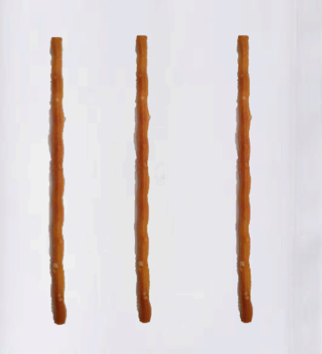
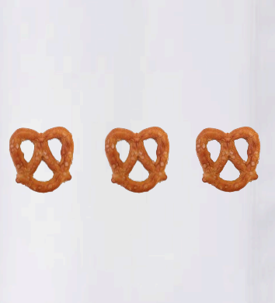
Is It Fair?
Emilio
Martha

Slide 3

Yes
No

Slide 4
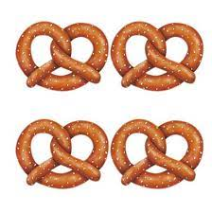
Is It Fair?
Emilio
Martha

