Slide 1
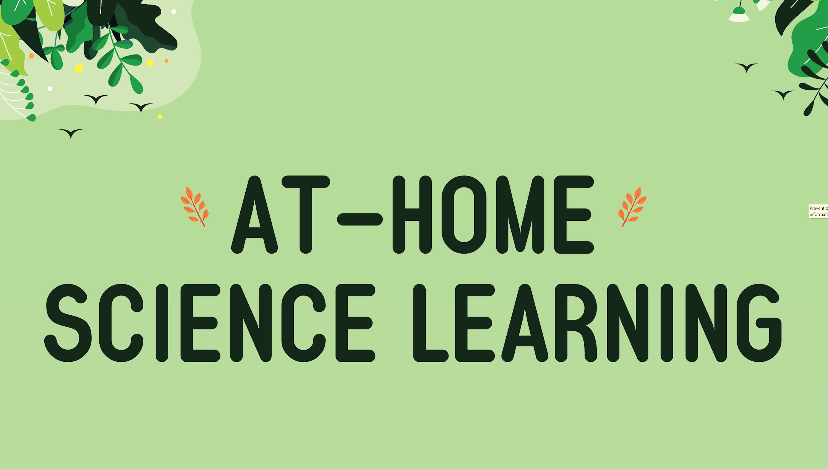
@mrdueck Jonathan Dueck jdueck@fcoe.org

Slide 3
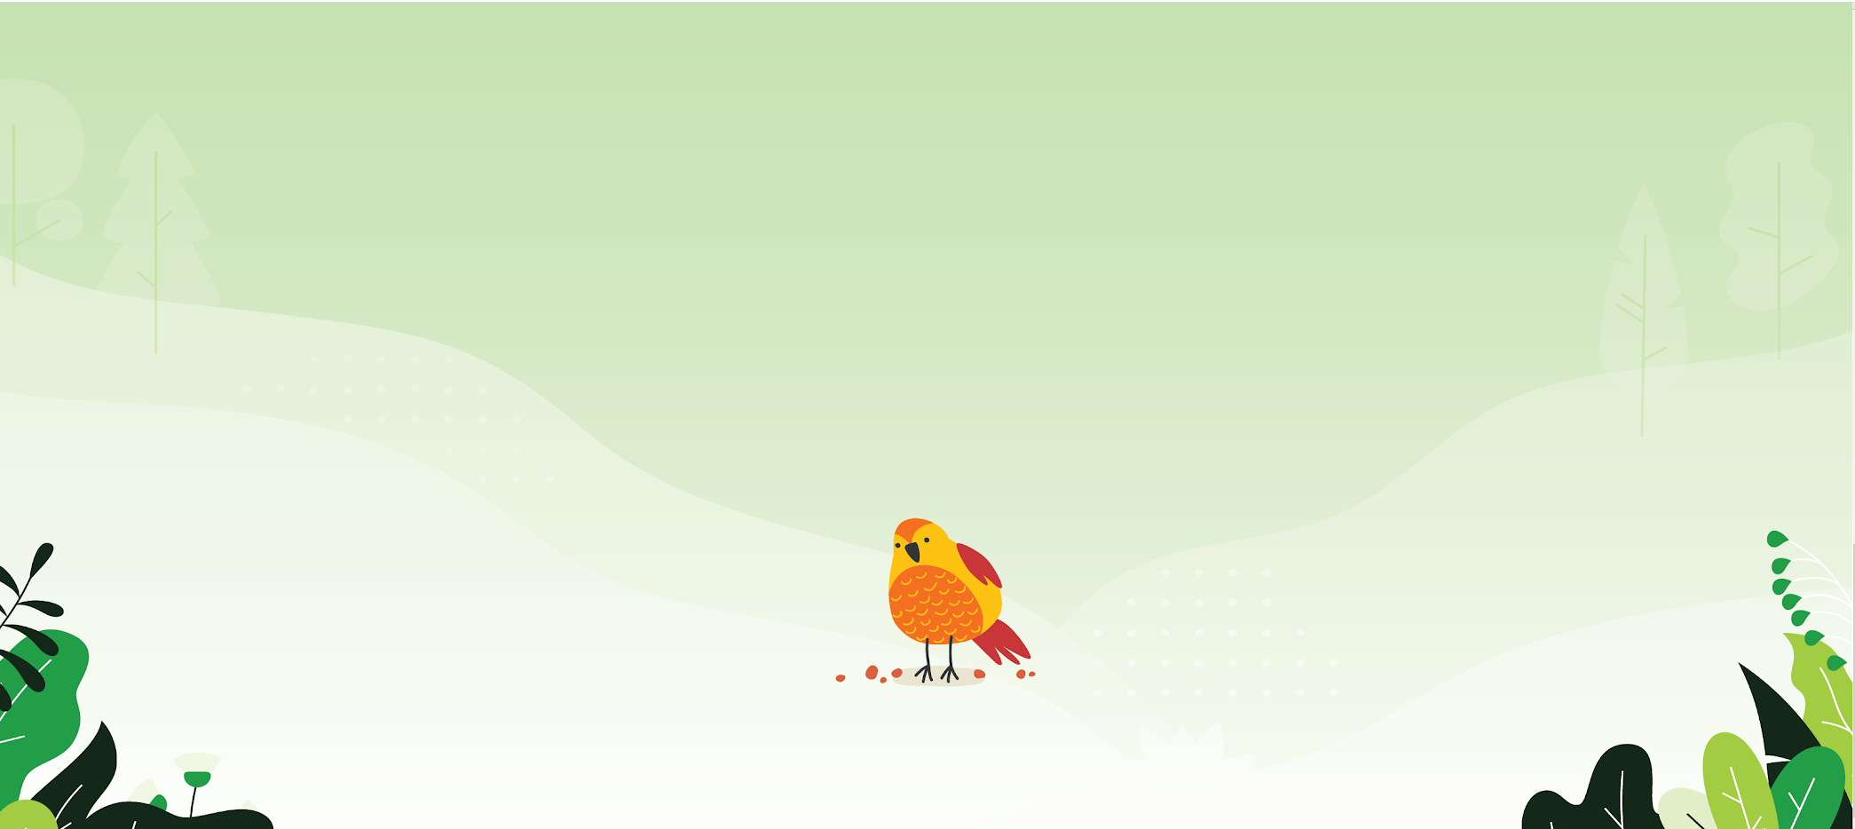
How are families involved in science learning?
Family science night
Take-home experiments
Asynchronous learning

Slide 4
How often are families involved in science learning?
1 2 3 4 5 6 7 8

Slide 5
Components of a Strong Science Program
At Home Science is meant to be a supplemental part of a science program. This is designed to pull in family members and/or be a part of an expanded learning community.
At Home Science can be a part of a the engagement piece of your science program.

Slide 6
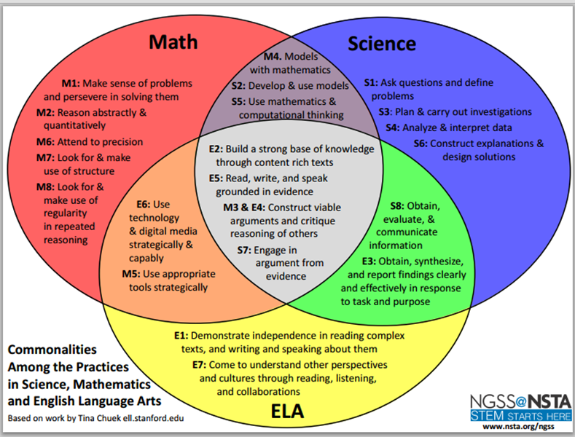
https://static.nsta.org/ngss/PracticesVennDiagram.pdf

Slide 7
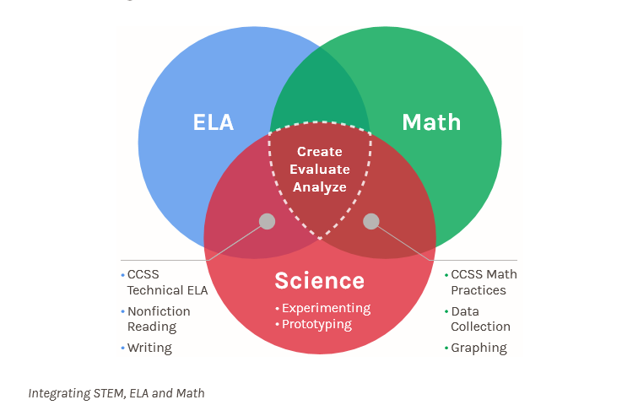
https://www.knowatom.com/blog/stem-crossover-where-ela-math-meet-science
Connections between content areas

Slide 8
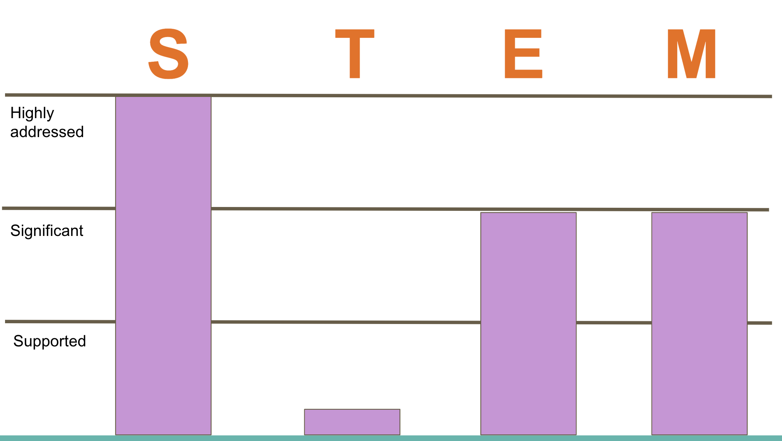

Slide 9
TECHNOLOGY
VAPA
MATH
ELD
SCIENCE

Slide 12
#1 Nature Scavenger Hunt
Activity 1: Decide on an appropriate location for your child to do this nature scavenger hunt (backyard, front yard, nearby green space).
Activity 3: Categorize the objects you found
Activity 5: “Silent sit” Be completely quiet and listen to the sounds you hear. Set a timer for 3-10 minutes… “I heard…” “I wasn’t sure about…”
Activity 6: Use iNaturalist and identify the items you find

Slide 13
Activity 1: Decide on an appropriate location for your child to do this nature scavenger hunt (backyard, front yard, nearby park).
Activity 3: Categorize the objects you found
Activity 5: “Silent sit” Be completely quiet and listen to the sounds you hear. Set a timer for 3-10 minutes… “I heard…” “I wasn’t sure about…”
Activity 6: Use iNaturalist and identify the items you find

Slide 14
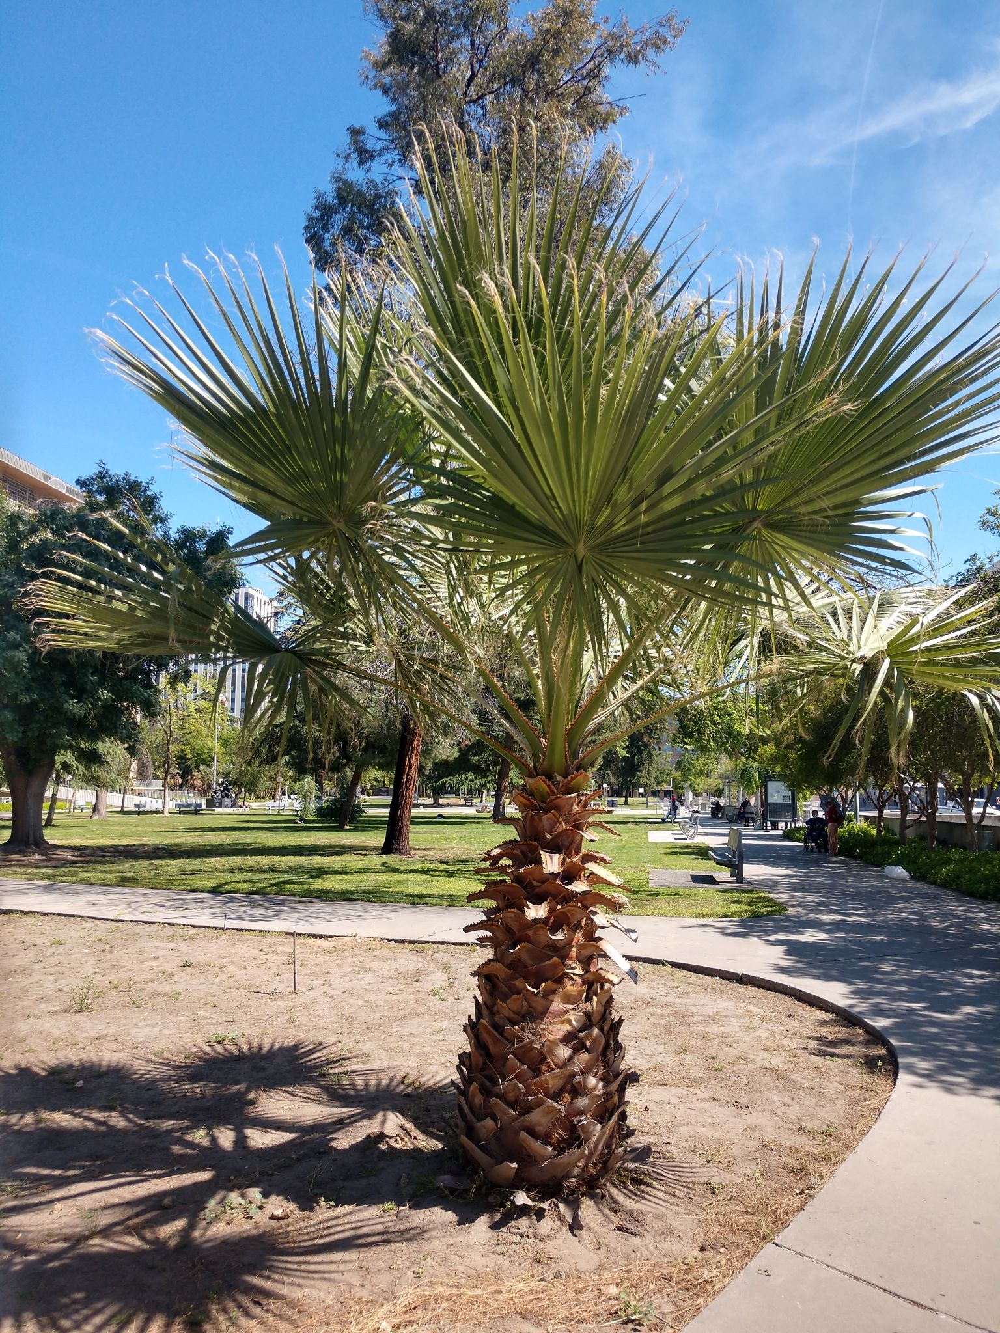
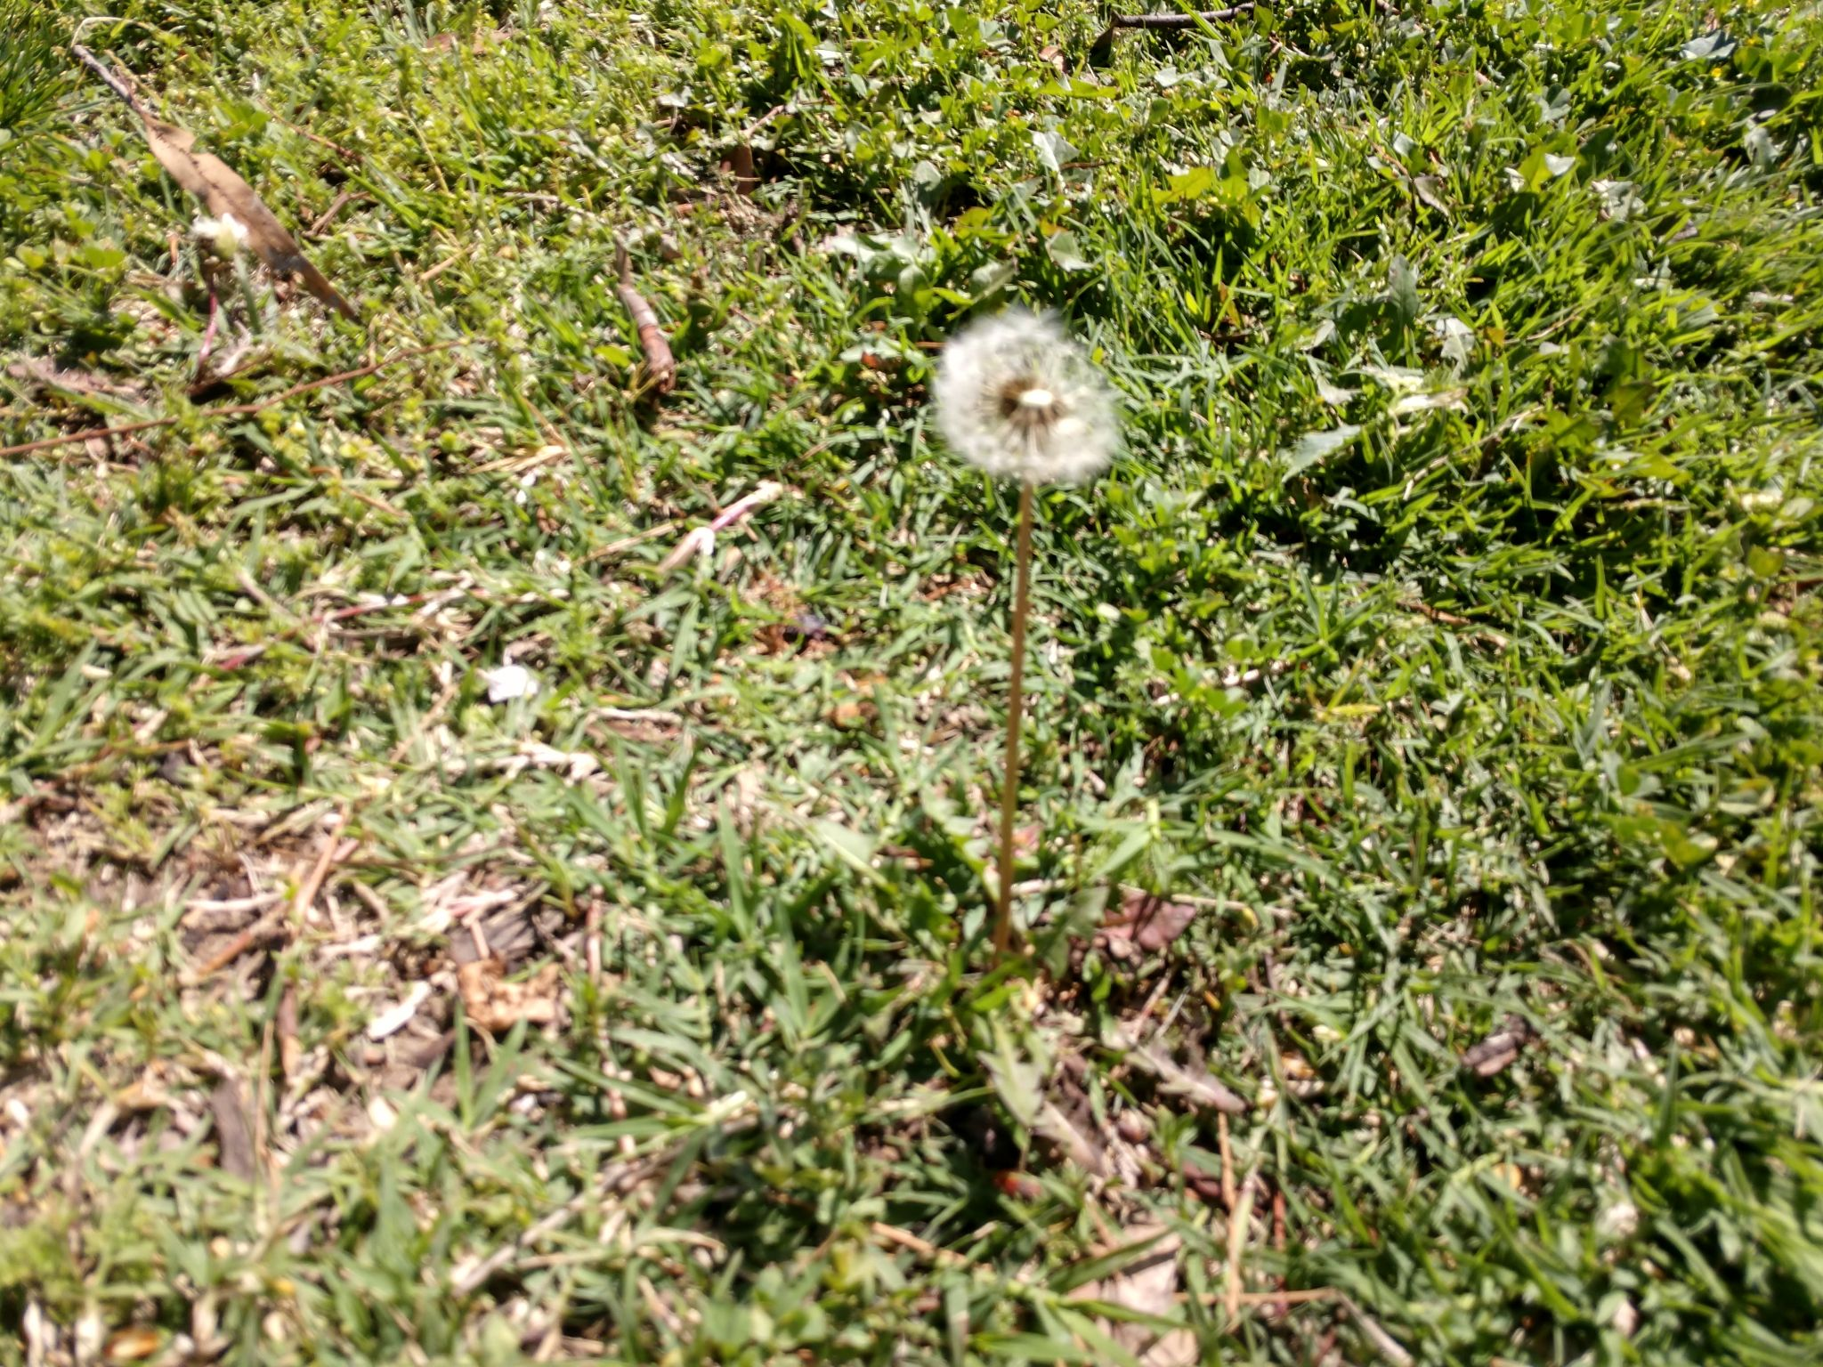
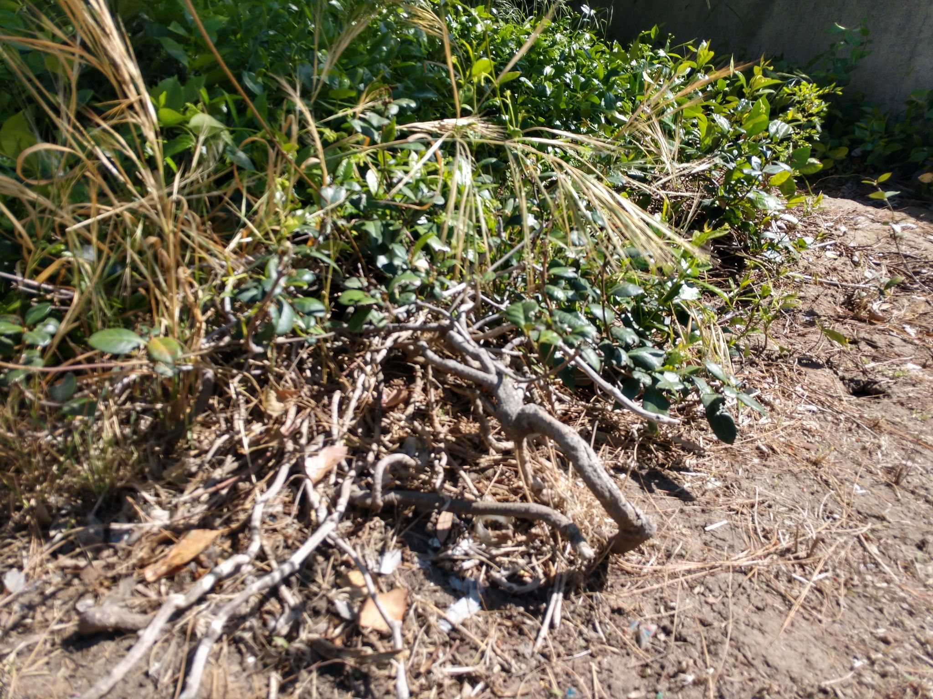

Slide 15
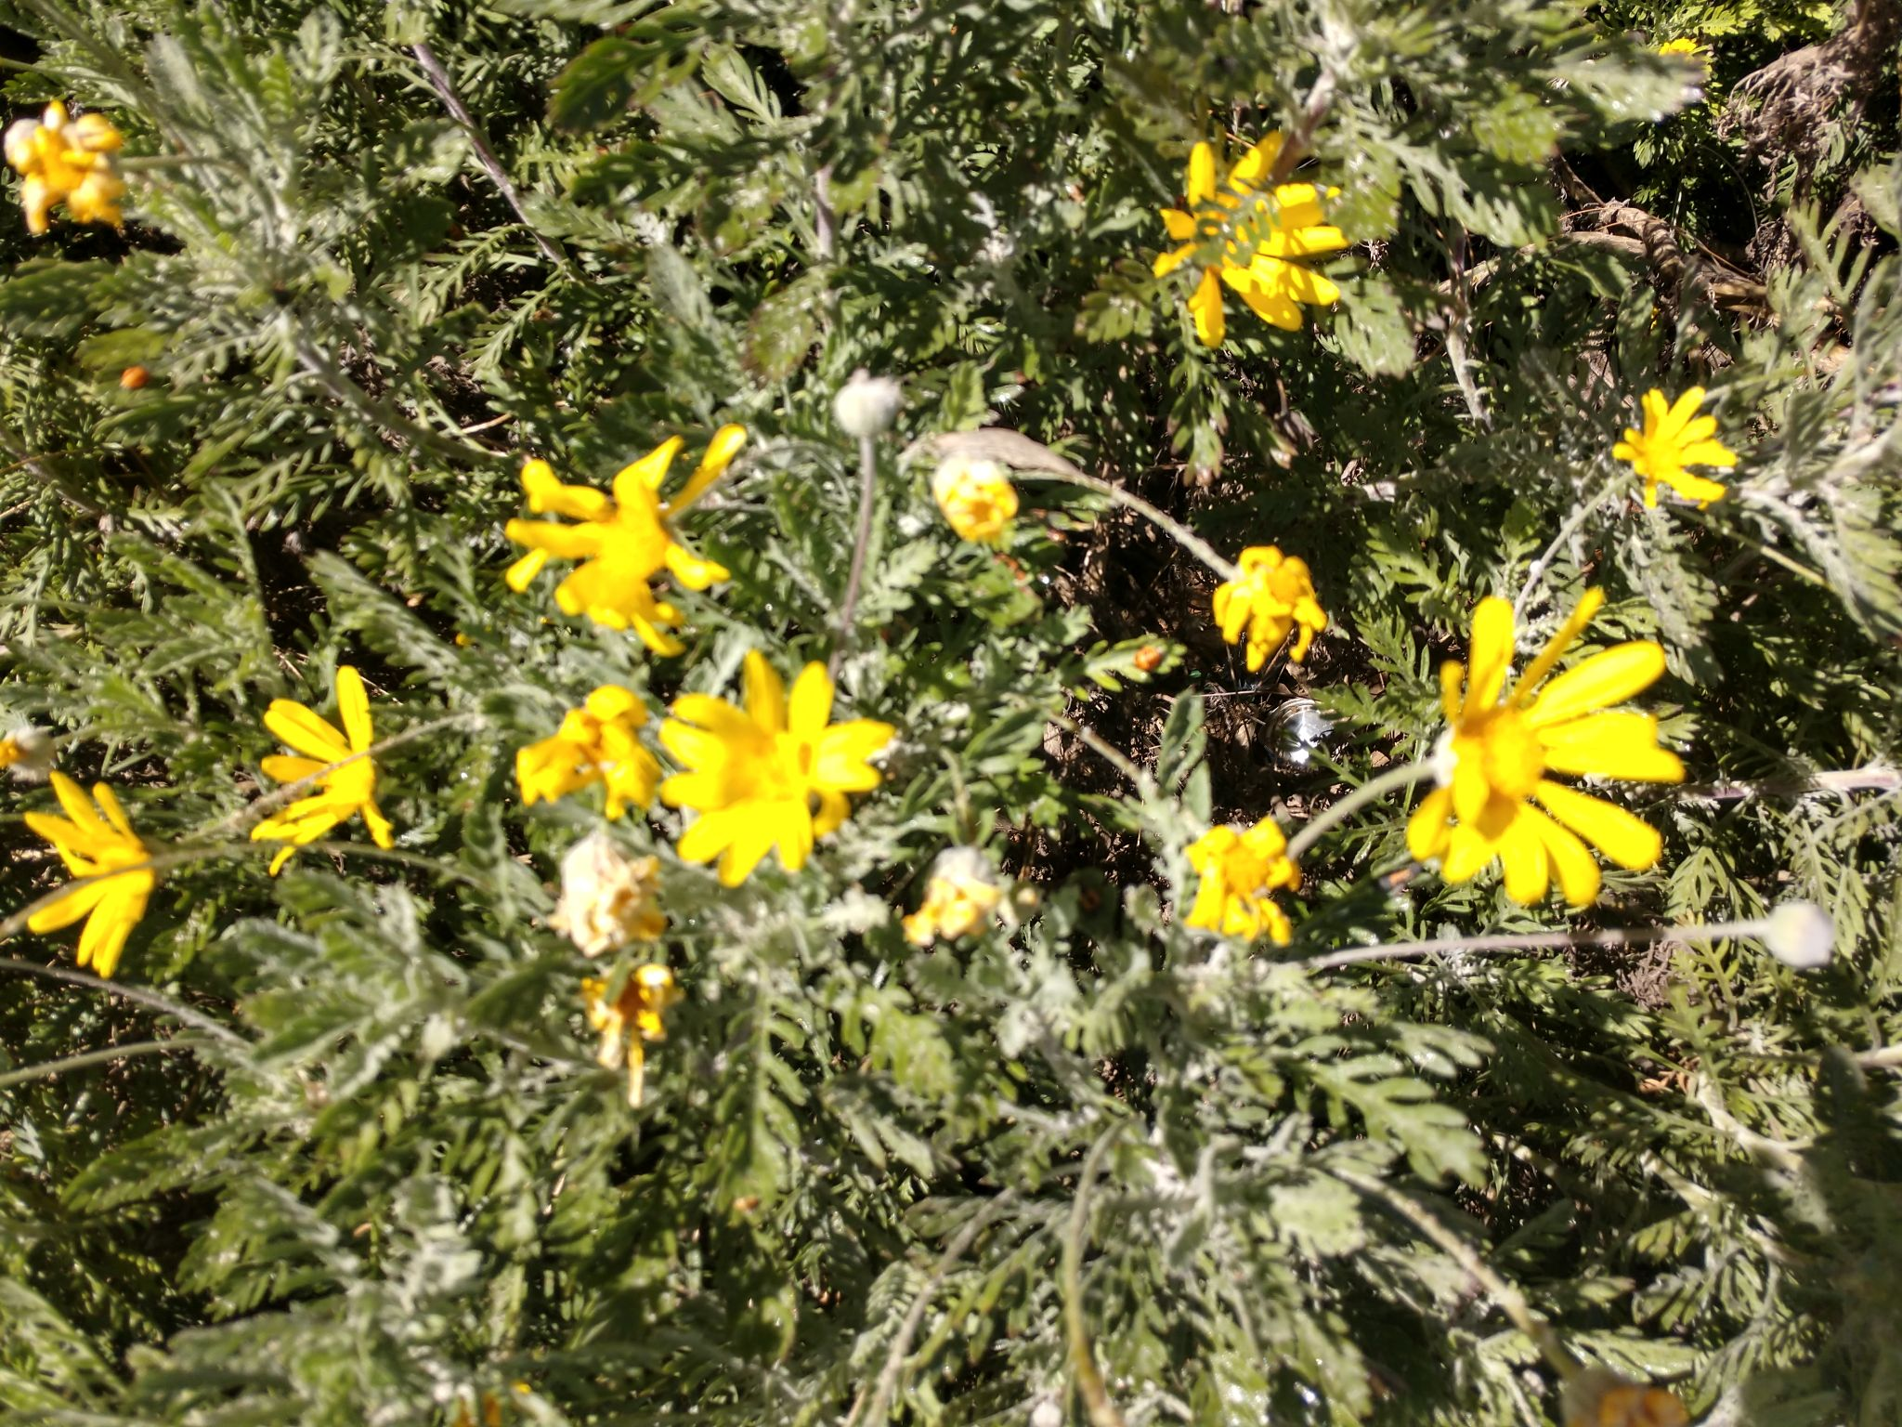
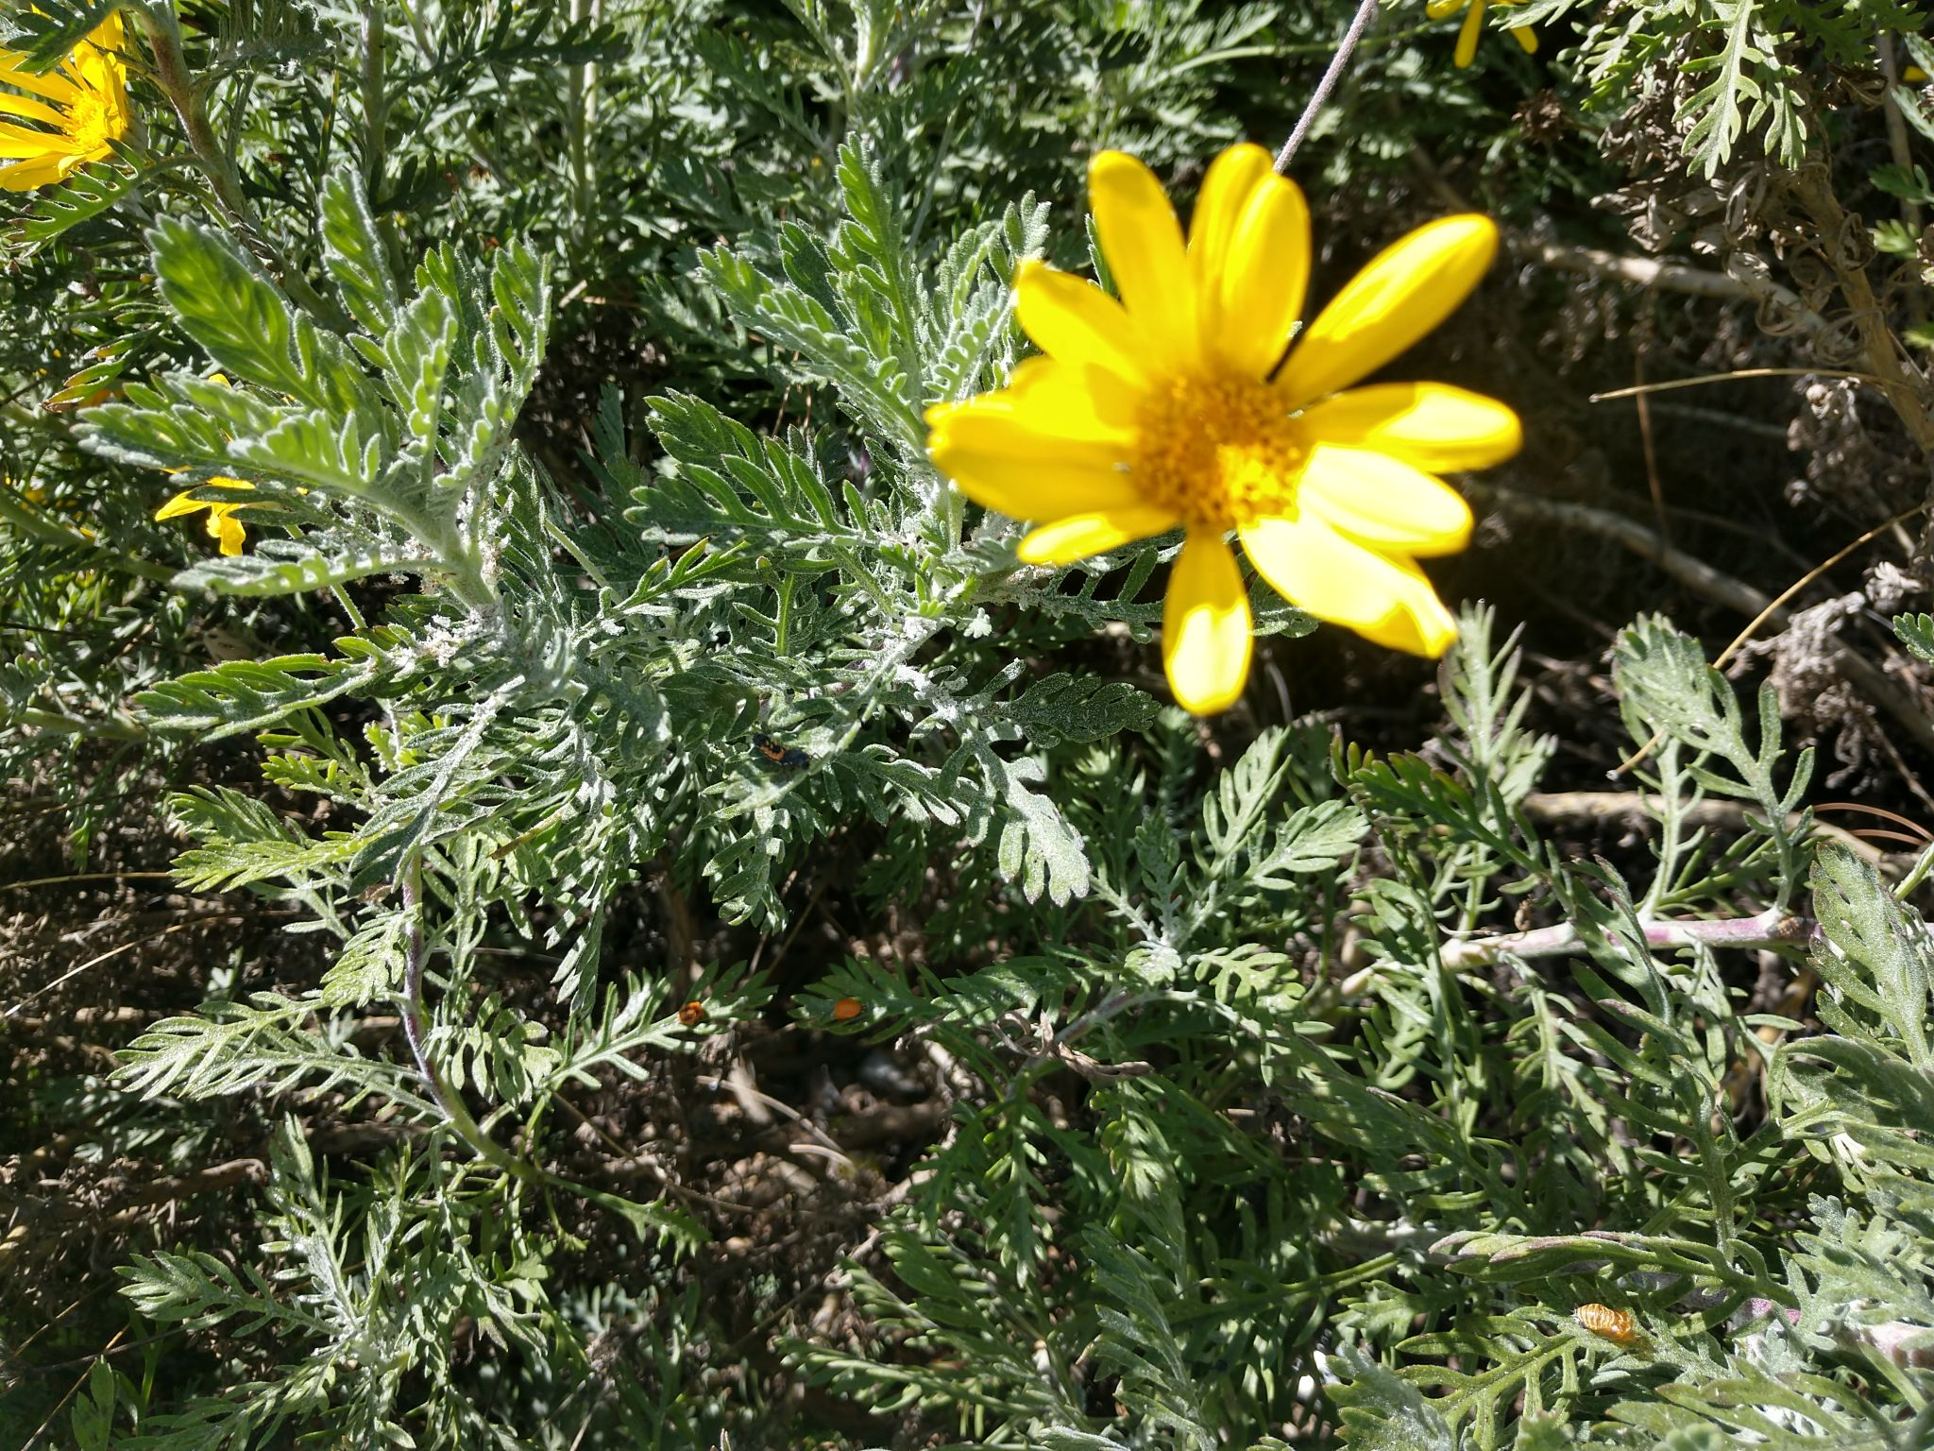

Slide 16
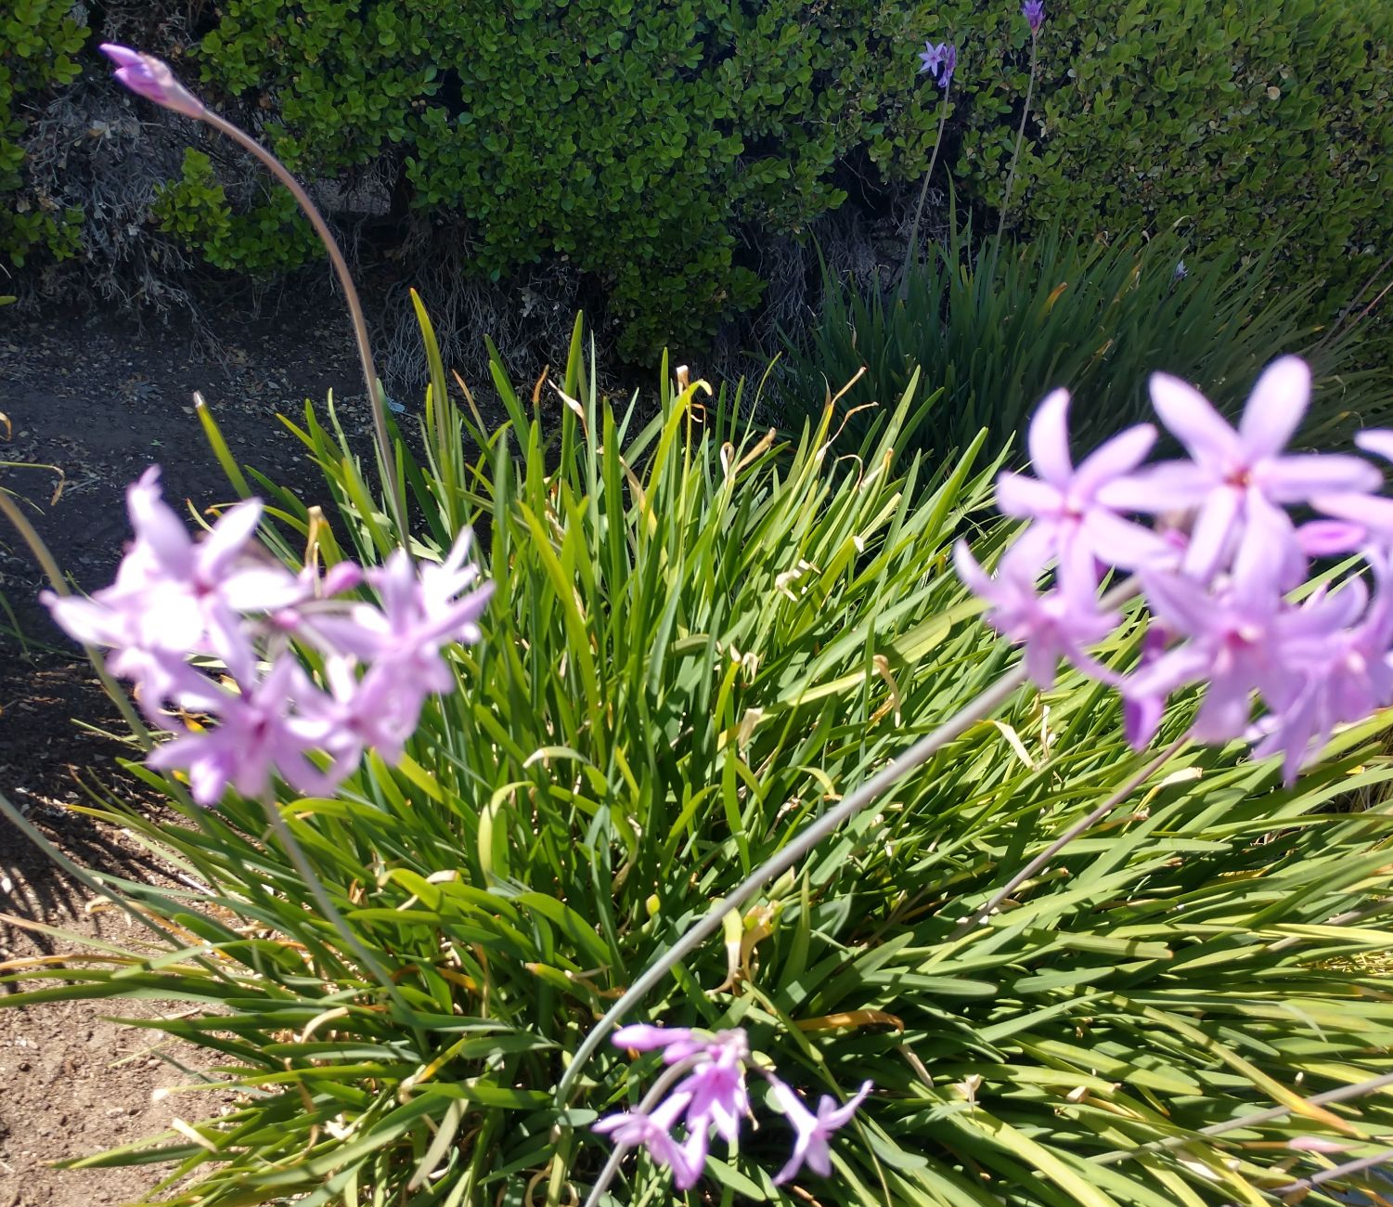

Slide 17
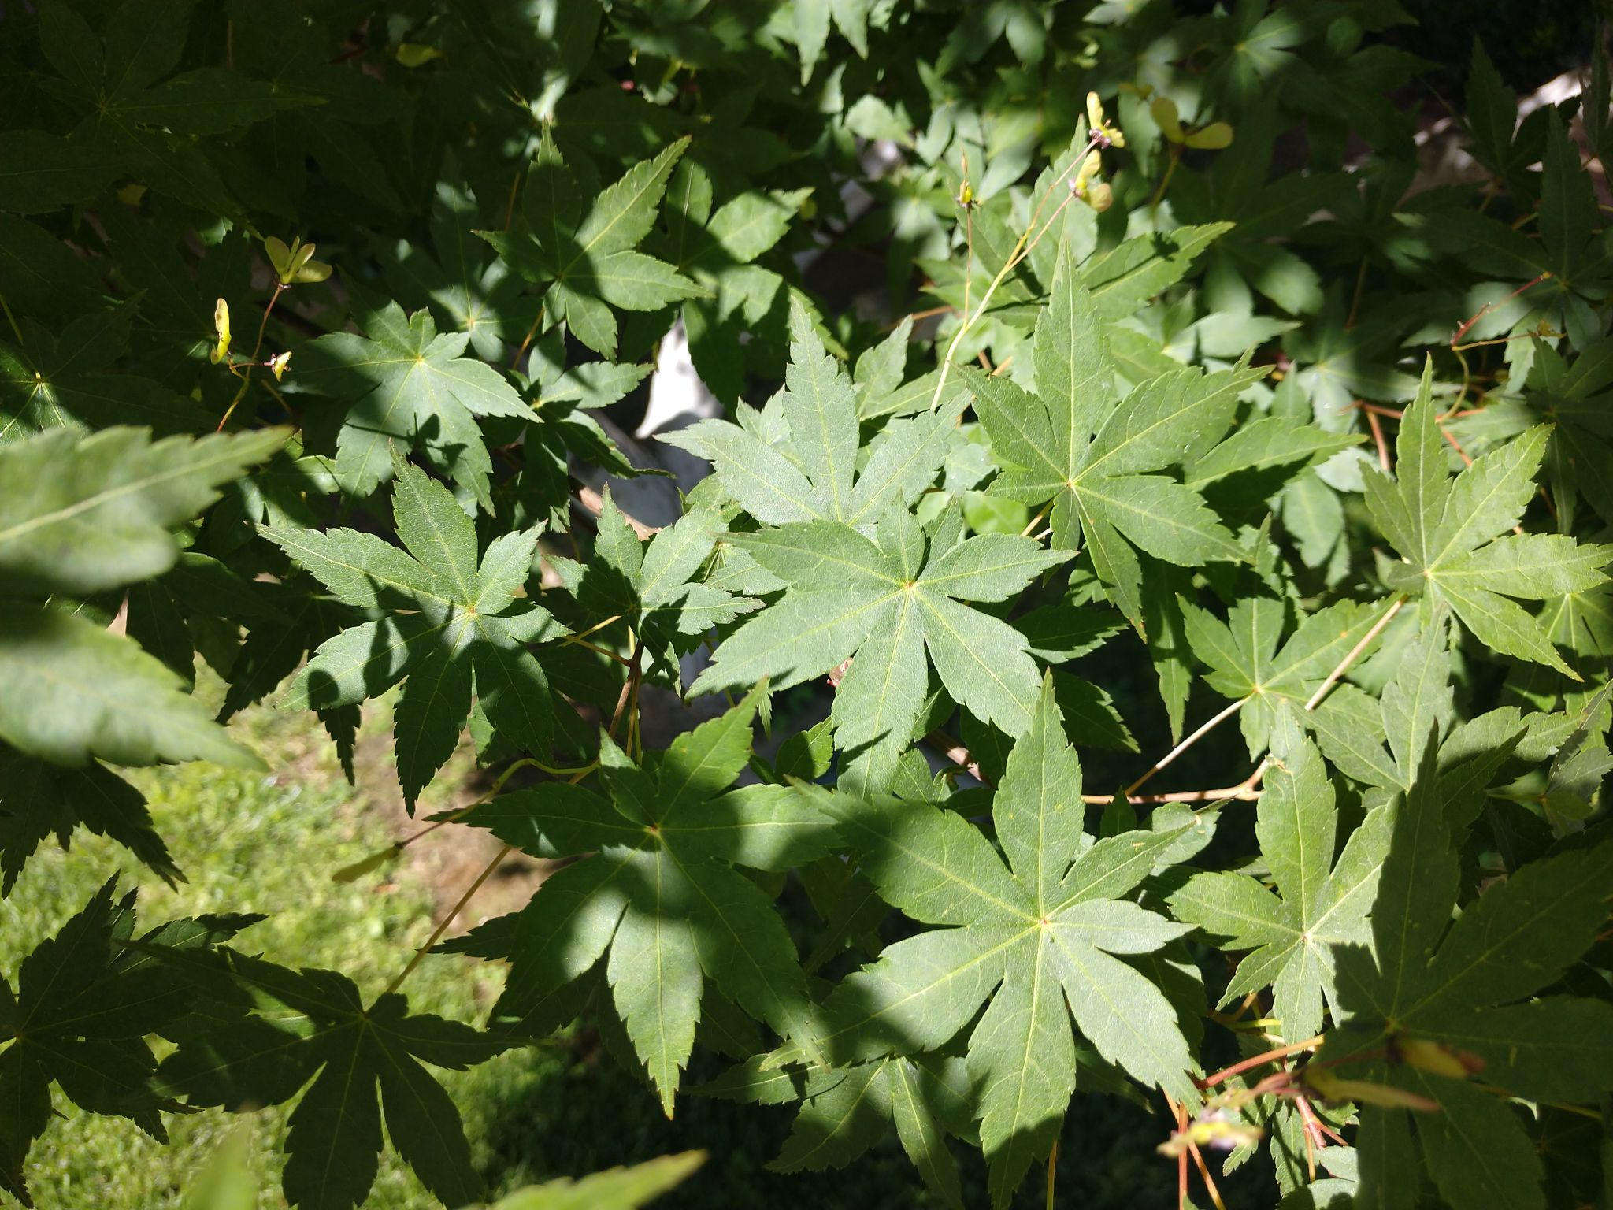
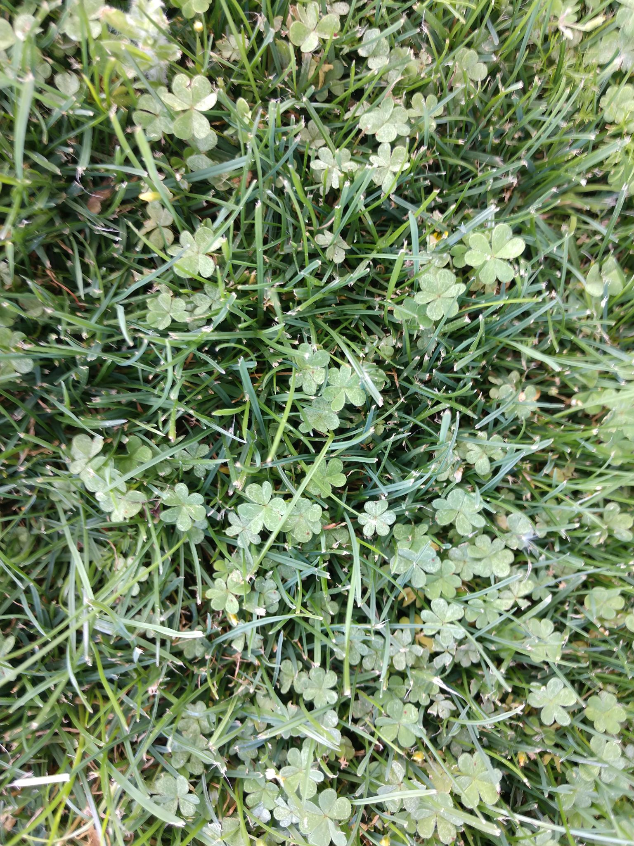

Slide 18
What else might you see in your backyard or nearby park?

Slide 19
Activity 1: Decide on an appropriate location for your child to do this nature scavenger hunt (backyard, front yard, nearby green space).
Activity 3: Categorize the objects you found
Activity 5: “Silent sit” Be completely quiet and listen to the sounds you hear. Set a timer for 3-10 minutes… “I heard…” “I wasn’t sure about…”
Activity 6: Use iNaturalist and identify the items you find

Slide 20
Activity 1: Decide on an appropriate location for your child to do this nature scavenger hunt (backyard, front yard, nearby park).
Activity 3: Categorize the objects you found
Activity 5: “Silent sit” Be completely quiet and listen to the sounds you hear. Set a timer for 3-10 minutes… “I heard…” “I wasn’t sure about…”
Activity 6: Use iNaturalist and identify the items you find

Slide 21
Activity 1: Decide on an appropriate location for your child to do this nature scavenger hunt (backyard, front yard, nearby park).
Activity 3: Categorize the objects you found
Activity 5: “Silent sit” Be completely quiet and listen to the sounds you hear. Set a timer for 3-10 minutes… “I heard…” “I wasn’t sure about…”
Activity 6: Use iNaturalist and identify the items you find

Slide 22
Activity 1: Decide on an appropriate location for your child to do this nature scavenger hunt (backyard, front yard, nearby park).
Activity 3: Categorize the objects you found
Activity 5: “Silent sit” Be completely quiet and listen to the sounds you hear. Set a timer for 3-10 minutes… “I heard…” “I wasn’t sure about…”
Activity 6: Use iNaturalist and identify the items you find

Slide 23
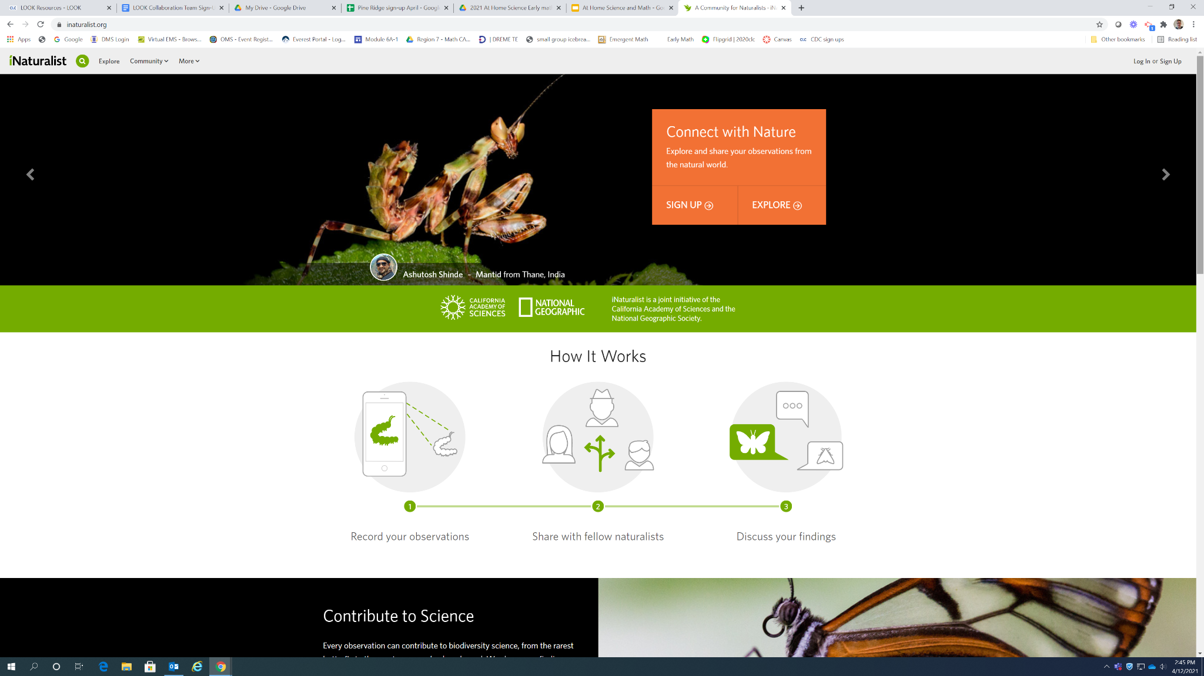
The “shapes” one is mainly math, tie into the videos on the web app.

Slide 24
Activity 1: Decide on an appropriate location for your child to do this nature scavenger hunt (backyard, front yard, nearby park).
Activity 3: Categorize the objects you found
Activity 5: “Silent sit” Be completely quiet and listen to the sounds you hear. Set a timer for 3-10 minutes… “I heard…” “I wasn’t sure about…”
Activity 6: Use iNaturalist and identify the items you find
Math connection:

Slide 25
Activity 1: Decide on an appropriate location for your child to do this nature scavenger hunt (backyard, front yard, nearby park).
Activity 3: Categorize the objects you found
Activity 5: “Silent sit” Be completely quiet and listen to the sounds you hear. Set a timer for 3-10 minutes… “I heard…” “I wasn’t sure about…”
Activity 6: Use iNaturalist and identify the items you find
Math connection: Count, Graph, Sort & Classify

Slide 27
Nature Scavenger Hunt
Bottle Bowling
Sun and Shadows
Sink or Float
What’s the Weather?
Plants and Pollinators
Where did the Water Go?
Reduce, Reuse, Recycle
Shapes in Nature
Paper Challenges
Parent Guides and Student Journals are available in English and Spanish

Slide 36
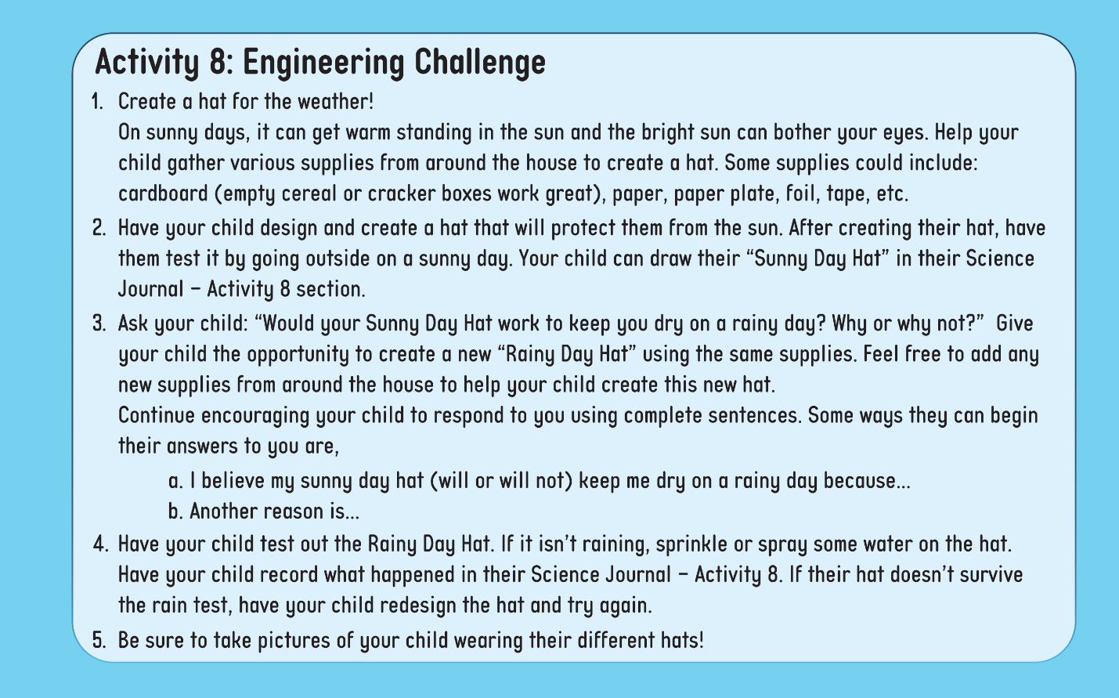

Slide 37
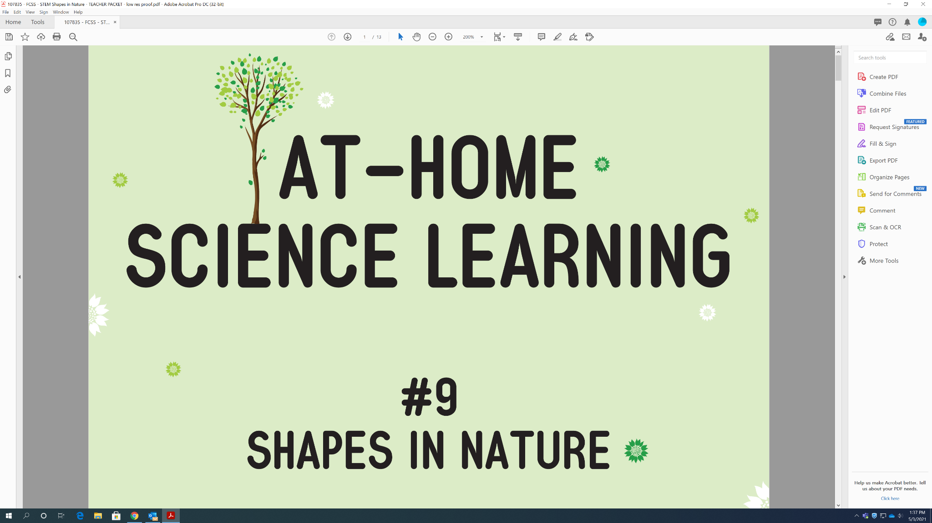

Slide 39
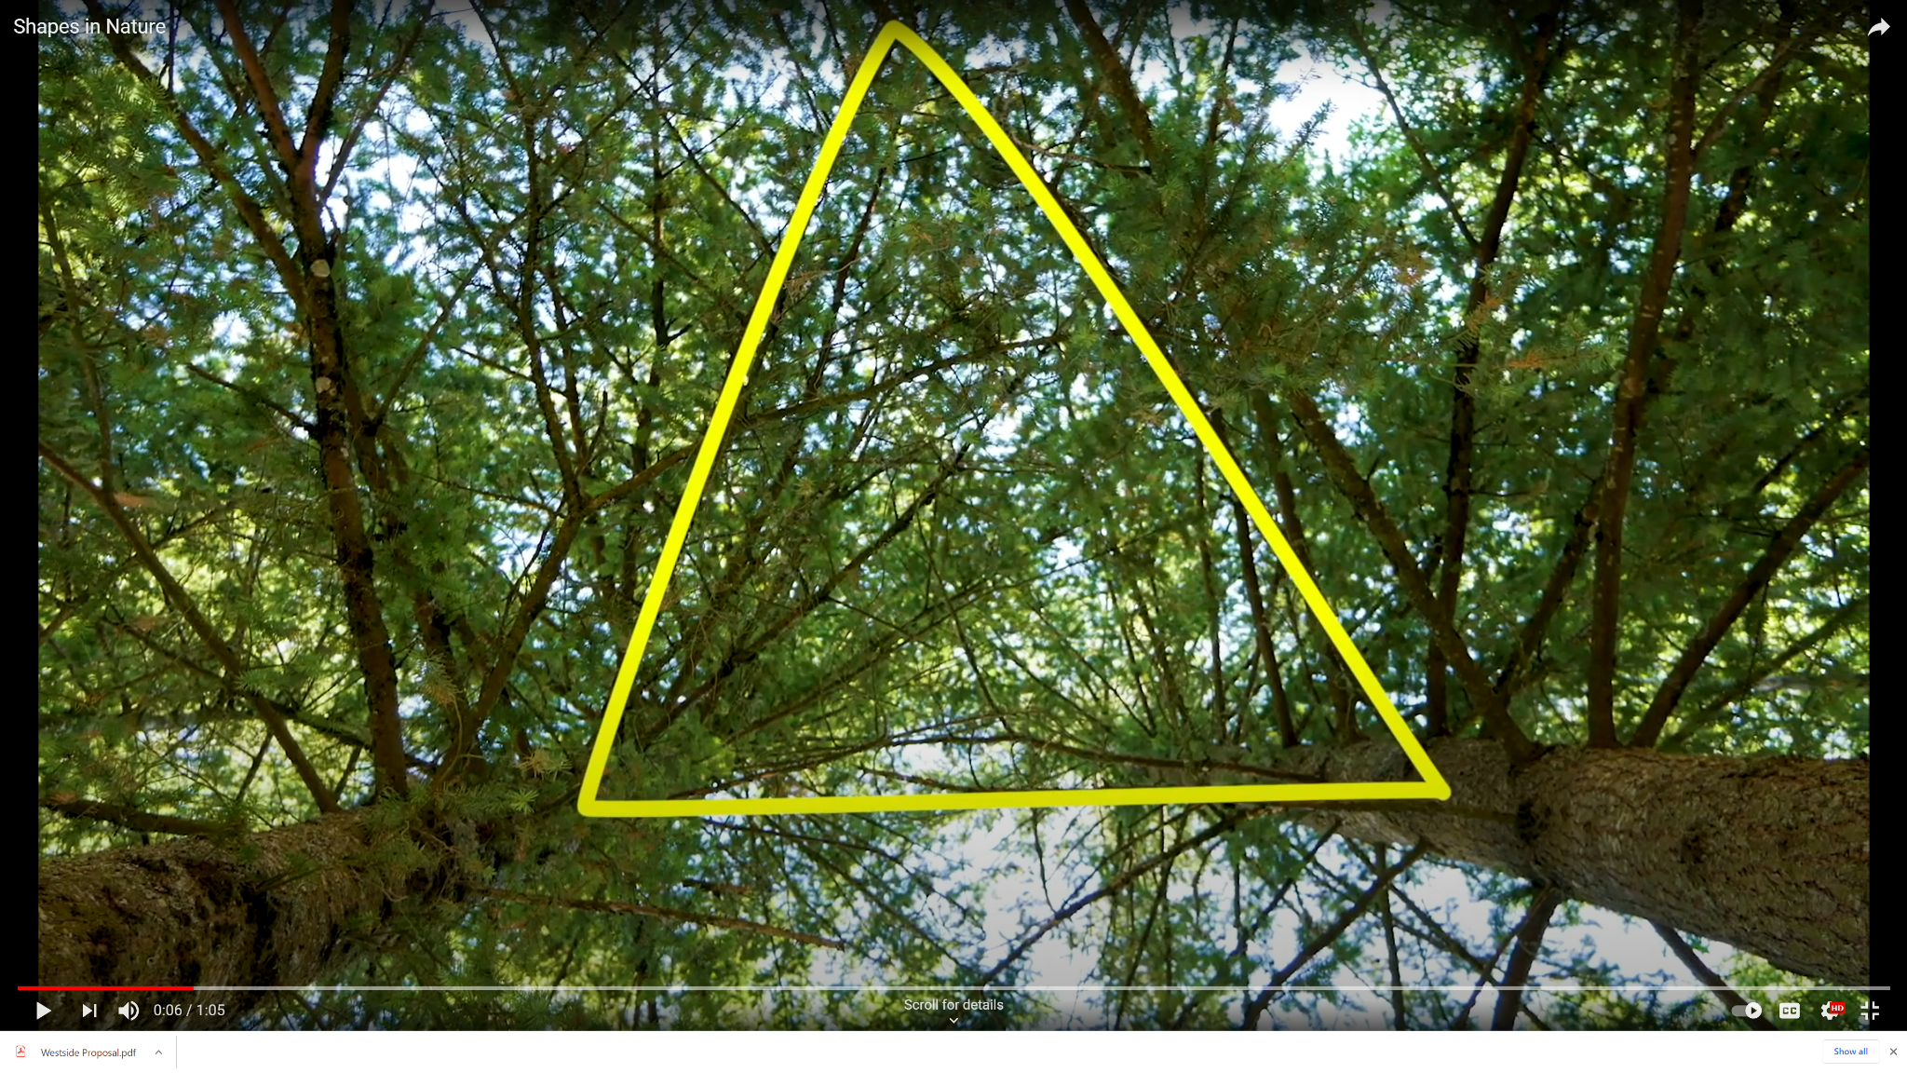

Slide 40
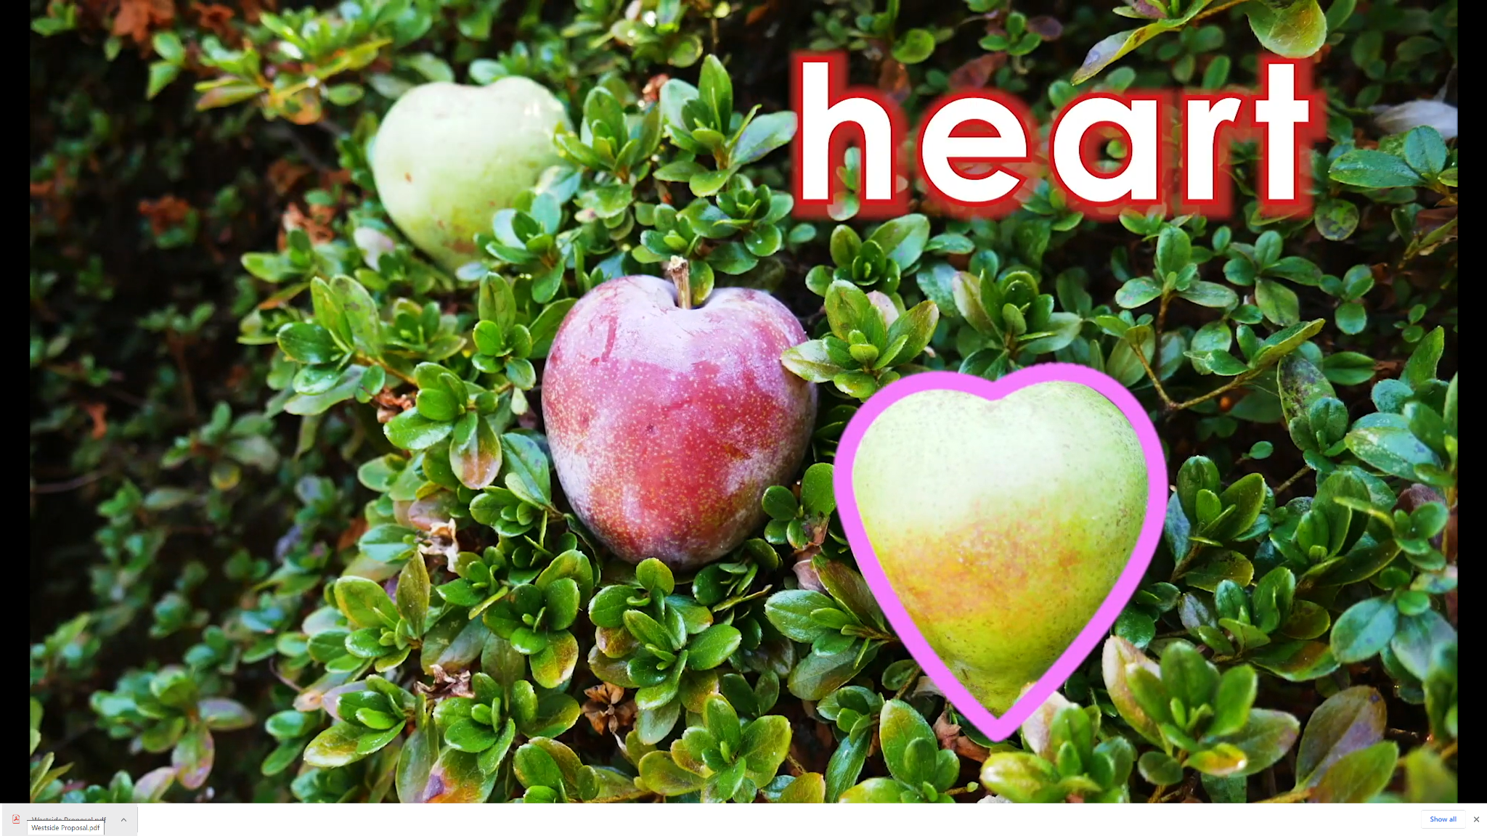

Slide 42
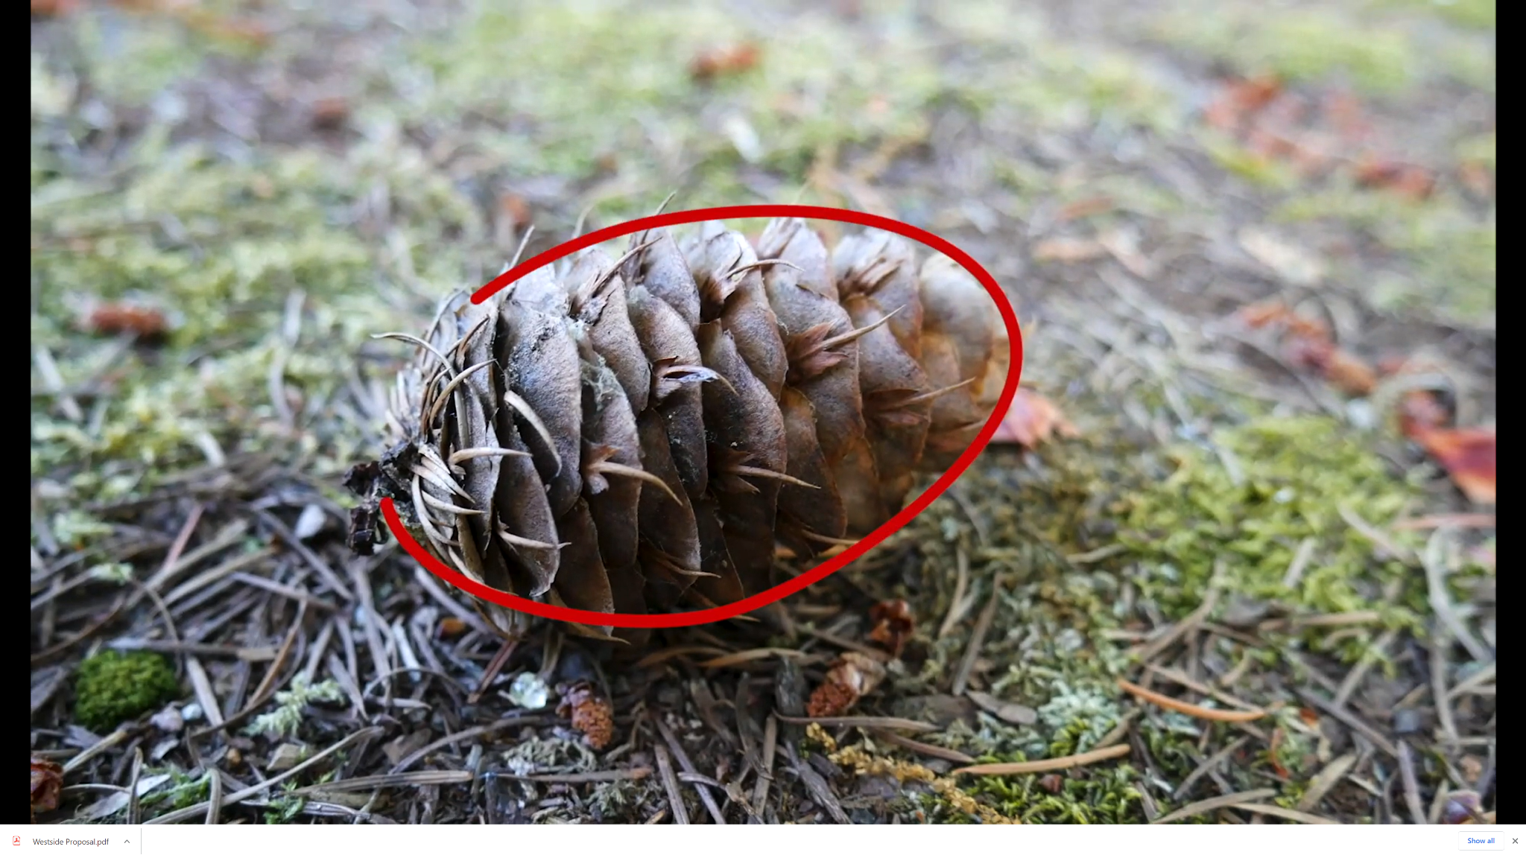

Slide 45
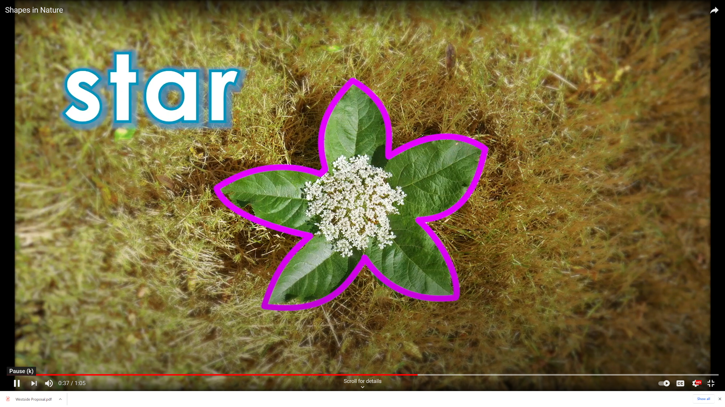

Slide 51
Nature Scavenger Hunt
Bottle Bowling
Sun and Shadows
Sink or Float
What’s the Weather?
Plants and Pollinators
Where did the Water Go?
Reduce, Reuse, Recycle
Shapes in Nature
Paper Challenges
All available in English and Spanish

Slide 52
Possible Uses:
Mixed grade level experiences
Family science night
Summer school
After school
At home

Slide 53
How are families involved in science learning?
Family science night
Take-home experiments
Asynchronous learning

Slide 54
How often are families involved in science learning?
1 2 3 4 5 6 7 8

Slide 55
Components of a Strong Science Program
At Home Science is meant to be a supplemental part of a science program. This is designed to pull in family members and/or be a part of an expanded learning community.
At Home Science can be a part of a the engagement piece of your science program.

Slide 56
Talk to the Creator
Lesley Gates
Science Content Specialist
lgates@fcoe.org

Slide 57
@mrdueck Jonathan Dueck jdueck@fcoe.org

