Slide 1
WELCOME
DO YOU REALLY REMEMBER HOW TO COUNT?
EARLY MATH SYMPOSIUM
JUNE 2021
Scott Nielsen
Brook Williams

Slide 2
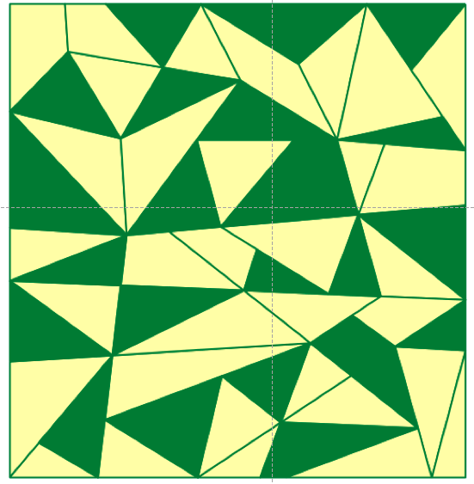
You need some items to count
Find the star

Slide 6
THIS SESSION:
EXPERIENCES
REFLECTION
TAKEAWAYS

Slide 7
WELCOME TO LETTER WORLD
LET’S COUNT

Slide 9
COUNTING ITEMS
Remember:
No going back to “Number World”

Slide 10
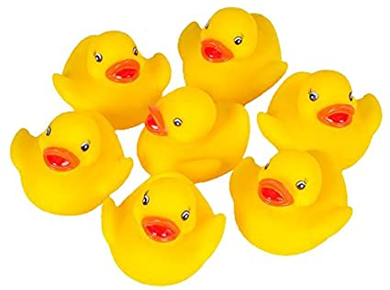
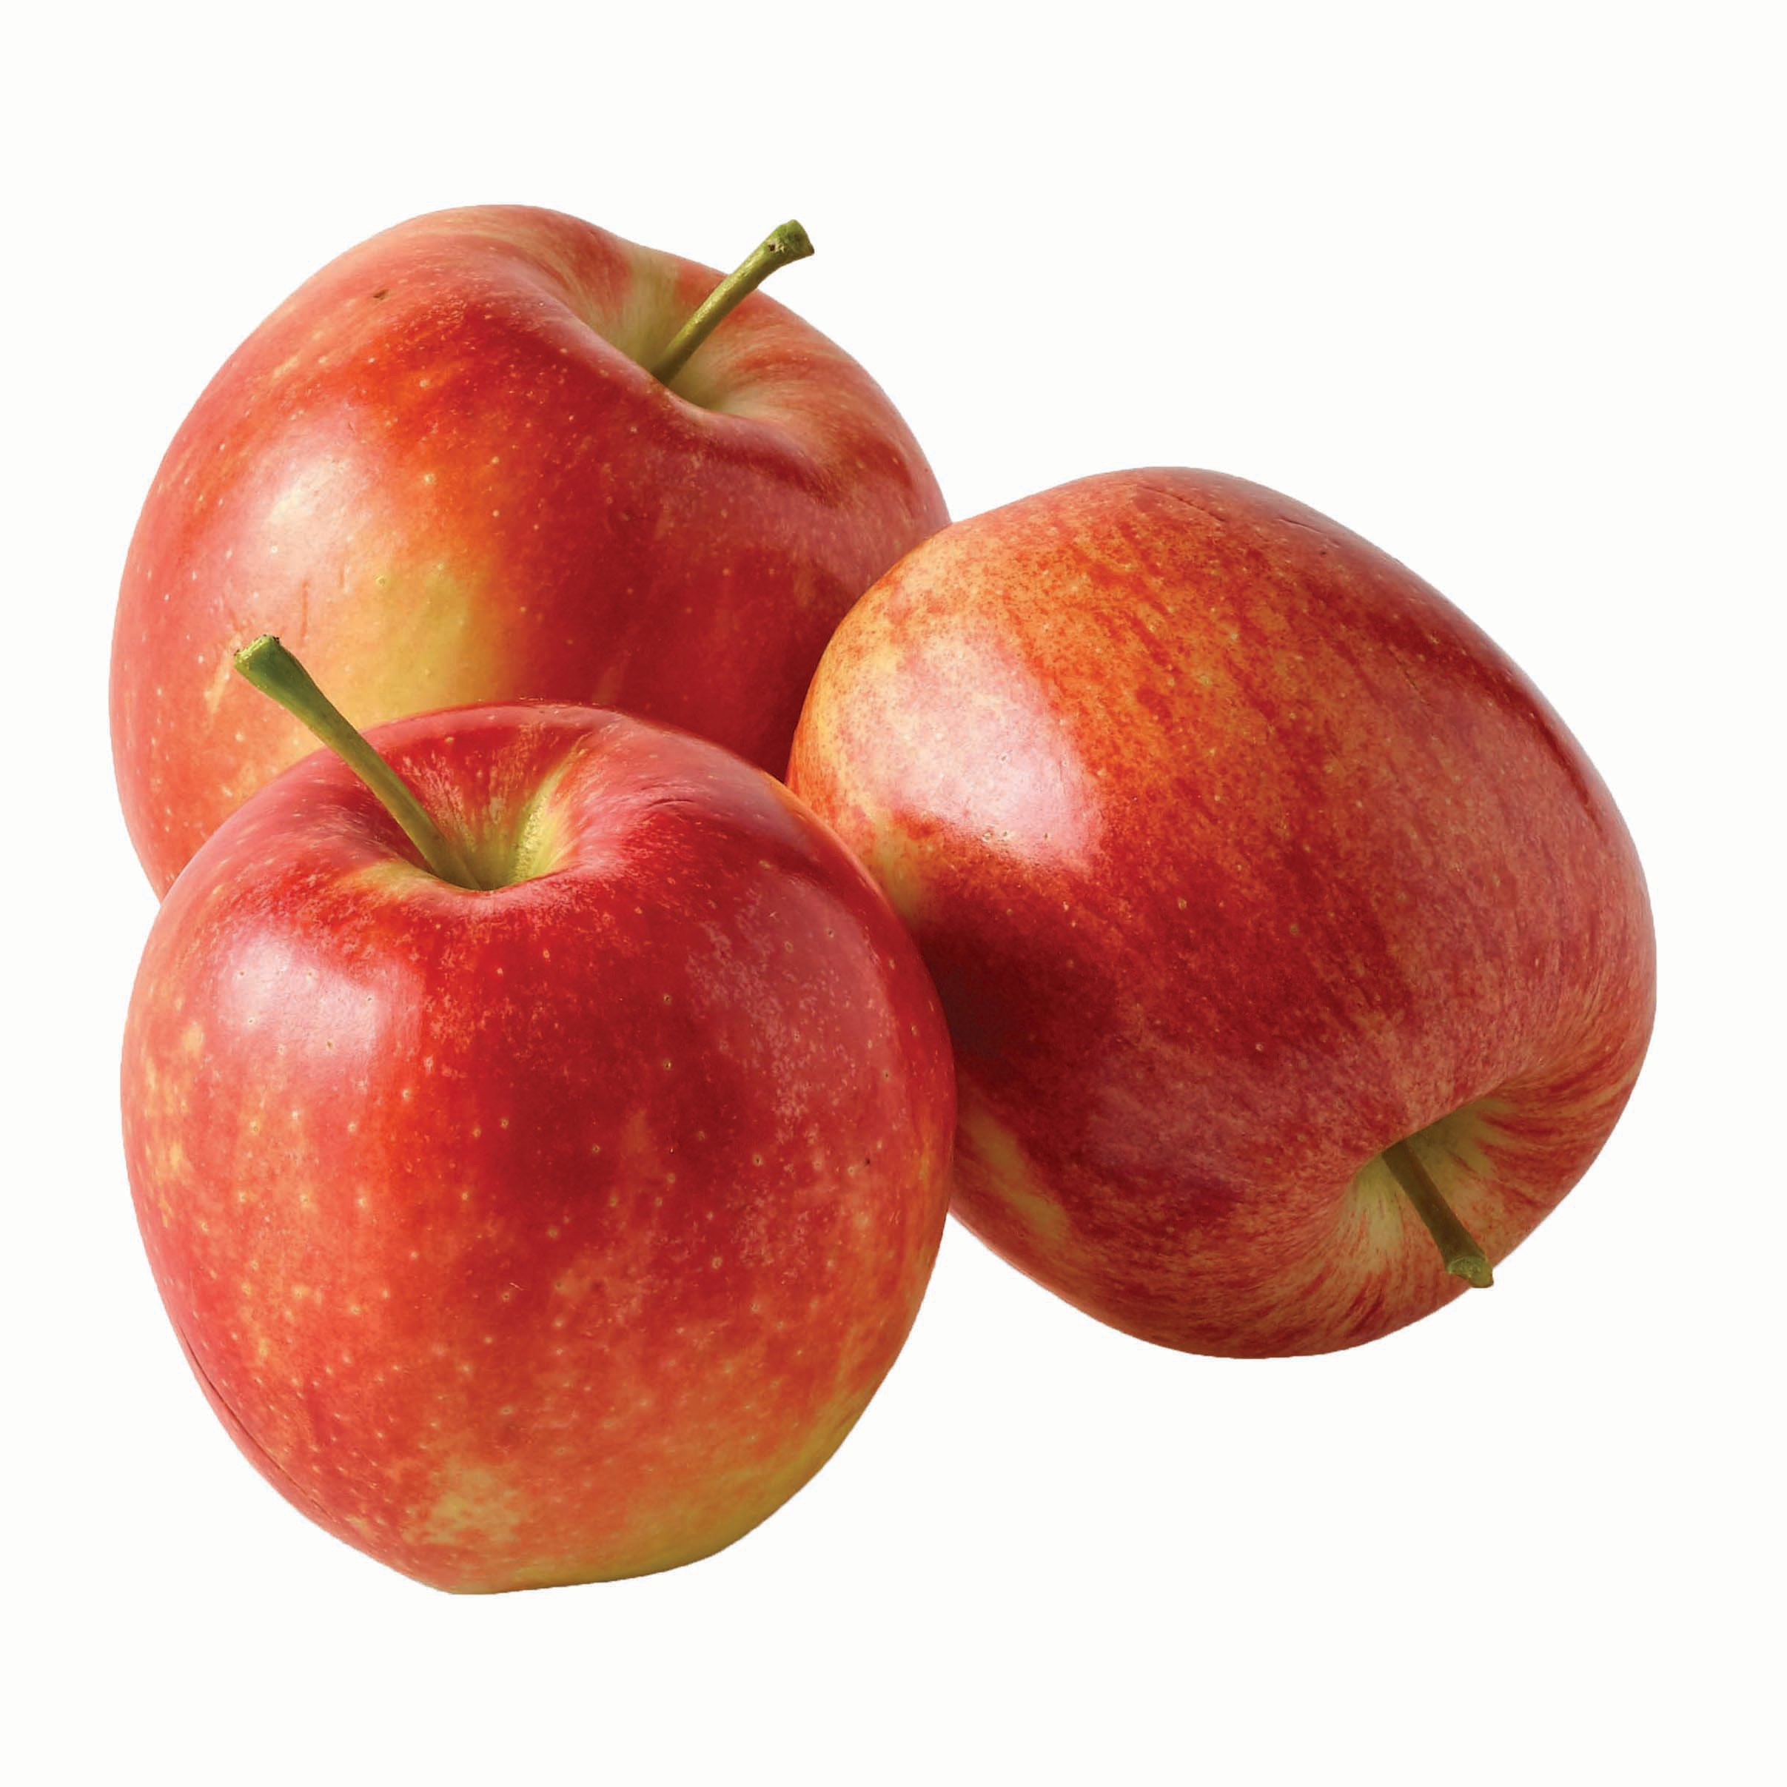
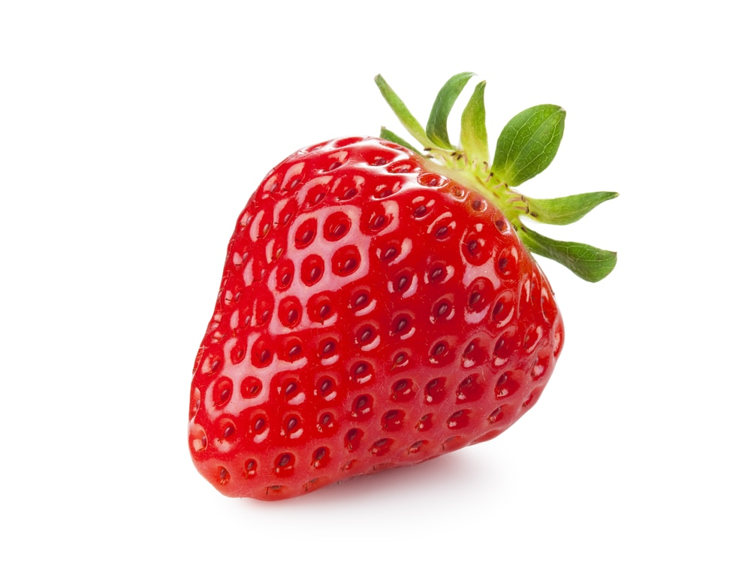
Collections

Slide 11
Dot Patterns

Slide 12
Finger Patterns

Slide 13
Reflection:
How did you get your answer to these questions?
What strategies were like something you have seen students do?

Slide 14
Addition
Remember:
No going back to “Number World”

Slide 15
Addition
G + B
D + C
C + A

Slide 16
Reflection:
How did you solve it?
Why did you solve it that way?

Slide 17
Addition
N + K
I + D

Slide 18
Reflection:
How did you solve it?
Why did you solve it that way?
What strategies were like something you have seen students do?

Slide 19
Subtraction
Q - H

Slide 20
Reflection:
How did this feel for you?
What might be some implications for how students feel when learning to count?

Slide 21
Reflection:
How might this affect the ways you engage with students as they learn to…
…count?
…add?
…subtract?

Slide 23
Thank You
www.aimscenter.org
Scott@aimscenter.org
Brook@aimscenter.org

