Slide 1
PUT SOME ZING IN YOUR ZOOM:
MAKING THE MOST OF ONLINE PD
Brook Williams, PK-12 Coordinator
Bev Ford, PK-12 Coordinator
Paul Reimer, Executive Director

Slide 2
STEM EDUCATION
SCIENCE. TECHNOLOGY. ENGINEERING. MATHEMATICS.
Equity: Who participates? What counts as STEM?
Early childhood context
Professional learning
Early Childhood STEM Working Group. (2017). Early STEM Matters Providing High-Quality STEM Experiences for All Young Learners.
McClure, E. R., Guernsey, L., Clements, D. H., Bales, S. N., Nichols, J., Kendall-Taylor, N., … Ashbrook, P. (2017). STEM starts early: Grounding science, technology, engineering, and math education in early childhood. New York: The Joan Ganz Cooney Center at Sesame Workshop.

Slide 4
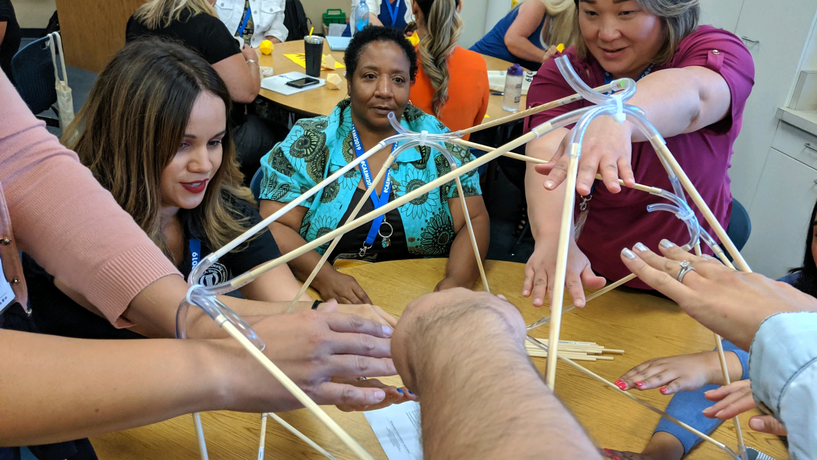

Slide 5
CURRENT CHALLENGES
DESIGN
Blended in-person and remote learning
RESOURCES
We can’t make assumptions about availability
INDIVIDUALS
Meeting individual learners’ needs

Slide 6
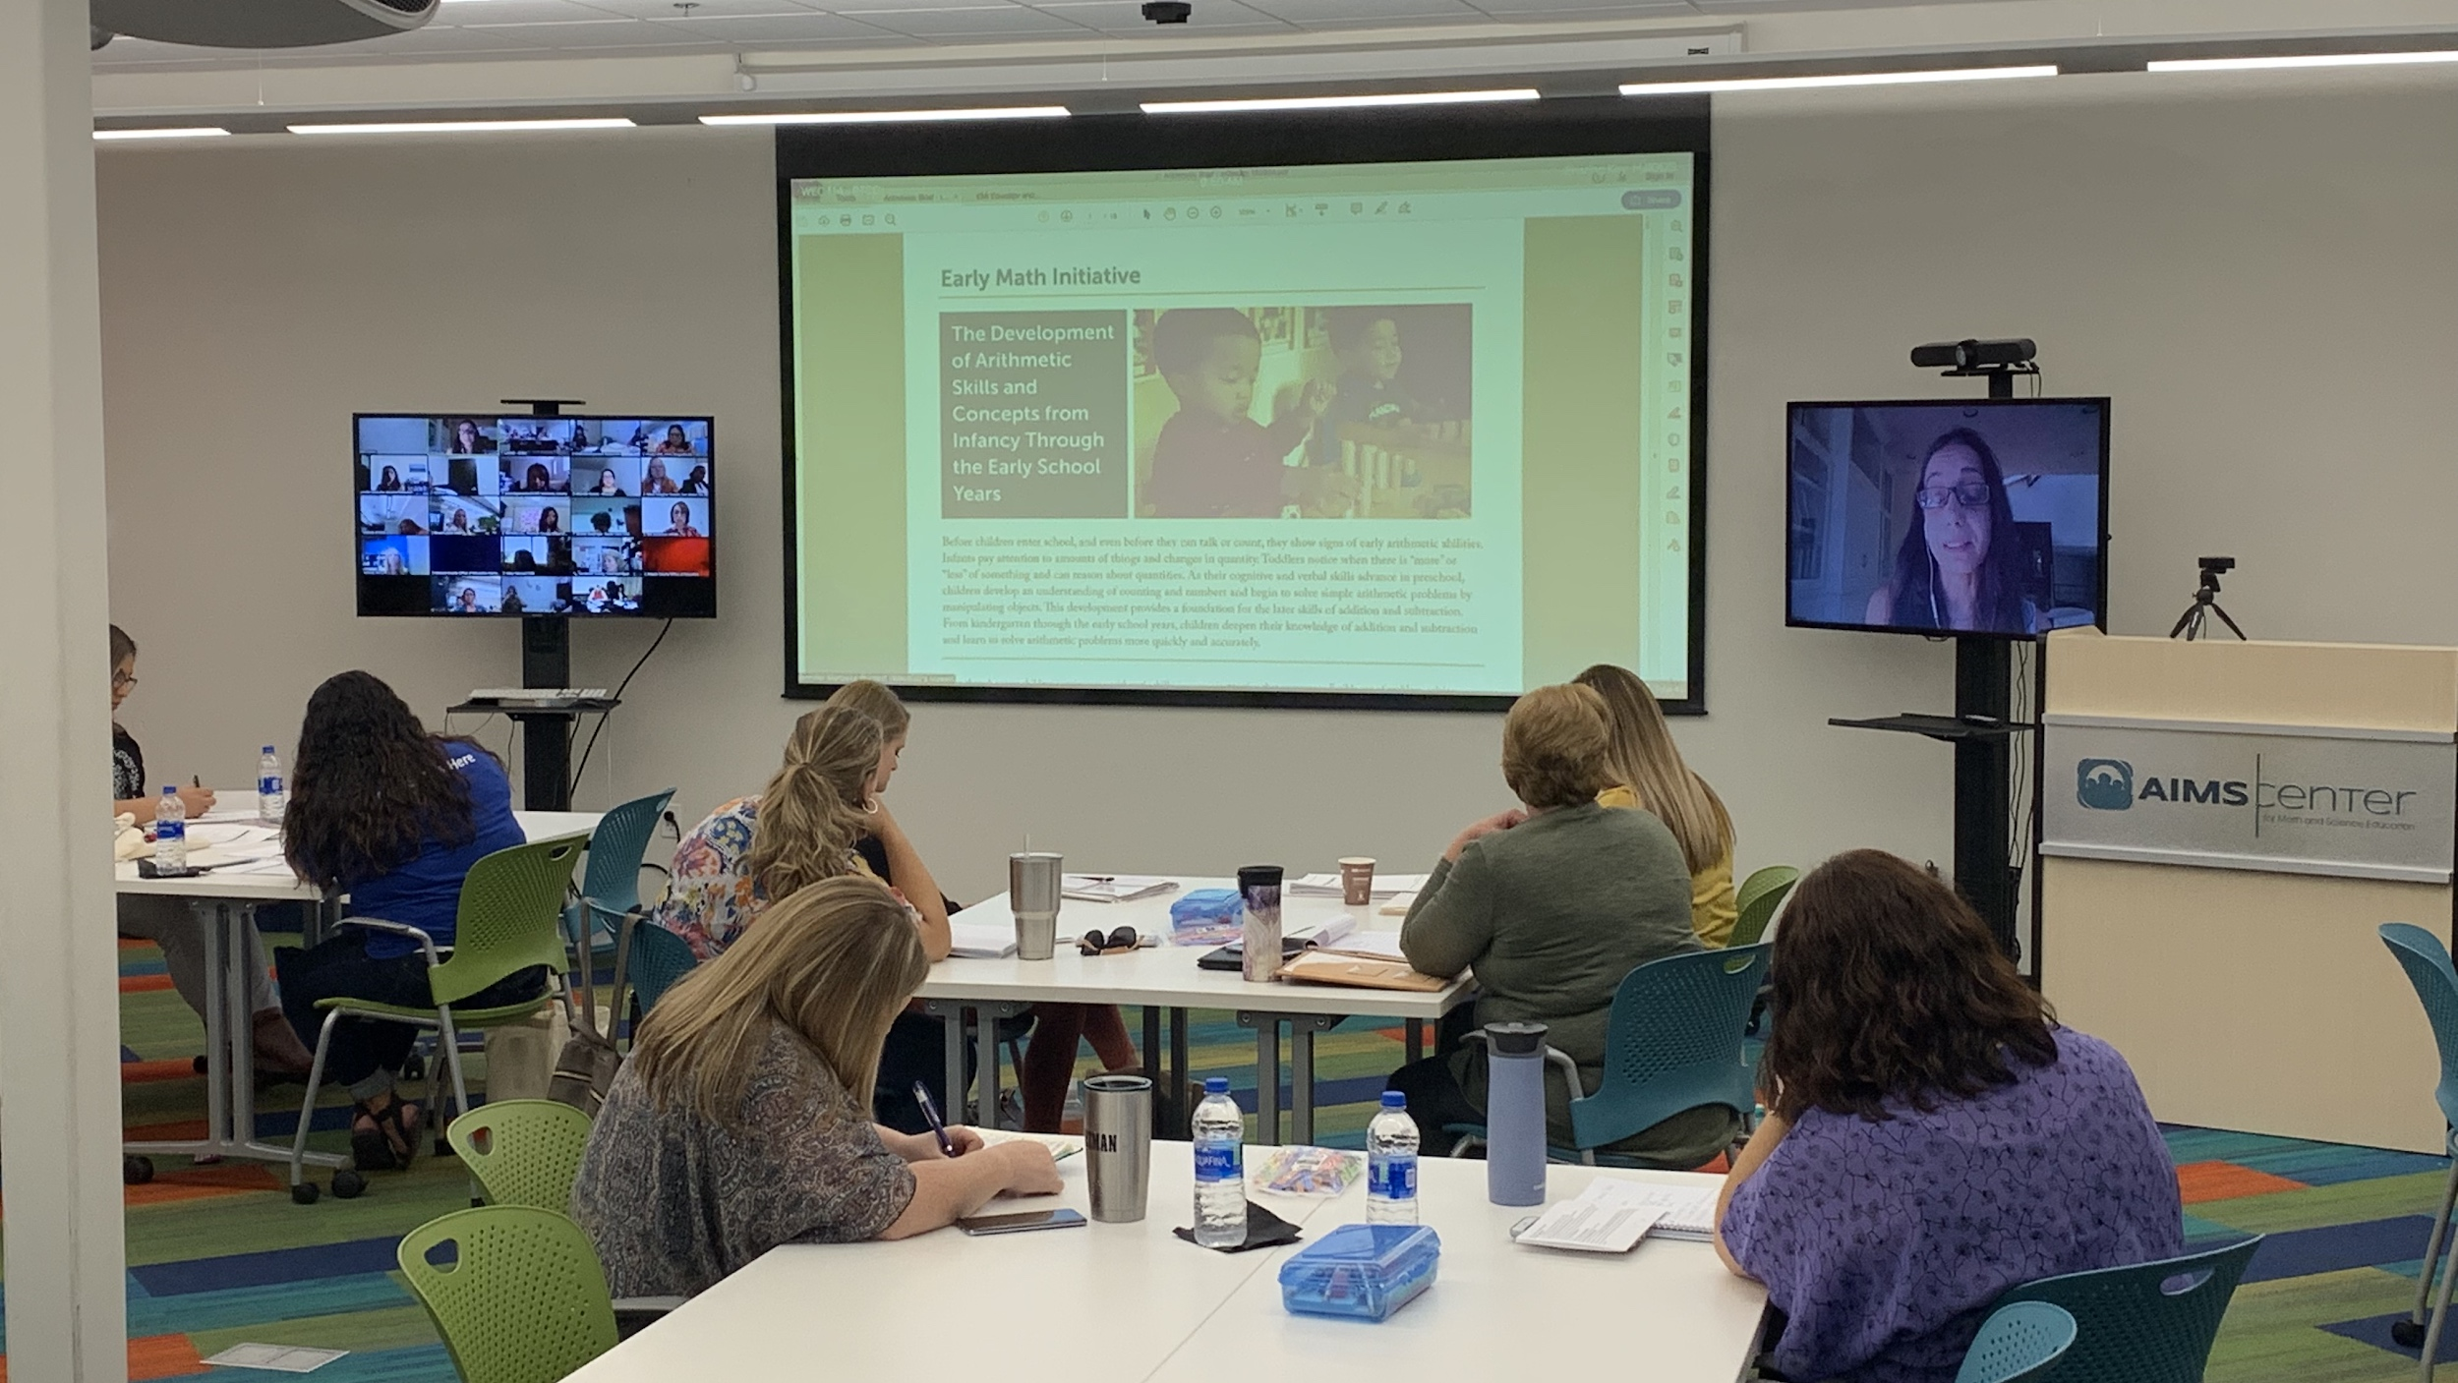

Slide 7
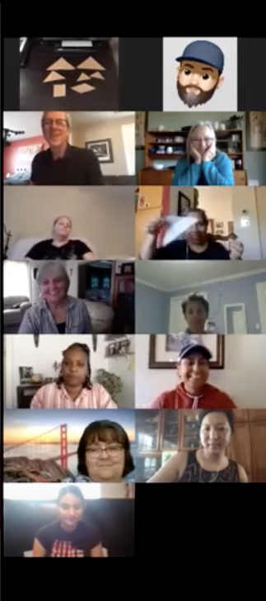

Slide 8
LEARNING-CENTERED VIRTUAL PD
1
2
3
4
ENVIRONMENT
Create a safe, collaborative and inclusive environment for online presence
OPTIONS
Provide options for engagement
ACTIVITY
Stay active by virtualizing in-person activities
TOOLS
Use tools for collaboration

Slide 9
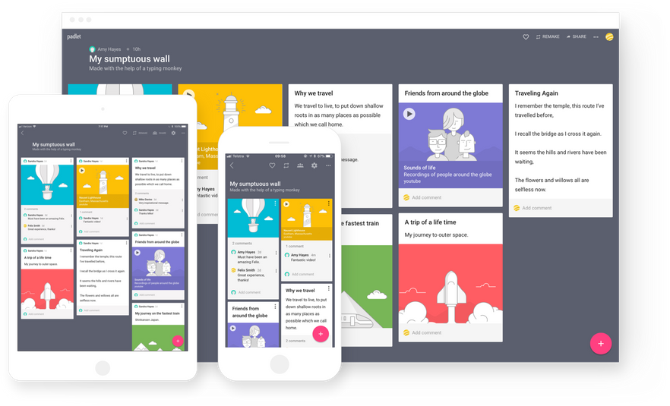
COLLABORATIVE PADLET
https://bit.ly/AIMSpadlet

Slide 10
SHAPE HUNT
Create a safe, collaborative and inclusive environment for online presence
1
2
Provide options for engagement

Slide 11
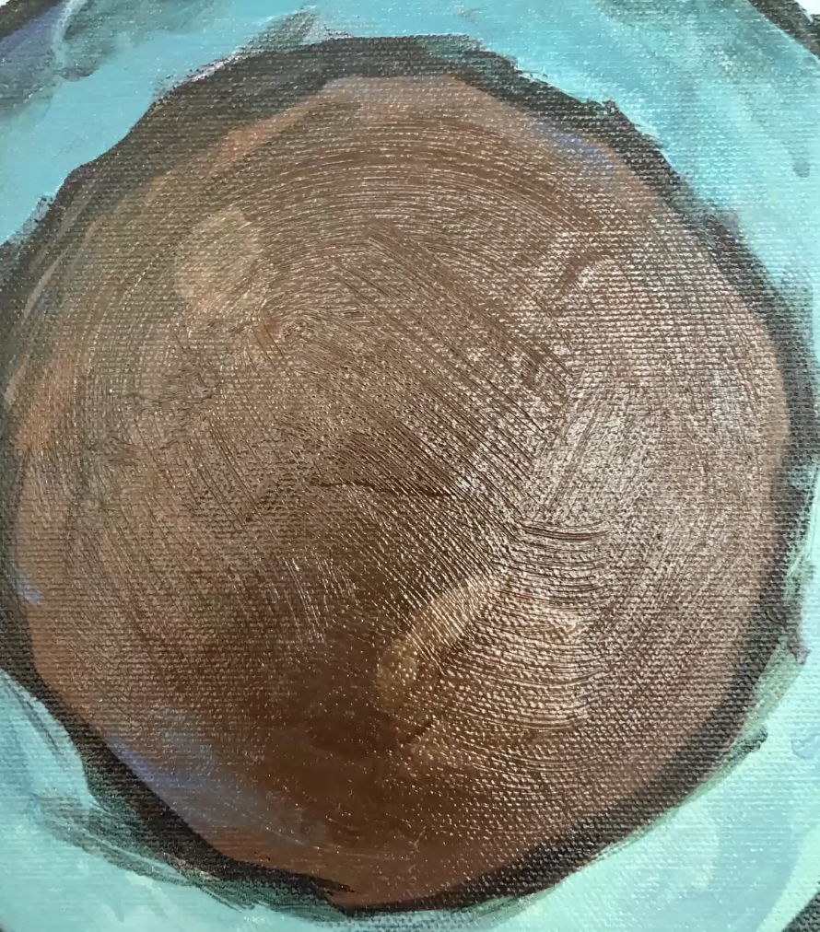
REIMAGINING A SHAPE HUNT
Reprocessing an existing activity
Learning new technological tools

Slide 12
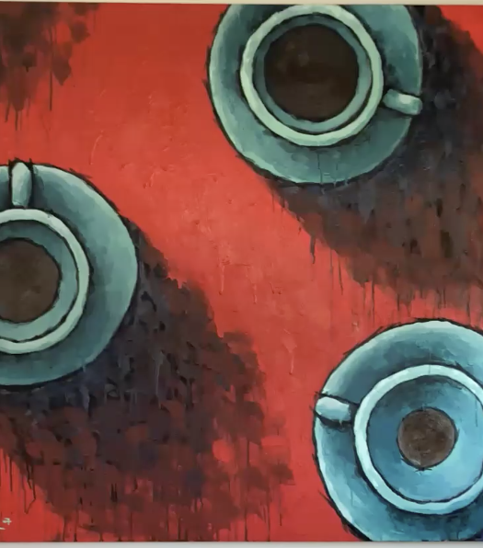
SHAPES AND SPATIAL AWARENESS

Slide 13
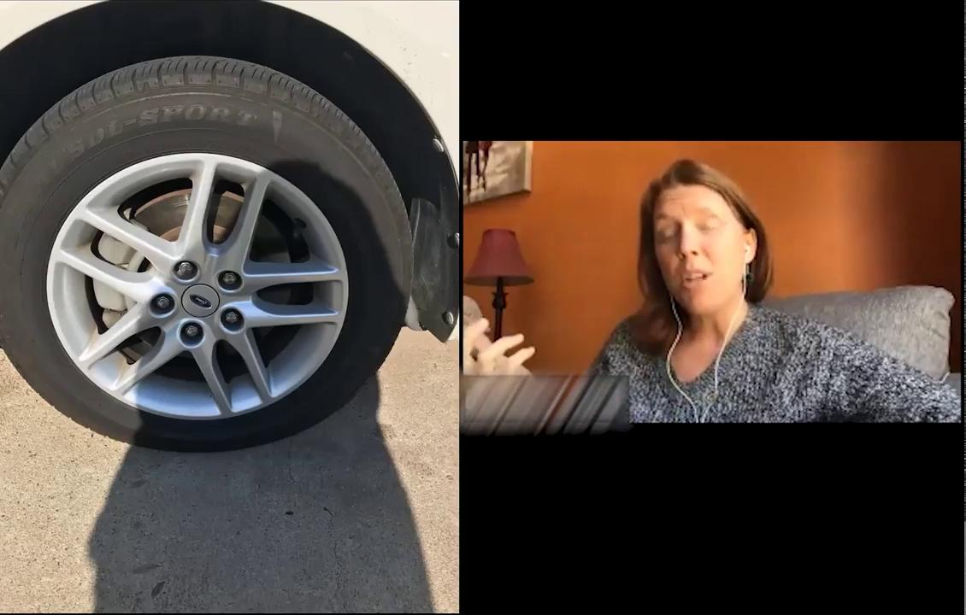

Slide 14
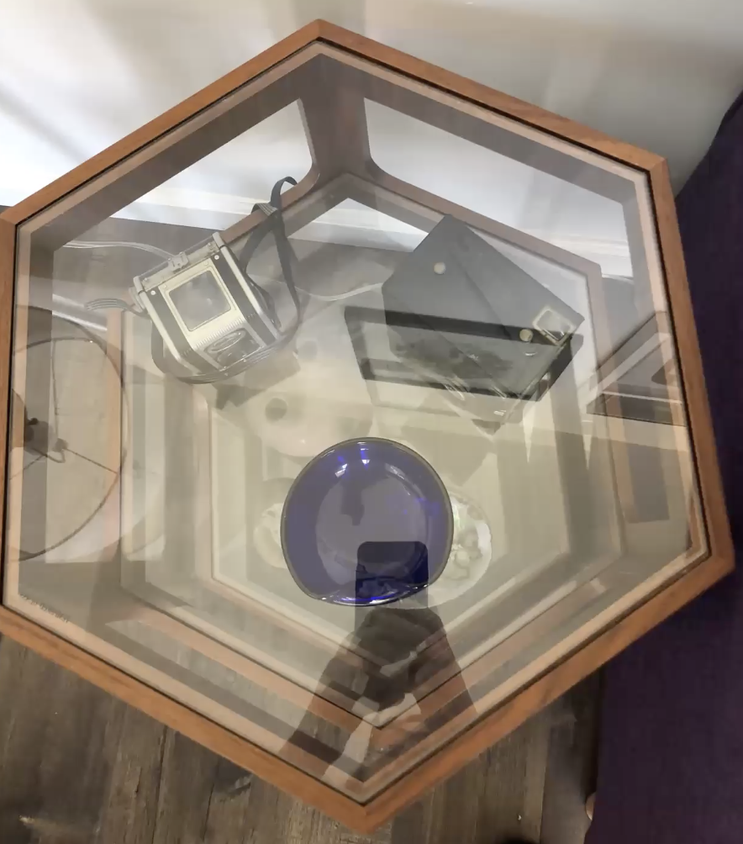
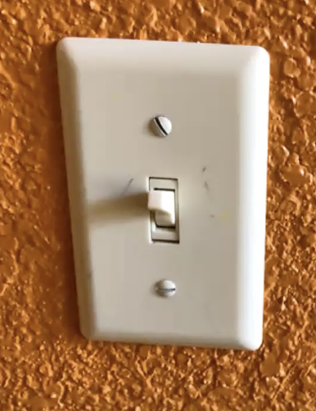
3D
2D

Slide 15
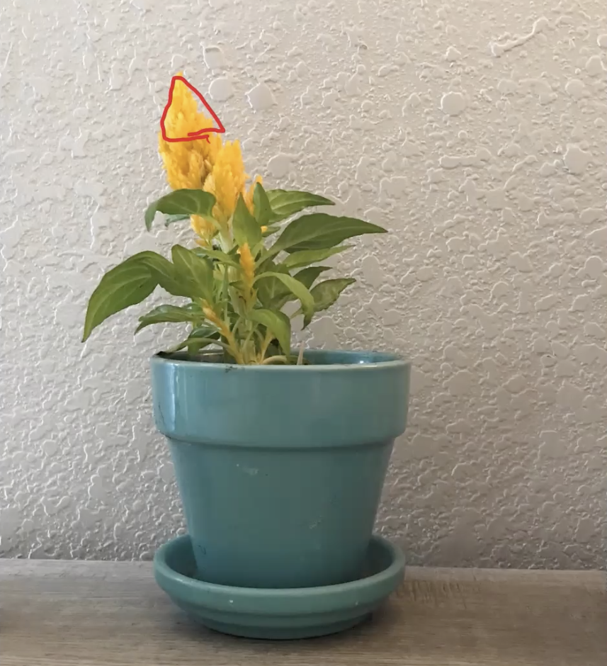
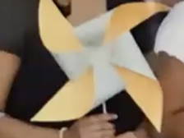
TEACHABLE MOMENTS
SEEING EXPERIENCES AND SKILLS
WITH A NEW LENS

Slide 16
SHAPE HUNT
Create a safe, collaborative and inclusive environment for online presence
1
2
Provide options for engagement

Slide 17
TANGRAMS
3
Stay ACTIVE - Virtualize in-person activity
4
Use tools for collaboration

Slide 18
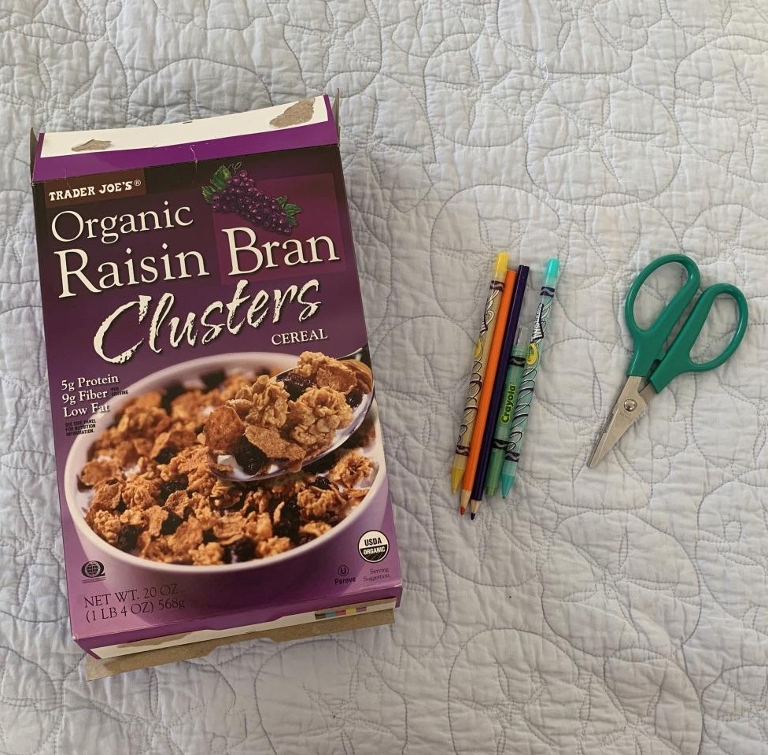
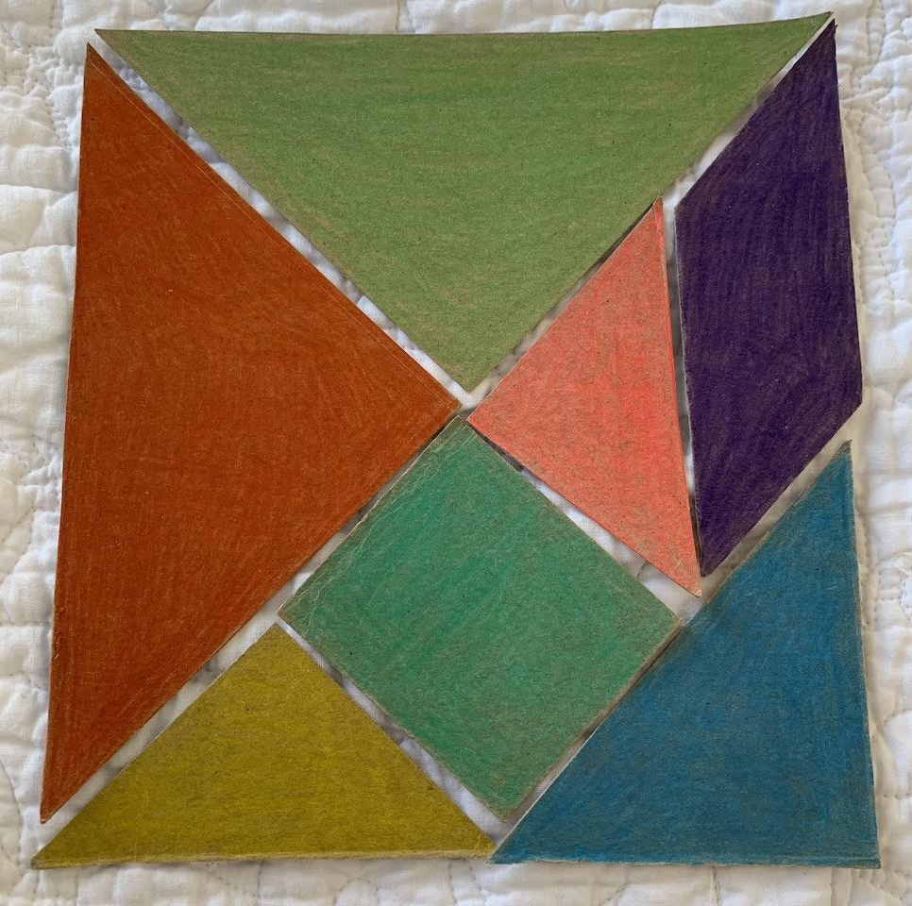

Slide 20
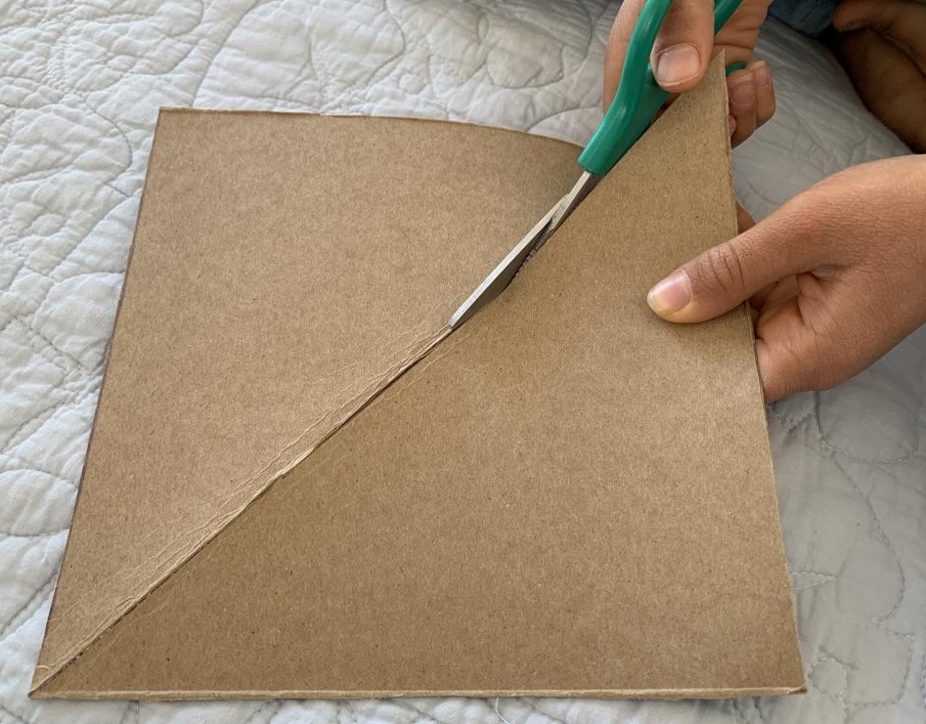
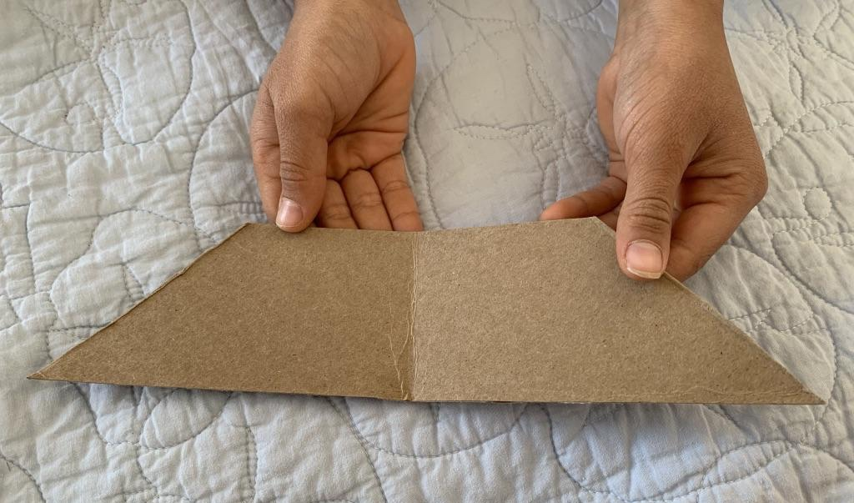
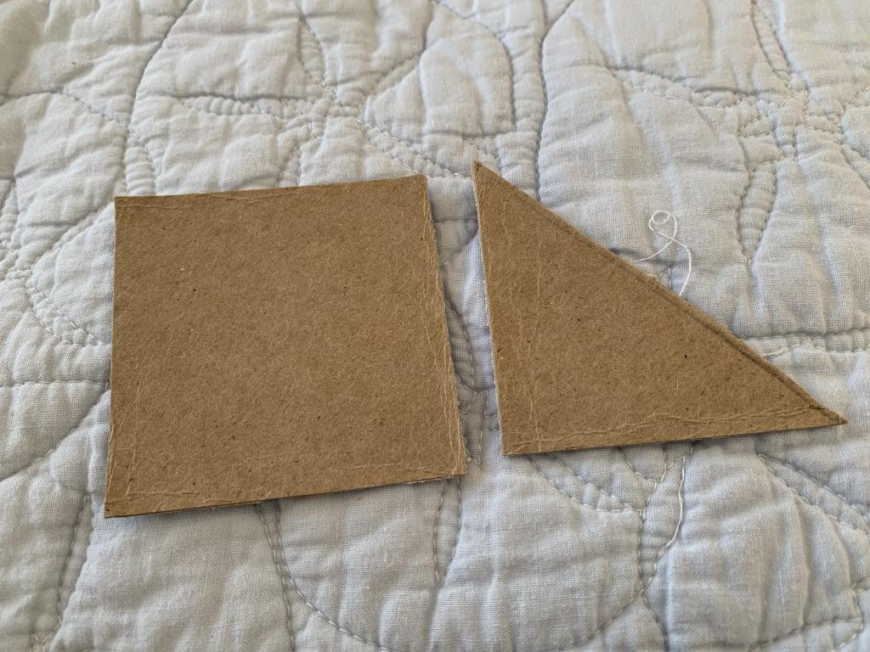

Slide 22
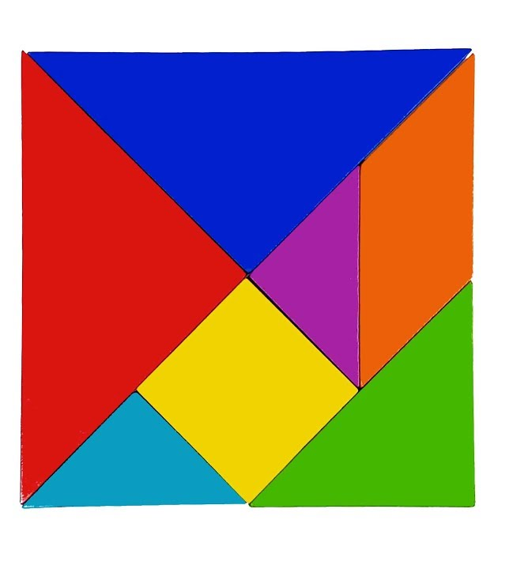

Slide 23
CAN YOU MAKE A BOAT?

Slide 25
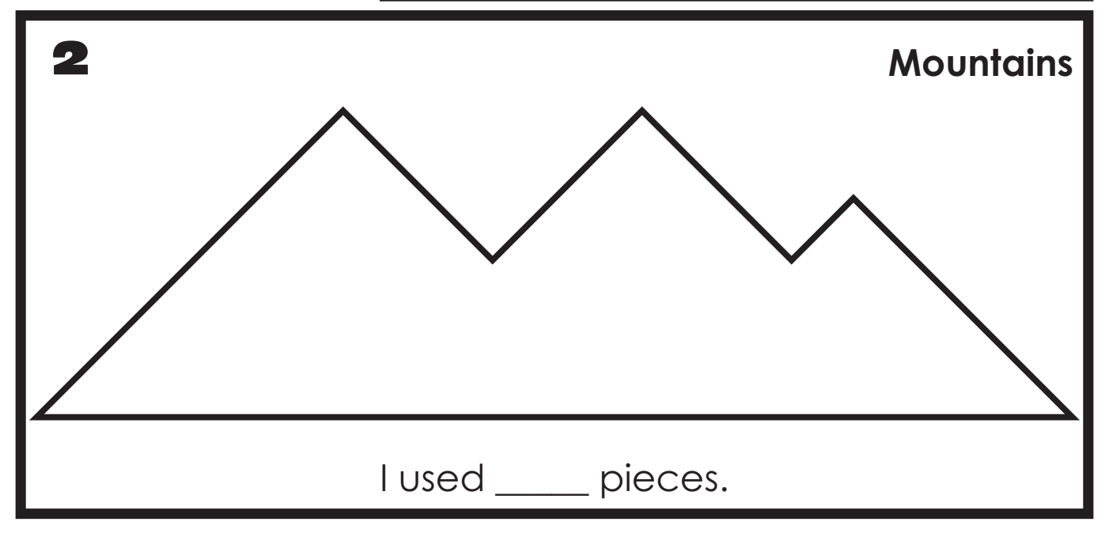
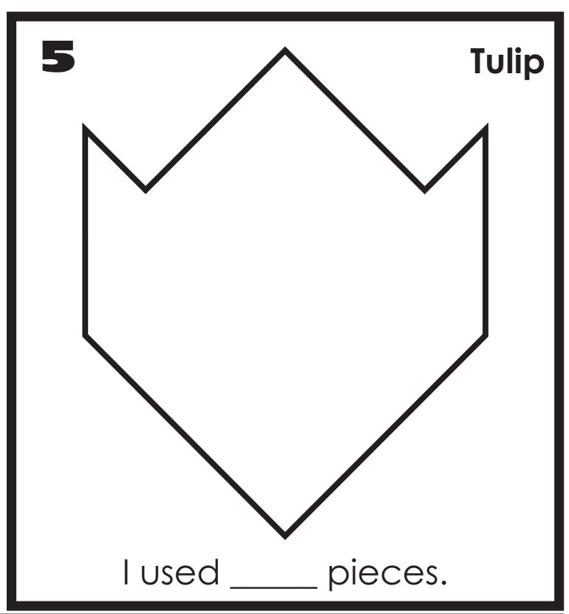

Slide 26
TANGRAMS
3
Stay ACTIVE - Virtualize in-person activity
4
Use tools for collaboration

Slide 27
LEARNING-CENTERED VIRTUAL PD
1
2
3
4
ENVIRONMENT
Create a safe, collaborative and inclusive environment for online presence
OPTIONS
Provide options for engagement
ACTIVITY
Stay active by virtualizing in-person activities
TOOLS
Use tools for collaboration

Slide 28
THANK YOU!
BROOK WILLIAMS BEV FORD PAUL REIMER
PK-12 Coordinator PK-12 Coordinator Executive Director
brook@AIMScenter.org bev@AIMScenter.org paul@AIMScenter.org
RESOURCES
AIMSCENTER.ORG

