Slide 1
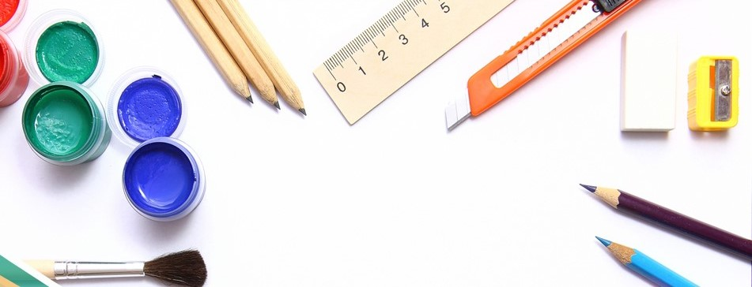
Math in art
Notes:
Thank you for joining the 2020 Early Math Symposium. My name is Dana McVey, I am a Child Development Consultant with First 5 California, and very pleased to be part of the Early Math Project team.
This breakout session will focus on math concepts (obviously) in early education, but also ways to connect those concepts to the tools and materials used in preschool art curriculum.

Slide 2
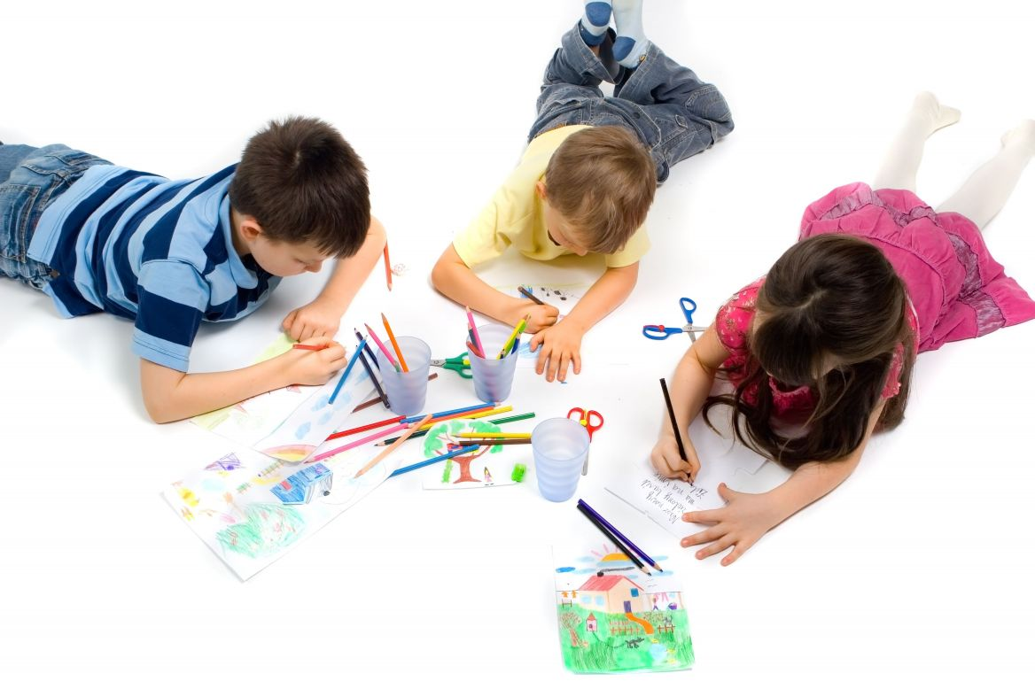
Key Math Concepts
Shapes
Patterns
Spatial Relationships
Classification
Measurement
Cause and Effect
Notes:
In education, the phrase “learning outcome” is used a lot. This is frequently presented as a question, without support or providing information, for example: what is the intended learning outcome of this activity?
In the world of Early Education, birth to five, we know children learn by doing, and for young children, “doing” is often through play.
The two notions of desired academic achievement and creative expression can seem contradictory. When you add in developmental milestones and school readiness assessment requirements, they can seem further apart.
When considering curriculum, and activities that support the whole child, finding exciting ways that areas of focus can complement each other, instead of competing can have amazing results.
Art and Math, at first, seem to be very different things, but there are many ways they overlap. We will discuss six of the key math concepts typically taught through pre-school math activities that are present in everyday art activities.
(CLICK)
Shapes
Patterns
Spatial Relationships
Classification
Measurement
Cause and Effect

Slide 3
Skill Development Through Art
Communication and expression
Fine Motor
Critical thinking
Notes:
Art activities include any experience a child can have using materials and tools. These experiences encourage the development of a wide variety of skills directly connected to the key math concepts I just mentioned. Making art encourages:
Communication and Expression – through art, children learn they can express thoughts and ideas through visual representation. While this skill easily applies to making and understanding graphs and grids. Beyond that, When choosing media, using materials and manipulating tools in their own way, to produce something different than what they started with, children realize there is more than one way to represent their ideas.
Fine Motor Skills – as they sculpt, draw and paint children use tools and a variety of media. This allows practice and increased control in using fine motor skills, building muscles and developing the hand-eye coordination essential for self-help skills and academic tasks such as writing
Critical thinking skills –
When children make art they learn to use critical thinking skills and practice problem solving in two distinct ways.
Convergent problem solving is the ability to gather individual pieces of information and come to a single solution to a problem.
Where as Divergent problem solving is the ability to gather many pieces of information and consider a variety of possible solutions to a problem.
Creating art freely or for a specific purpose (making masks for example), fosters flexible thinking, provides practice associating observation with a desired result. Making connections that employ both types of problem-solving.
The creative process is by nature an exercise in cause and effect. Through art, young children can explore mathematical concepts in a different way.

Slide 4
Media and Supplies
Drawing
Paint
Three dimensional
Collage
Tools
Notes:
When thinking about incorporating math concepts into art activities, the first question that comes to mind is usually “What special supplies will I need?” The good news is – none.
It can help planning and facilitation to think of materials by category first. Some categories are more conducive to particular concepts than others. A suggested list will include:
Drawing – things to scribble and draw with: crayons, markers of all types (felt tip, watercolor), pens, pencils, colored pencils, chalk, stick pastels. And don’t forget material to draw on: various sizes and types of paper, chalk boards
Paint – Different paint has different characteristics (viscosity, pigment saturation) and they each react differently when manipulated / mixed. A variety of paint types, like Finger, tempra, watercolor, paint palette sets, non-toxic oils, will mean more possibilities.
Three dimensional – materials such as playdough, clay, wood, wire, pipe cleaners, modeling compound allow children to build and create up and out. For example, materials in this category are especially helpful supporting key concepts in spatial relationships and measurement.
Collage – materials can include 3-D materials, but also 2 dimensional items and textiles such as felt and fabric, cardboard, yarn/string, glitter, sequins, stickers, feathers and other natural objects (leaves, shells). This category also includes safe free and found: cardboard tubes, egg cartons
When considering art materials, Tools are very important – Using tools of different complexity, adds to fine motor development and critical thinking. Tape, glue, scissors, hole punches, stencils, rulers, playdough tools, brushes and rollers, stamps.
Let's get back to those key Math Concepts

Slide 5
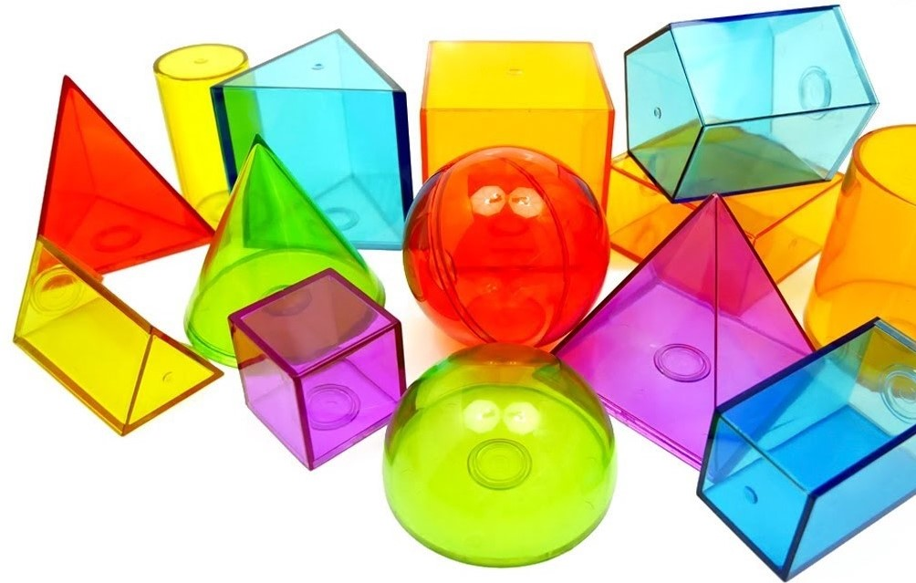
Shapes
Explores and manipulates the shape of objects
Begins to distinguish similar shapes
Identifying and naming basic shapes in their environment
Recognizes shapes as parts of other objects
Describes many types of shapes
and the differences between them
Notes:
Most basic is Shapes
When you think about math terms Geometry is the study of shapes. When children show interest in exploring shapes and their characteristics, they are practicing early geometry!
At this age, children work at:
Exploring and manipulating the shape of objects by feeling the edges, placing and stacking together and following lines.
They will begin to distinguish similar shapes by grouping and matching objects, choosing items that are round (like a ball) to roll
Start to identify and name basic shapes in their environment. They will use appropriate language to recognize different shapes and talk about their attributes. Such as, finding the square on the rug, and saying the clock is a circle.
Preschoolers will recognize familiar shapes as parts of other objects. Like identifying square windows, triangle roof and rectangle door in a basic drawing of a house
Older children can describe many types of shapes and the differences between them. Knowing a circle is curved, triangles have two short sides, one long and that a square has four sides that are all the same
They can start to look at and compare two-dimensional (flat) and three-dimensional (solid) shapes.
Identifying basic shape names, comparing, sorting, and classifying them quickly leads to creating them.

Slide 6
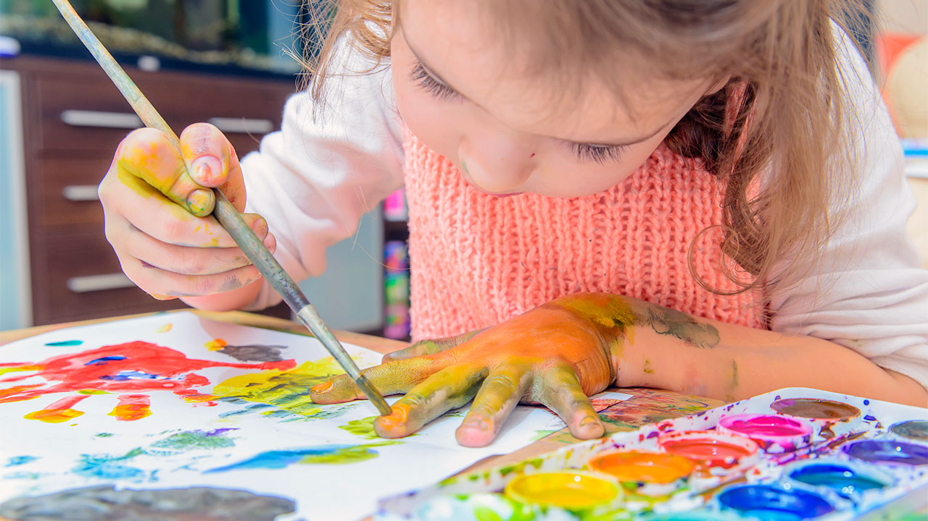
Process
Approach like open-ended play
Enough materials
Time
Free participation
Verbal engagement
Freedom to change
Add new materials
Ownership of the creations
Notes:
Before the first example, I’d like to talk a little about the differences between process- and product-focused art.
The goal of pre-school art curriculum is often to encourage children’s creativity through developmentally appropriate art experiences.
But, as we discussed, exposure to art materials also carry potential for cognitive enrichment when children compare, predict, plan, and problem solve as they create. As well as supporting physical development using small motor skills to paint, write, glue, use clay, and make collages.
Embedding math concepts into the process is simply a matter of facilitation and engagement. It does not require a full departure into product-focused art experiences. As we move forward When viewing the examples for each concept, consider how you can introduce the materials, and share the concepts as you maintain the characteristics of process-focused art experiences.
Tips for keeping it process-focused
Approach like any open-ended play. Even when you’ve chosen materials to support a key math concept, the child should still lead the experience
Make quantities of materials open to the children. Let them use whatever is provided in whatever amount they need to create (obviously, in appropriate ways, not wasteful or destructive).
Provide plenty of time for children to carry out their plans and explorations
Let children come and go from their art at will
Notice and comment on what you see, using the vocabulary that supports the key concept, with out correcting or altering their work. Use math language throughout the activity. Take the opportunity to introduce new words with activities such as “This is a pattern! Red, white, red, white.” Other examples of math language we use in preschool are heavy, light, tall, short, round, rectangular, add to, take away, etc.
Say YES to children’s ideas. The goal here is exposure, not mastery. So if the conversation and ideas stray from your original introduction – go with it!
Offer new and interesting materials as they work or by request. Again, follow their lead.
Let the children choose whether their art goes home or stays in the classroom. Remember that it’s the children’s art, not yours
NOW, lets get back to exploring shapes through art!

Slide 7
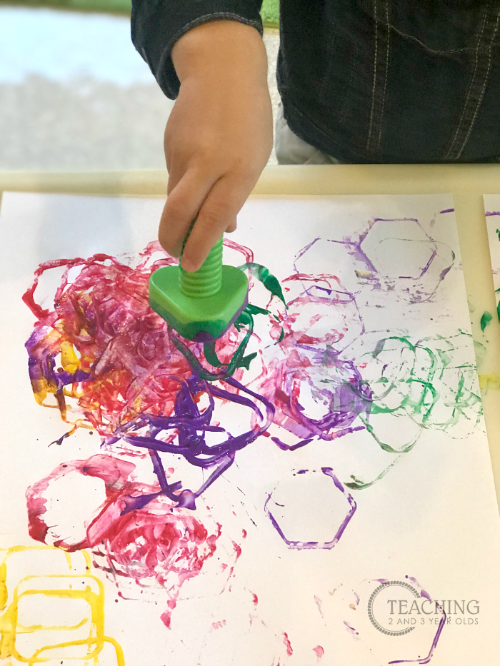
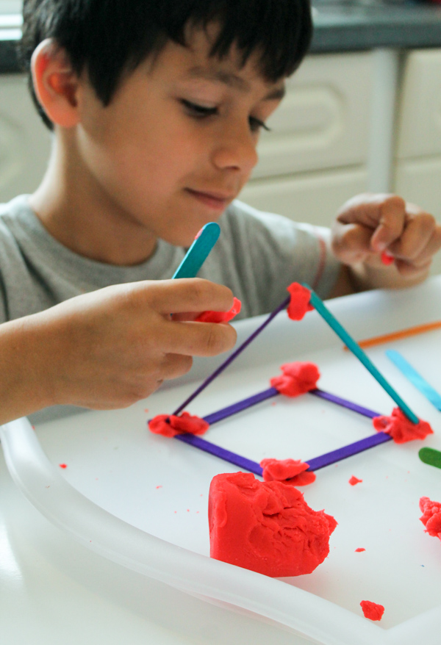
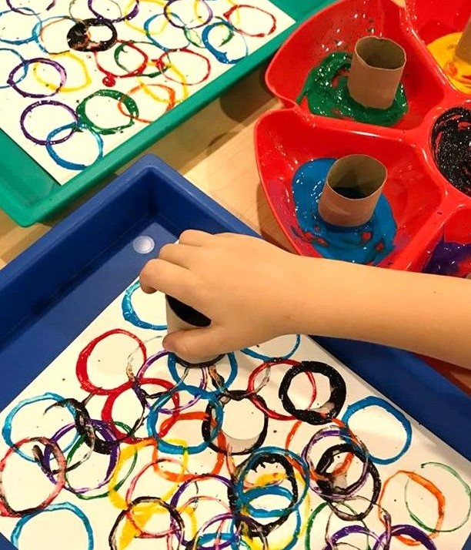
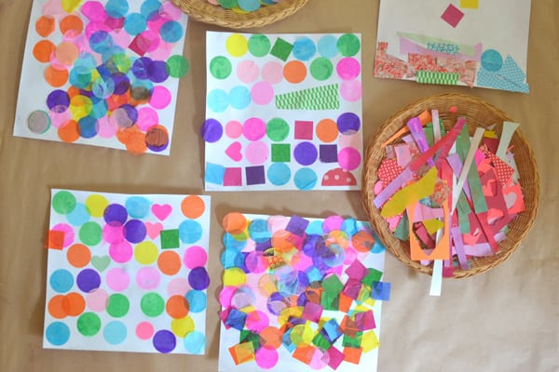
Art Activities That Focus On Shapes
Notes:
Children are starting to look at and compare two-dimensional (flat) and three-dimensional (solid) shapes. They are using appropriate language to recognize different shapes and talk about their attributes. Some art activities that can support this include:
Shape stamps and gadget painting
Paper collages
Tracing, cutting shapes
Using shapes to make other pictures
Modeling: using clay, sticks, pipe-cleaners, etc.
Right about now, you may be thinking “I do art activities like these ALL THE TIME!”
You are right - you do. That is kind of the point. The math is already there. You just need to highlight it.
Verbal Encouragement as they work that supports the exploration of shapes: Count the different number of sides and angles, you can name the features of each shape that make them different. Be cautious about injecting rote questions. Instead of “What shape is this?” try asking about their thinking: why they chose a particular shape or material, what is the plan?
I’d like to leave a few minutes for you to What can you do say and offer to further explore the key concept of shapes while working with art materials?
(PAUSE FOR PARTICIPANTS TO WRITE DOWN IDEAS, THOUGHTS ON POSSIBLE IDEAS. FOR EACH KEY CONCEPT)

Slide 8
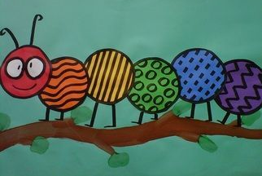
Patterns
Notice sequences
Participates in repeating sequencing
Matching patterns
Creating patterns
Extending sequences
Notes:
Our next concept is Patterns
Patterns are items in a specific order that repeats. Young children begin showing interest in, and increased ability to recognize, reproduce and create patterns of varying complexity.
Very young children begin experience with patterning by
Notice and respond to simple repeating sequences: notices repetitive sounds, mimics repetition in songs
They begin to Participates in repeating sequencing: attempts to follow sequence when working with materials - gets smock when sees teacher putting out brushes for painting
Matching patterns – draws the same item or in the order as another child
Creating patterns – designs begin to show intentional order, paints in pairs of colors
Older children will start Extending sequences – adds complexity to creative depictions: understands colors of a rainbow are constructed in a specific order.

Slide 9
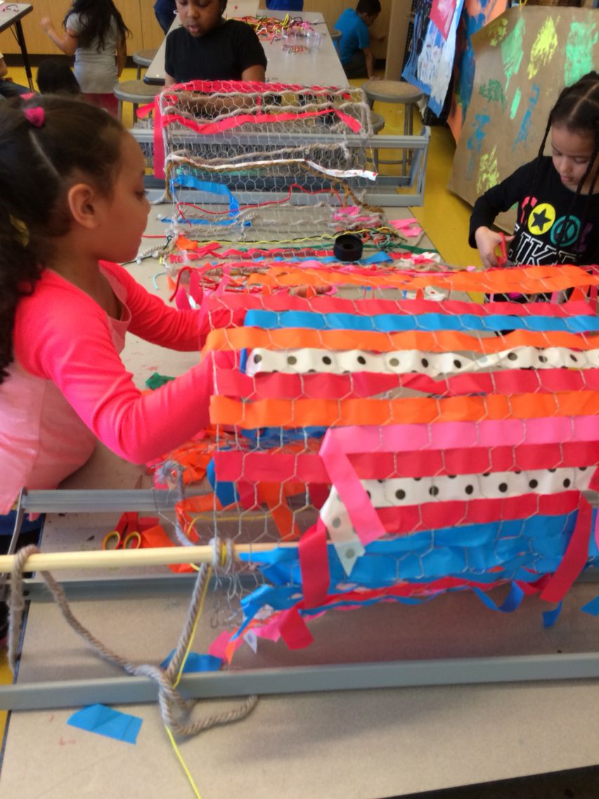
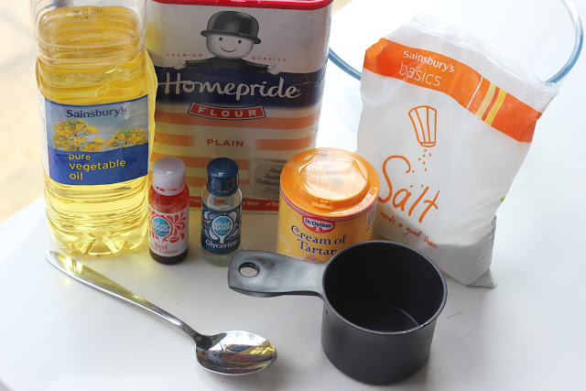
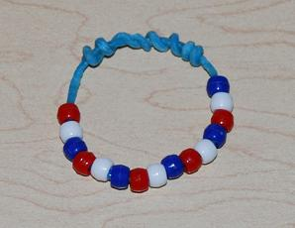
Art Activities That Focus On Patterns
Notes:
Working on patterns and sequencing skills helps preschoolers begin to understand events in a logical order. It also helps self regulation and independence as they work toward doing things for themselves – first socks, then shoes, etc.
Some activities:
Mimicking patterns in nature –flowers, sea shells
Beading and lacing – creating wearable art
Weaving activities are inherently pattern based. The process is literally repeating a sequence (over, under, in, out) =, You can extend this by adding difficulty and involve patterns by creating them in the design (alternating colors and textures in a repeating pattern)
You can also incorporate Sequencing by involving children in the of steps of an art activity – for example, when working with watercolors, talk about the necessary order (first, wet the brush, next dip in paint, then to the paper. Using a recipe to make playdough (dry ingredients first, wet, then heat, last color),
While working, Use words like first, next, and last as you go about your day, talk about the beginning, middle, and end.
(PAUSE FOR PARTICIPANTS TO WRITE DOWN IDEAS, THOUGHTS ON POSSIBLE IDEAS FOR EACH KEY CONCEPT)

Slide 10
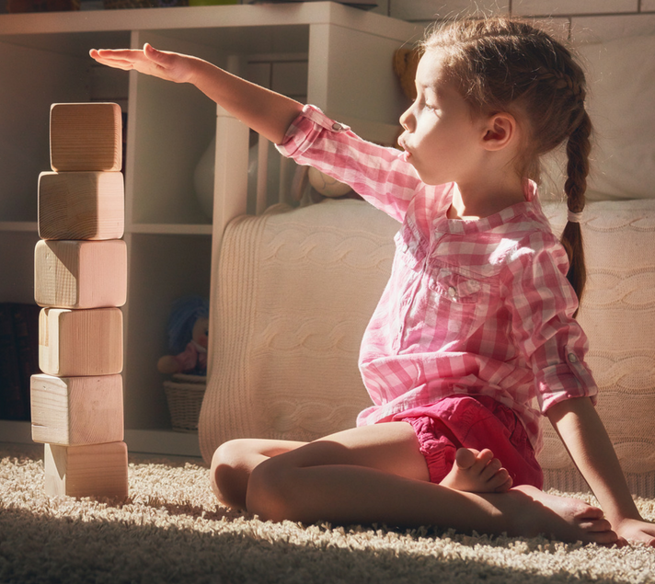
Spatial Relationships
Responds as objects move
Explores how objects fit
Explores variety of ways objects move
Considers the physical properties of materials
Notes:
Spatial sense is the ability to place items in the correct spaces or places using a logical design or a pattern. Children develop increasing understanding of how objects move and fit in different spaces. Spatial activities are designed to help young children understand the world around them and how they interact with it.
Responds as objects move – watching, tracking movement of an object, predicting where it will end up
Explore how objects fit – rotating, manipulating objects to fit (puzzels), filling purses
Explores variety of ways objects move – rolls round items,
Considers the physical properties of materials – stacks item largest to smallest, uses positioning to move items: turns a bike sideways to get through a smaller space, goes under an object instead of all the way around

Slide 11
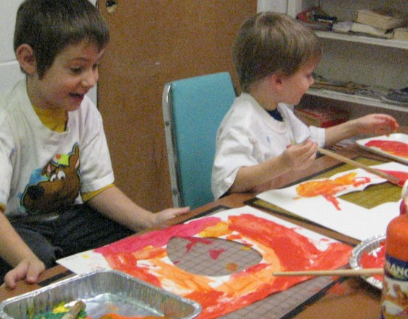
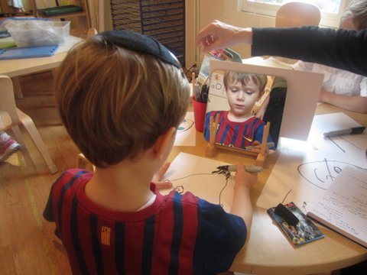
Art Activities That Focus On Spatial Relationships
Notes:
What does all that have to do with a young child’s mathematical development?
When children have opportunities to explore two- and three-dimensional objects, they develop an ability to coordinate movement.
By participating in art activities that involve perceptions of objects and their attributes, children develop cognitive skills that let them see a piece of an object, and know that it is part of a whole. Children become capable of recognizing objects in different orientations.
Some activities:
Dioramas
Self portraits
Tangrams (form specific shapes given only an outline or silhouette of a basic shape)
Negative space art - refers to the empty spaces the art is created around, between, and within the subjects.
Young children’s use of spatial language directly relates to later skills at spatial problem solving.
Vocabulary that supports spatial relationships include words describing location/position (under, in front of), attributes (long, high, side, angle, same, symmetrical), orientation (left, turn, match), and geometric shape names (rectangle, triangle, sphere).
(PAUSE FOR PARTICIPANTS TO WRITE DOWN IDEAS, THOUGHTS ON POSSIBLE IDEAS FOR EACH KEY CONCEPT)

Slide 12
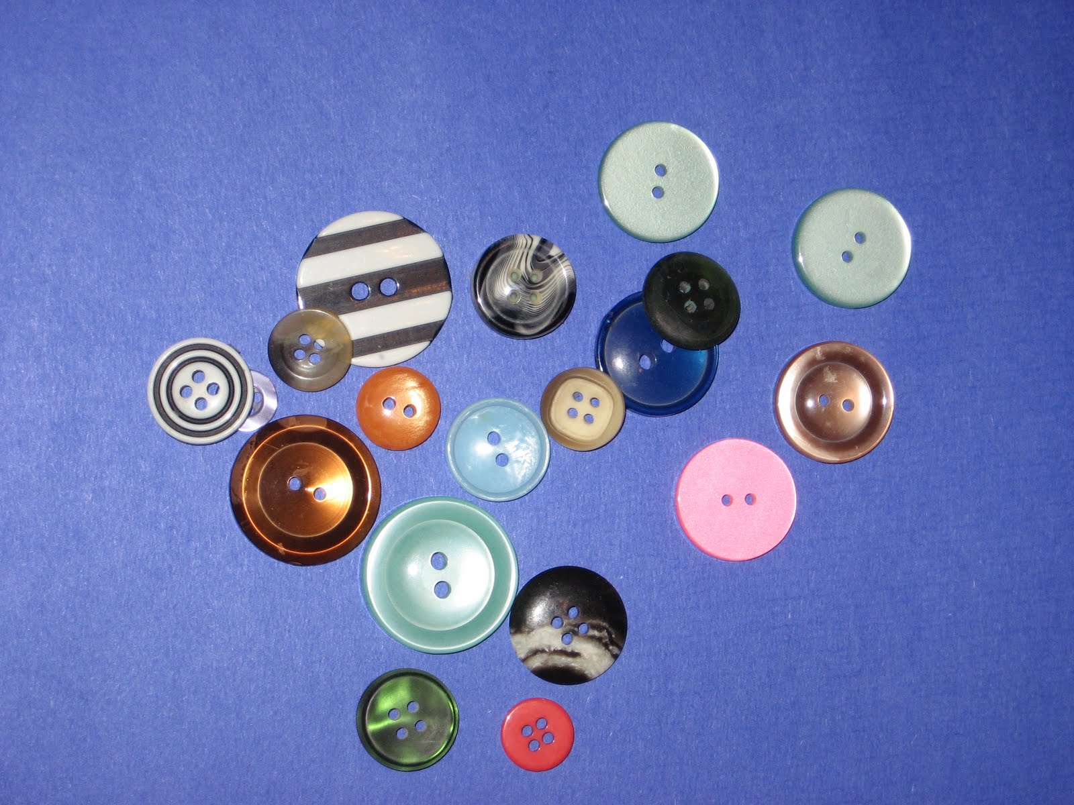
Classification
Attention to attributes of an object
Interacts differently with familiar materials
Associates objects with one another
Sorts in one or two groups
Sorts objects by more than one attribute
Groups by one or two features
Notes:
Creating sets is the ability to make groups of items in a logical way. It requires the skill of classifying.
By observing and manipulating materials, children will show increasing ability to compare, match and sort objects into groups according t o their attributes.
Attention to details of an object – often fixating on a particular feature. Using a single color in a paint palette until its gone.
Interacts differently with familiar materials – making it more important to vary art experiences. Children continuously change how they work each time materials are introduced. They lean new properties, or develop ideas on ways to experiment. Re-introducing a familiar media, with unfamiliar tools is a great way to expand on this thinking.
On a very simple level, Associates objects with one another – markers with paper, paint with smocks
Sorts in one or two groups – separates by basic features like shape (all square things), and color (all blue)
Sorts objects by more than one attribute – square
Groups by one or two features - creates more complicated groupings. Sorting by multiple features and use. (all stuffed animals are grouped together, then separated by size, then color, then things that fly)

Slide 13
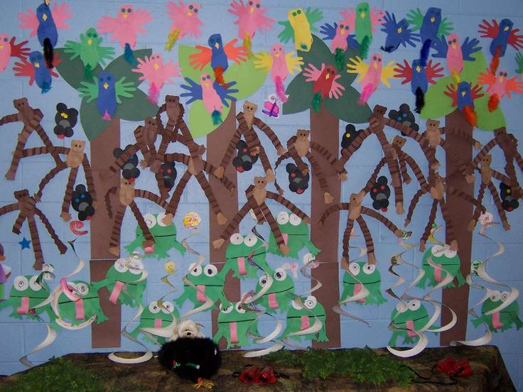
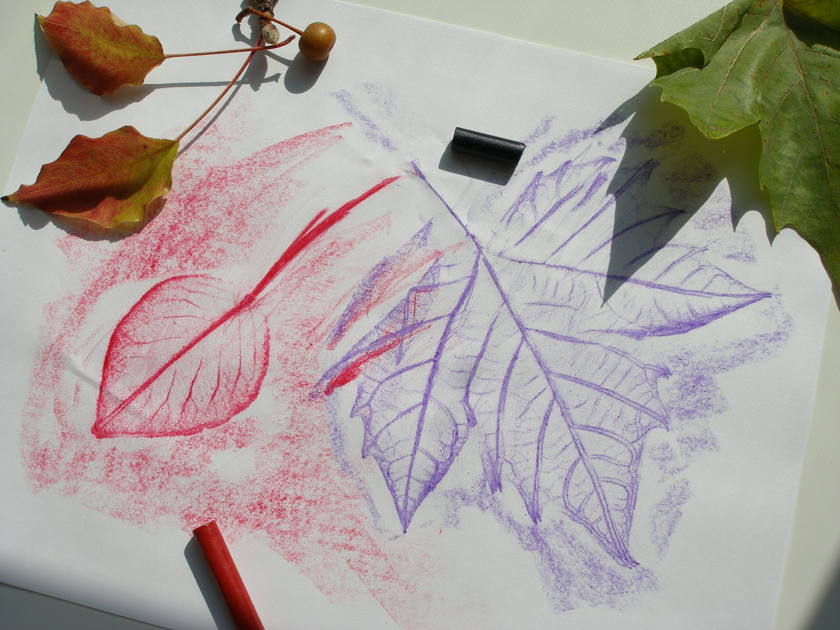
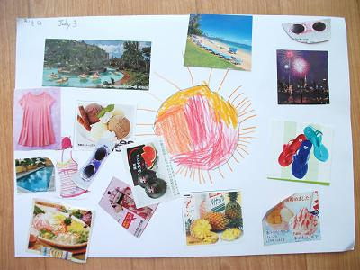
Art Activities That Focus On Classification
Notes:
Young children become more interested in math if their experiences have a purpose and match their abilities. Since many math concepts are abstract, early experiences should be with concrete materials.
Some activities:
Collages by groups and type (colors, shape, ocean animals)
Texture rubbings
Color seriation, working with shades
Theme or seasonal art work
When engaging in conversation about sorting and classification, point out how things are alike and different as children work. These are all green, but some are pointy, others are curved.
Use expanded adjectives, and explain the meaning: Pink is a shade of red. Shade is how light or dark a color is.
(PAUSE FOR PARTICIPANTS TO WRITE DOWN IDEAS, THOUGHTS ON POSSIBLE IDEAS FOR EACH KEY CONCEPT)

Slide 14
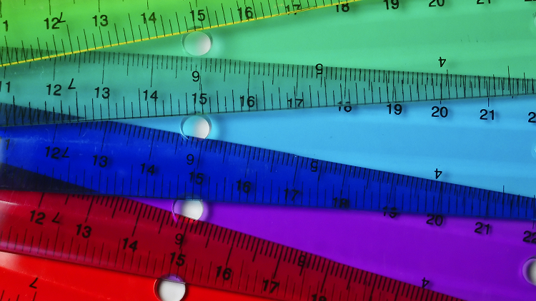
Measurement
Awareness of the property of size
Explores how size effects how object interact
Understanding of measurable properties
Identifies differences with comparative words
Orders by measurable properties
Uses tools to measure
Notes:
Measurement
Young children are beginning to describe and compare their physical world. We just looked at ways they are starting to classify, sort and group objects into categories. Measuring expands the groups and sets by including areas such as volume, weight, length, height, temperature and time.
Through art, children will show increased understanding of these measurable properties and how to quantify those properties.
Develop and demonstrate awareness of the property of size – choses larger paper to take to the easel
Explores how size effects how object interact – use many sizes of brushes in the same color paint
Understanding of measurable properties – uses hands to indicate how much tape they think they need
Identifies differences with comparative words – longer pipe cleaner, noting the larger clay statue will take longer to dry
Orders by measurable properties – places sets in order by size, placing tall materials behind shorter in a diorama
Uses tools to measure – uses foot steps to measure area needed for a sidewalk chalk mural, balances piece of a mobile on a scale when creating a mobile, testing length of a ribbon against their wrist for bracelets

Slide 15
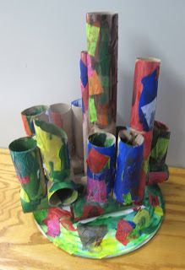
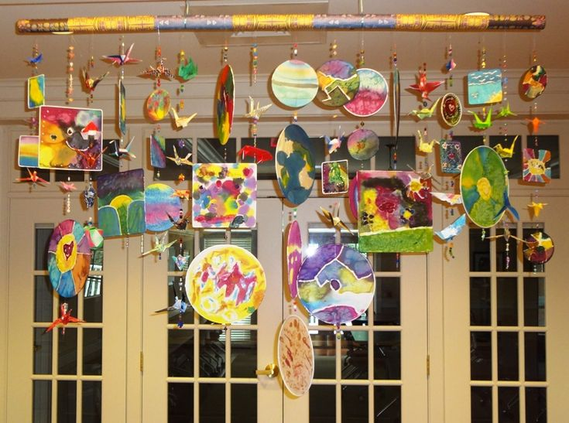
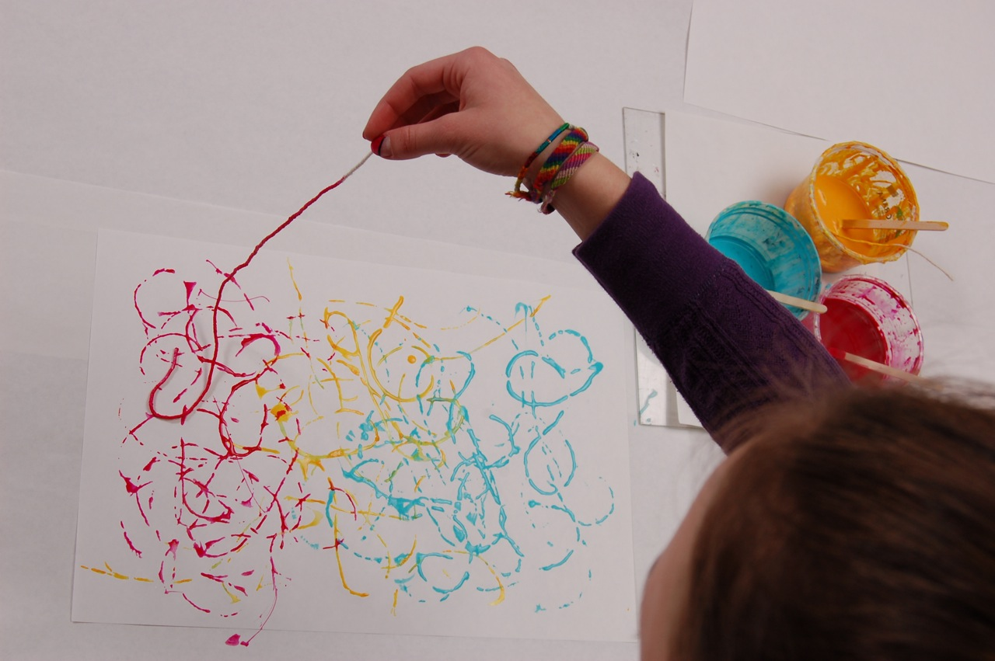
Art Activities That Focus On Measurement
Notes:
When teaching measurement skills to young children provide lots of opportunities to explore objects by size. Use art activities and experimenting with art materials to help children understand measurement concepts.
Activities
Murals
String art
Mobiles
3-D structures
Encourage discussion of properties and size by:
Comparing different objects using appropriate language. “This craft stick is shorter than that one, but is is heavier” Describe their physical world with directional words: in front of, behind, on top of, next to, below, etc.

Slide 16
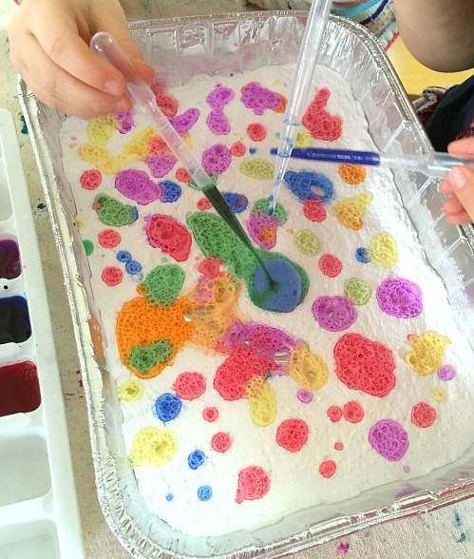
Cause and Effect
Anticipates actions
Repeats actions to
duplicate results
Seeks out reason for
cause and effect
Preemptive action in
advance
Verbal reasoning
Understand that
variation effects change
Notes:
Understanding the relationship between cause and effect is important in building mathematical thinking. As your child learns behaviors cause action, it helps develop early communication and cognition skills.
Art can help children develop increasing ability to observe, anticipate, and reason about the relationship between cause and effect.
A first indicator is when a child Anticipates actions – they may carry water carefully to prevent spilling
They often Repeats actions to duplicate results – repeats spinning brush on canvas to create a swirl pattern
Begin to seeks out reasons for cause and effect - a very young child may try using other end of marker to scribble
Older children, with a few more experiences under their belts, will take Preemptive action in advance – tapes down paper outside, uses small container to keep collage materials organized
On the higher end, they can Verbalize and explain reasoning – if I use too much glue, it will rip the paper and not dry, I need the bigger roller to cover my paper faster
They also Understands variations effects change - they will swing harder to create more arch when splatter painting, move the marker slower, press the crayon harder to deepen color.

Slide 17
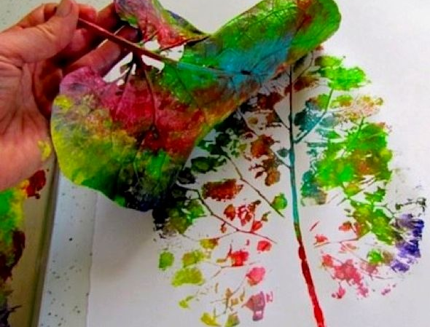
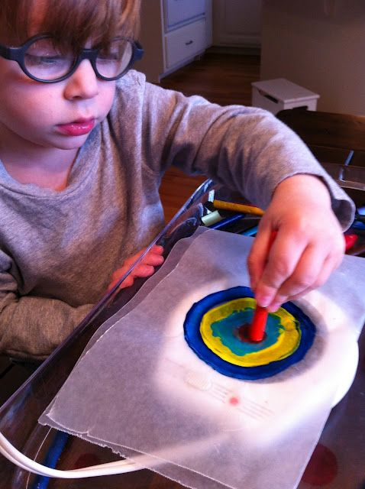
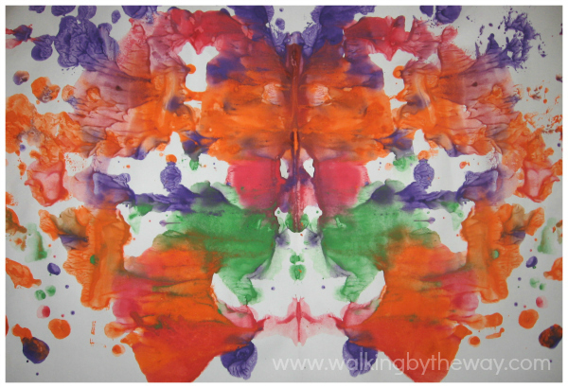
Art Activities That Focus On Cause and Effect
Notes:
Preschoolers may be more interested in being able to mix and manipulate materials, than in what they are creating. Remember at the beginning we talked about process vs, product driven art? This is especially true when using art activities to extend learning about the key math concept of cause and effect.
Don’t be surprised if a child who works very hard with media and materials but isn’t interested in preserving the work. We’ve all seen a colorful painting become a pile of brown paper sludge.
Some activities:
Marble paint
Fold-over art
Crayon melt
Transfer
Some common cause and effect linking words are ‘ because’, ‘since’, and so’. ‘
Because the paper is wet with paint it will tear easily
Since we used glue, we will have to wait to move our bird house
The melting tray is warm, so we will move the crayons with sticks
This can be extended by if / then statements
(PAUSE FOR PARTICIPANTS TO WRITE DOWN IDEAS, THOUGHTS ON POSSIBLE IDEAS FOR EACH KEY CONCEPT)

Slide 18
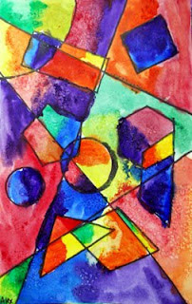
Thinking deeper
Number Sense of Quantity
Symmetry
Paper Mache
Relief painting
Graphing
Notes:
I encourage you to take the last of the session and think about the example activities and vocabulary extensions shared.
Try to apply the same planning and facilitation intensions to the following additional math concepts:
Number Sense of Quantity - Students are beginning their experience with numbers through counting, number names and written numerals. Students are learning to count objects and understand a one-to-one correspondence. They are also starting to compare different sets of objects and use appropriate language.
Symmetry is the balanced distribution of duplicate shapes. Literally, the word ‘symmetry’ means allowing an object to be divided into two equal parts such that one part coincides with the other.
And the math concepts embedded in other familiar art activities such as:
Paper mâché
Graphing is a way of recording or communicating observations and data that the children have learned.
And lastly, Encourage your children to:
Touch different objects and count out loud.
Move objects in new ways and from one group to another.
Use comparing words: more than, less than, the same as.
(PAUSE FOR PARTICIPANTS TO WRITE DOWN IDEAS, THOUGHTS ON POSSIBLE IDEAS)

Slide 19
Thank you
Dana McVey
First 5 California
dmcvey@ccfc.ca.gov
Notes:
Thank you for joining me. We’re always interested to hear about your favorite early math activities. Please feel free to reach out if you have questions.

