Slide 1
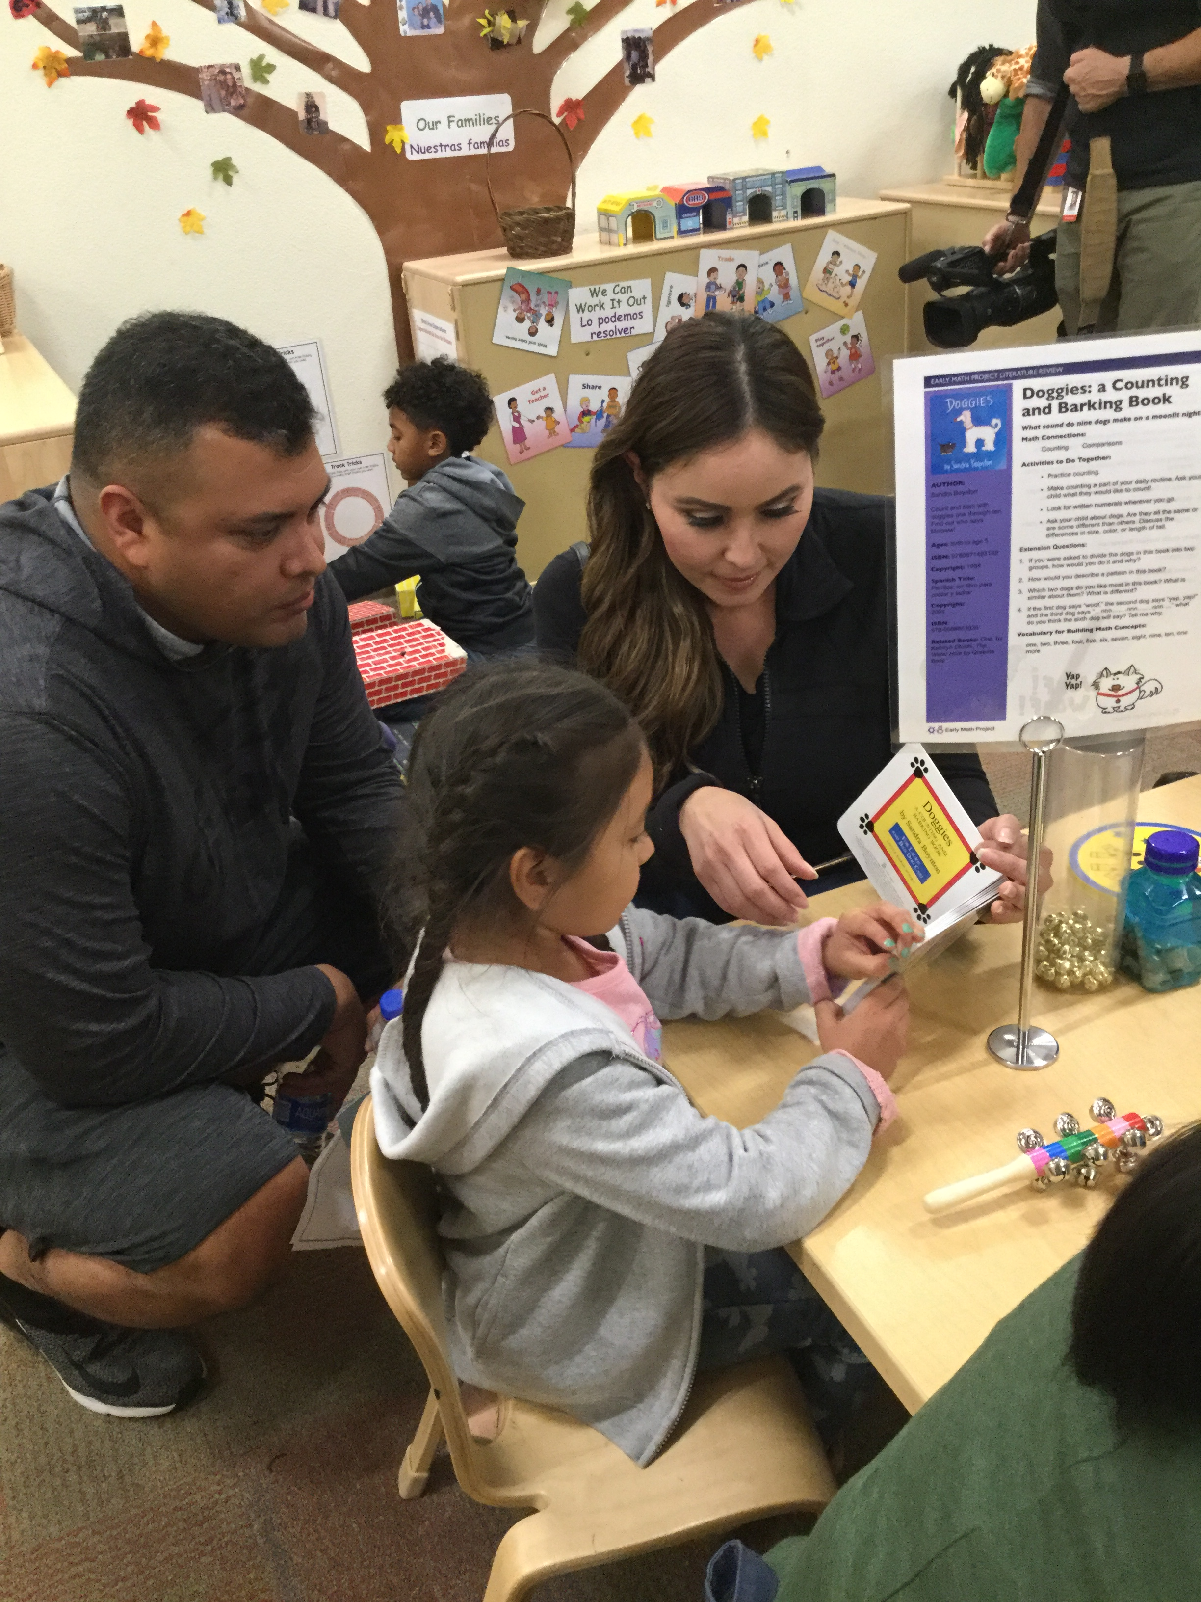
Engaging Families in Early Math: A Family Math Night
Barbara Daniel & Lisa Grant - Fresno County Superintendent of Schools
Sophie Savelkouls & Osnat Zur - WestEd

Slide 2
Focus
Why Engage Families in Early Math?
Family Math Night at The Lighthouse for Children
Learning from Data
Resources & Tips

Slide 3
Why Engage Families in Early Math?

Slide 4
The Importance of Engaging Families in Early Math
Parents are children’s first and primary teachers
Families have many natural opportunities to engage children in math as part of their day-to-day lives.
However, few families engage their children in daily math activities or math talk.

Slide 5
Why Do Families Not Engage their Children in Early Math
Parents may:
have negative feelings, or anxiety, related to math
believe that the school is primarily responsible for supporting children’s early math
need more support in understanding how children develop math skills and concepts
Notes:
Many parents have negative feelings, or anxiety, related to math. This may be because they had negative experiences learning math when they were a child. This often results in them inadvertently transfer these negative feelings to their children.
They also believe that the school, not the parent, is primarily responsible for supporting children’s early math. This is in contrast to their beliefs about language, where they believe they do play an important role.
Many parents also do not quite know what common math milestones might be for their child, and whether they child is falling behind or is on track.
Together, these beliefs can affect how often families engage in math activities with their child.

Slide 6
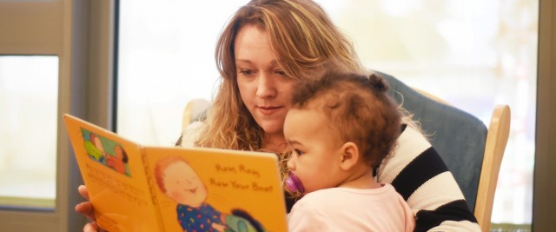
Math Talk
How Can Families Engage Children in Early Math?

Slide 7
Daily Routines
How can Families Engage Children in Early Math?

Slide 8
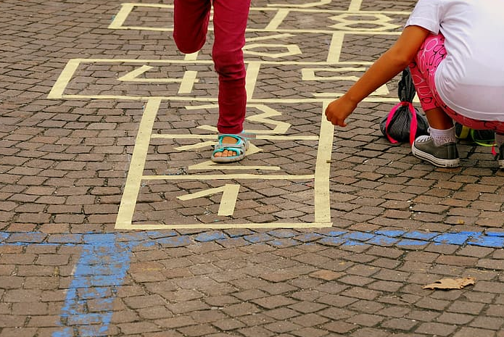
Activities & Games
How can Families Engage Children in Early Math?

Slide 9
Family Math Night Case Study: The Lighthouse for Children

Slide 10
The Role of Educators in Engaging Families
Model a positive attitude toward math for children and families
Provide families with concrete examples of how parents can engage in early math activities in daily routines
Encourage families to introduce math talk when engaging in reading, storytelling, and singing
Send home ideas for math activities that children can do together with their families

Slide 11
The Lighthouse for Children Child Development Center as a Demonstration Site for the California Early Math Initiative
The Lighthouse for Children is the home of programs, services and training opportunities in support of young children and their families.
First 5 Fresno County and community partners offer families a learning environment where they feel safe, supported and prioritized.
This three-story community building houses:
A child development center operated by the office of Fresno County Superintendent of Schools
The Community Learning Center
Conferencing and office space for community agencies
First 5 Fresno County’s administrative offices.

Slide 12
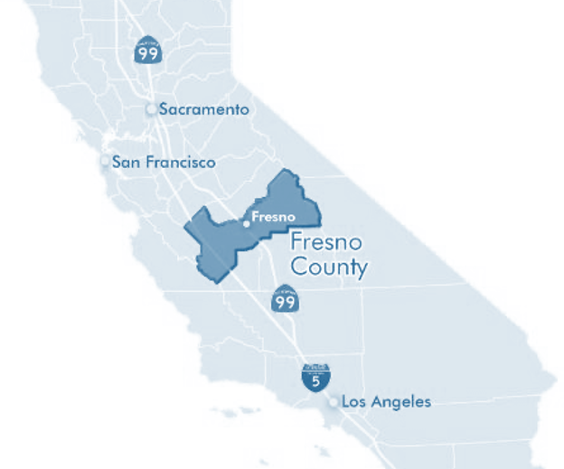
The Lighthouse for Children Child Development Center (LFC CDC) is in the heart of California in downtown Fresno County and represents a unique partnership between First 5 Fresno County and the office of Fresno County Superintendent of Schools
The LFC CDC offers high quality early learning experiences that prepare children for success. The Child Development Center features:
Six state-of-the-art classrooms
A dual language classroom that utilizes a 50/50 model
A natural playground designed to maximize learning indoors and out for infant, toddler and preschool aged children
Serves as a demonstration site and innovation lab for early childhood professionals and students. It offers observation areas and on-site training opportunities to learn about the program’s approach to high-quality care and utilization of a blended-funding model.

Slide 13
Using literacy as an entry point for math
Math Person vs Reading Person?
Math in Stories
Activities with low or no cost materials
Notes:
Families may need guidance on how to engage children in these math activities. Family engagement programs organized by the school can help encourage families’ support of math in the home.
Reading to a child comes naturally to most parents – it is already something they typically do and are comfortable with. We use this as a bridge to math activities. In general most parents are more comfortable with literacy skills than they are with mathematics. You often hear people say “Oh I’m just not a math person” but you never hear people say “Oh I’m just not a reading person!”. The Early Math Project reviews children’s literature and look for the math in the stories. We then create a fun math activity that is related to the story. Sometimes it’s easy to find the math in a story like in Quack and Count, sometimes the math is a little more subtle like in Goodnight Gorilla or Beep Beep, Vroom Vroom.

Slide 14
What it takes to Organize a Family Math Night
Who is your audience; who will be there?
What is your learning goal for families?
When and where will you hold it?
How will you inform families about Family Math Night?
Will you provide a meal or snacks?

Slide 15
Opening Session
Importance of mathematics
Parents’ feelings are contagious
How to read to a child
Practice

Slide 16
Activity Stations
Target ages:
Infants
Toddlers
Preschoolers
Early elementary school children
Math areas:
Number Sense
Geometry
Classification & Patterning
Notes:
6 math activity stations

Slide 17
Early Math Books
Notes:
Color Zoo
Baby Goes to Market
The Birthday Box
Who Sank the Boat
Doggies

Slide 18
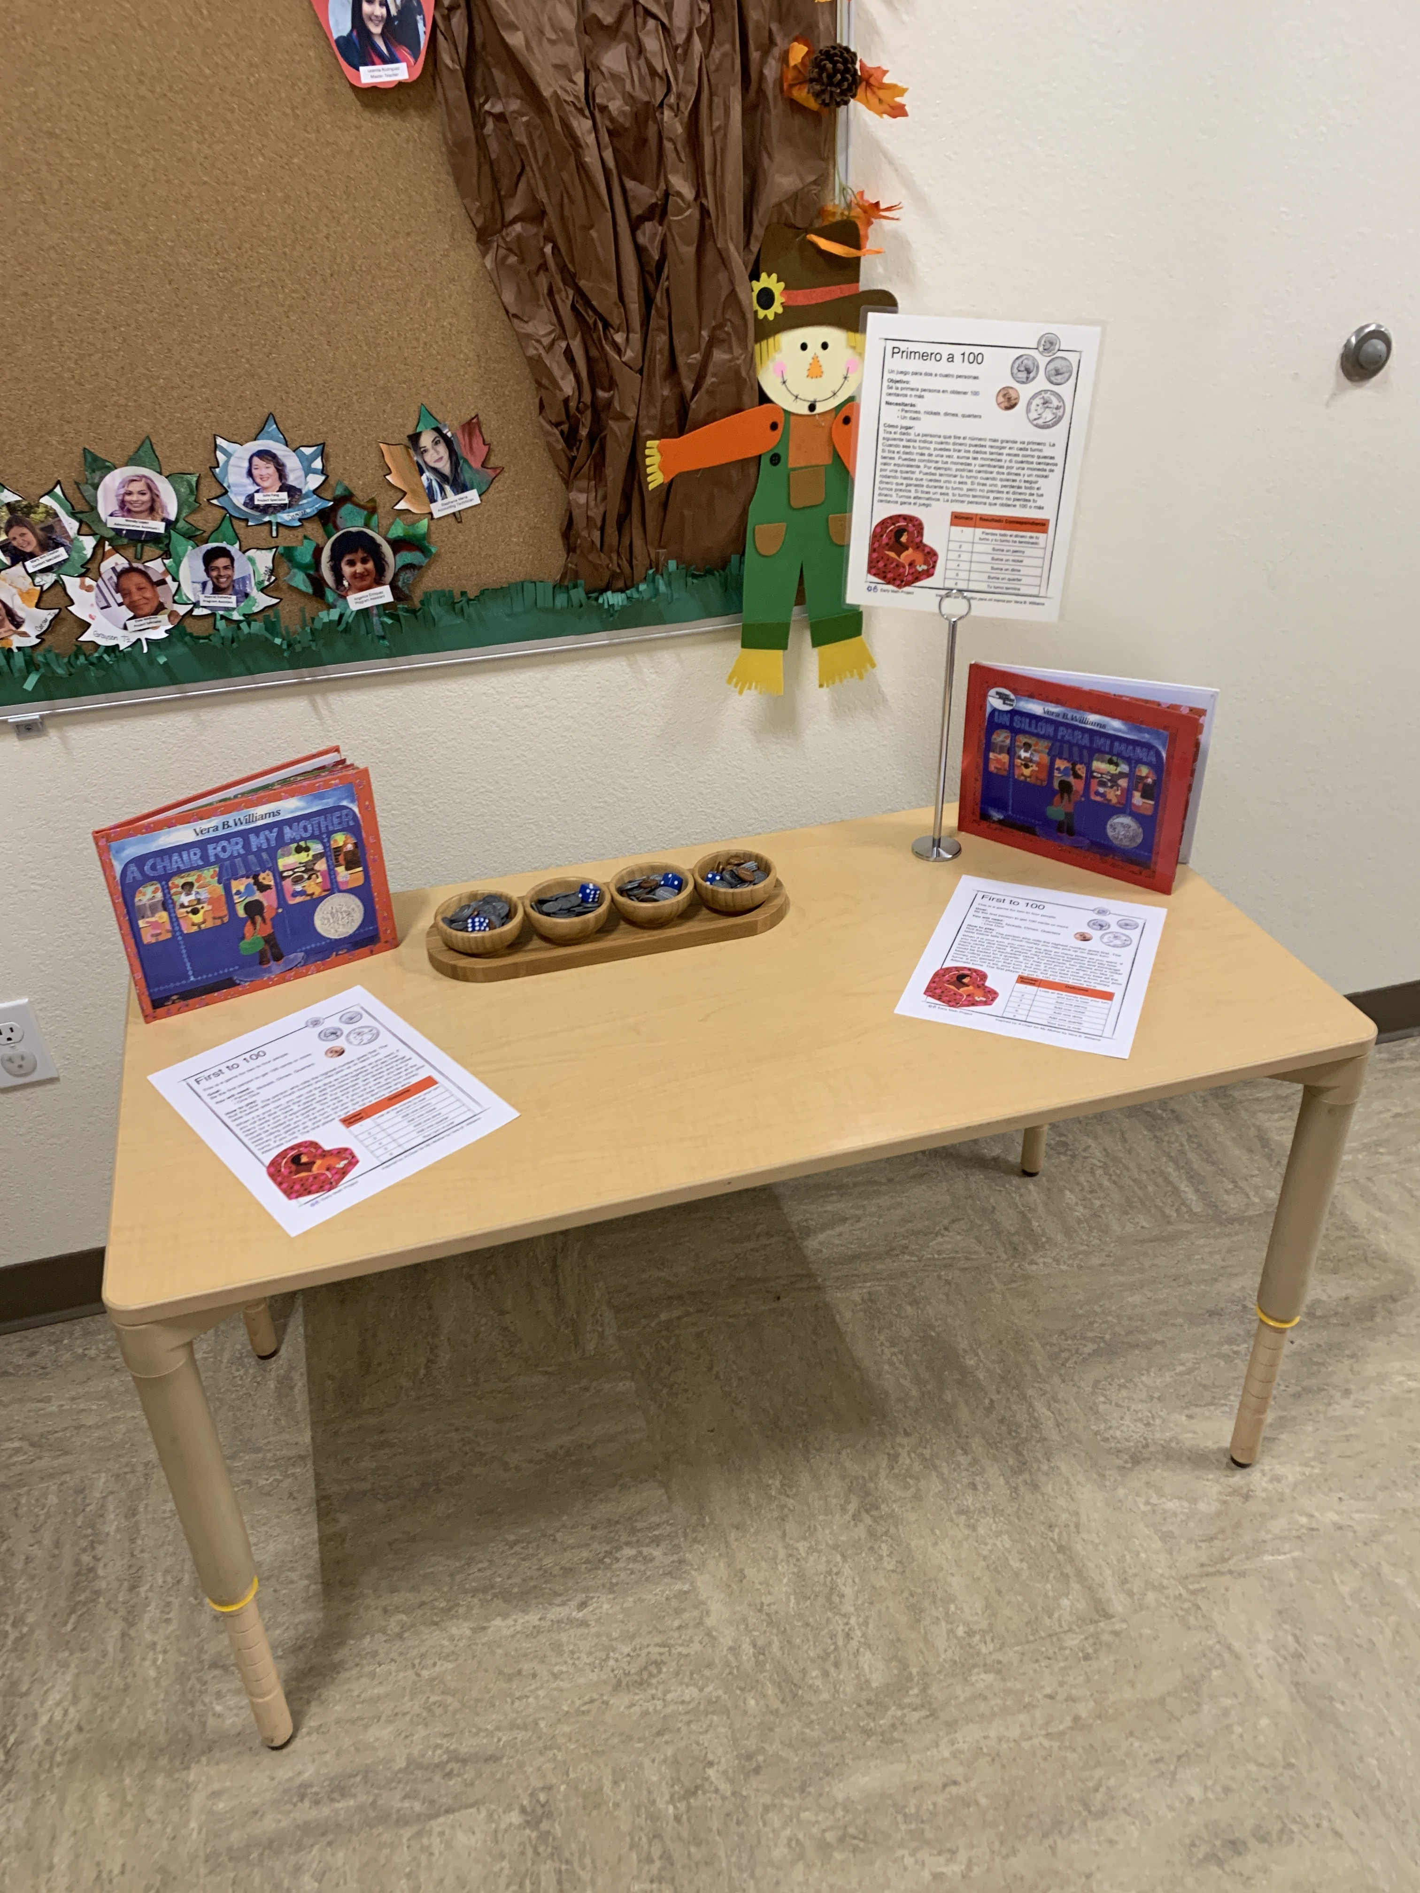
Activity Stations

Slide 19
Family Math Night
38 families attended, mostly mothers
Mostly children were 3 to 4-year-olds
Almost half of the children were bilingual

Slide 20
Video: Family Math Night

Slide 21
Learning from the Data

Slide 22
Evaluation
Sources of Data
Parent Survey
Observations
Discussions with Organizers

Slide 23
General Parent Impressions
94% of parents agreed that the Family Math Night:
provided ideas for math activities to do at home
taught them how to talk about math during everyday activities
built their confidence in supporting their child’s math learning

Slide 24
Math Activities
80% (or more) of parents, agreed that:
their children were engaged during the activities
the instructions for the activities were clear
there was a range of activities for different age groups

Slide 25
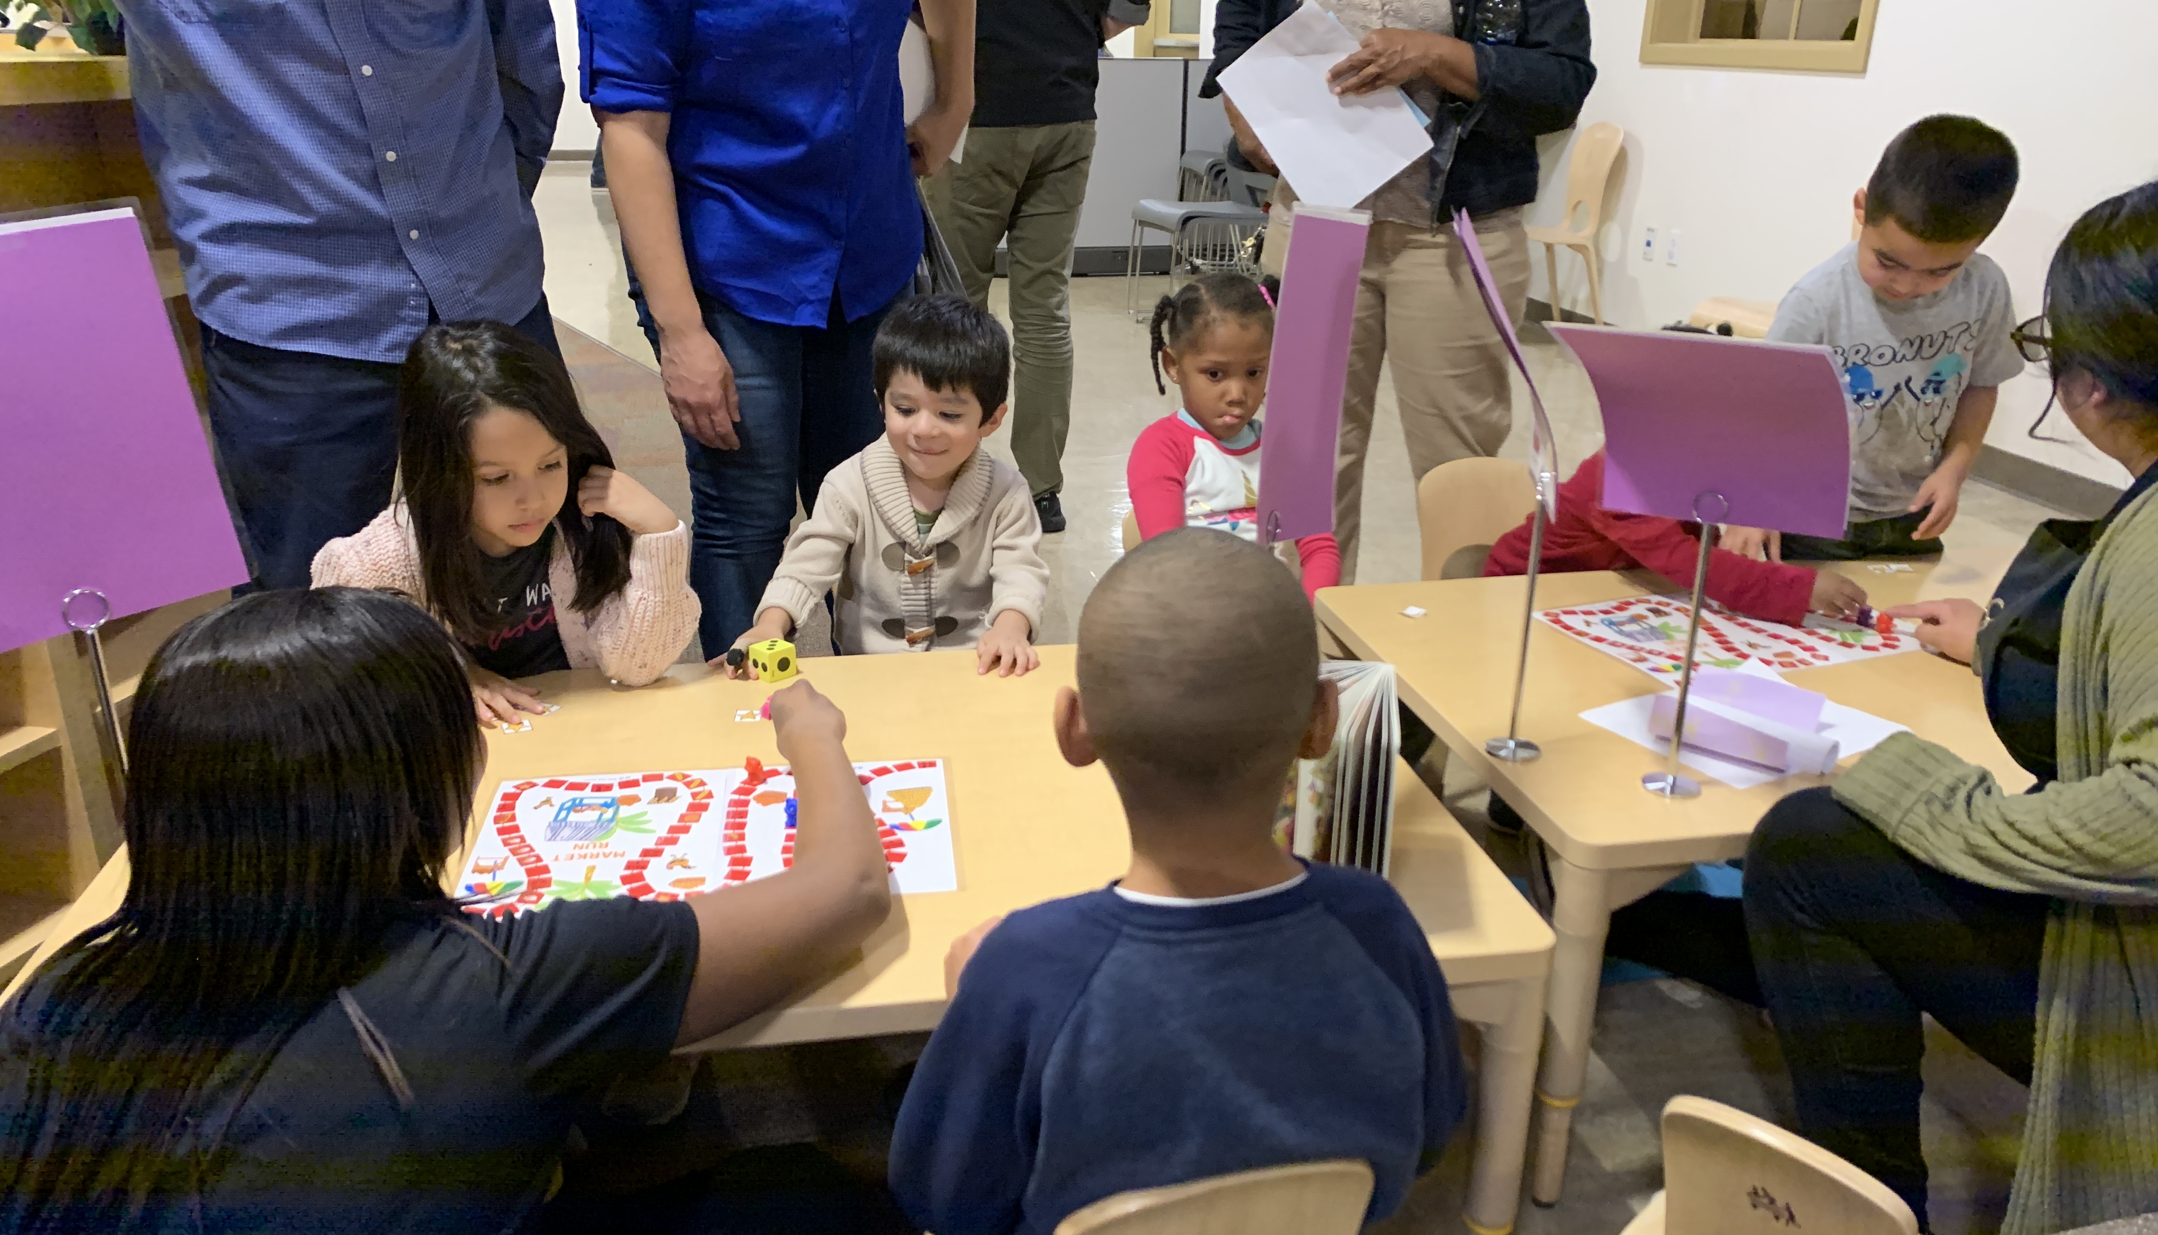
Level of Parent Engagement
Parents were highly engaged in the opening session and during activities
In stations where teachers led the activity, parents were observers but less actively engaged

Slide 26
Lessons learned
Clearly define the role of teachers as facilitators and the desired level of engagement of parents
Provide plenty of space for the activities and a loud speaker for the opening session
Set-up break-out groups by age of the child
If providing a meal or snacks ensure you plan for providing a child friendly option

Slide 27
Lowering Barriers to Participation
Give families a choice of times for the event
Consider offering a meal or some snacks during the event
Organize transportation to and from the event
Translate important materials in families’ home language

Slide 28
Planning Your Own Family Math Night

Slide 29
Resources
Early Math Project Website
https://www.earlymathca.org/
Early Math Festival Handbook
https://www.earlymathca.org/festival
Thrift Books
https://www.thriftbooks.com/
Local Libraries
Early Math App
National Council of Teachers of Mathematics

Slide 30
Resources
All About Young Children: Information for Families on Children’s Early Development
https://allaboutyoungchildren.org/
NAEYC Math at Home Tool Kit
https://www.naeyc.org/math-at-home
Young Mathematicians
http://youngmathematicians.edc.org/
NAEYC Book: "Where's the Math" Books, Games, Routines to Spark Children's Thinking by Mary Hynes & Laura Grandau

Slide 31
Thank you!

