Slide 1
Math for Preschool
Jon Dueck • jdueck@fcoe.org

Slide 2
http://spicyquiz.com/math/how-many-squares-do-you-see/
Notes:
Starts with ZERO
-counting numbers
-integers
Why go to 26?
Standards pages: Forefront/background?
Share Suse McDonald book on counting

Slide 3
Notes:
Starts with ZERO
-counting numbers
-integers
Why go to 26?
Standards pages: Forefront/background?
Share Suse McDonald book on counting

Slide 4
https://www.youtube.com/watch?v=LZGYDwjUwBI
Notes:
Starts with ZERO
-counting numbers
-integers
Why go to 26?
Standards pages: Forefront/background?
Share Suse McDonald book on counting

Slide 5
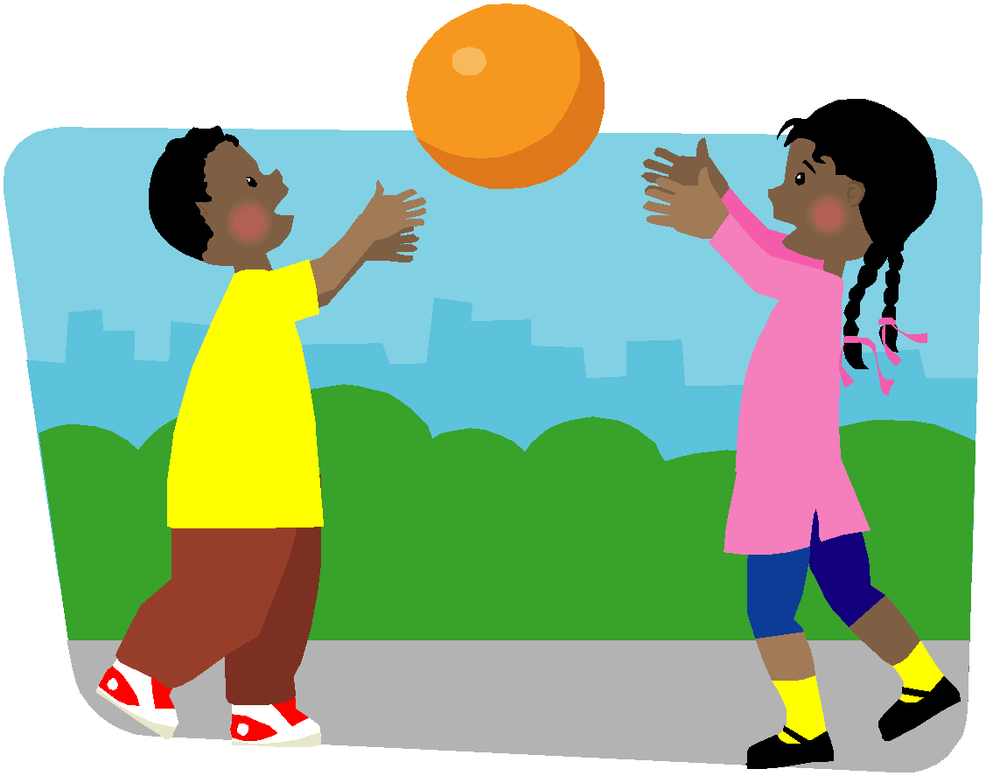
Counting Books
https://www.youtube.com/watch?v=rZGMe77tiG0

Slide 6
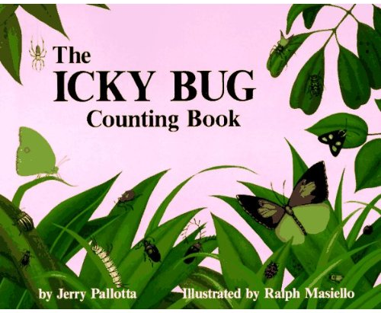
Counting Books
https://www.youtube.com/watch?v=sVl9G-0zhN0

Slide 7
Counting Books
https://www.youtube.com/watch?v=DLjYPT5SYuc

Slide 8
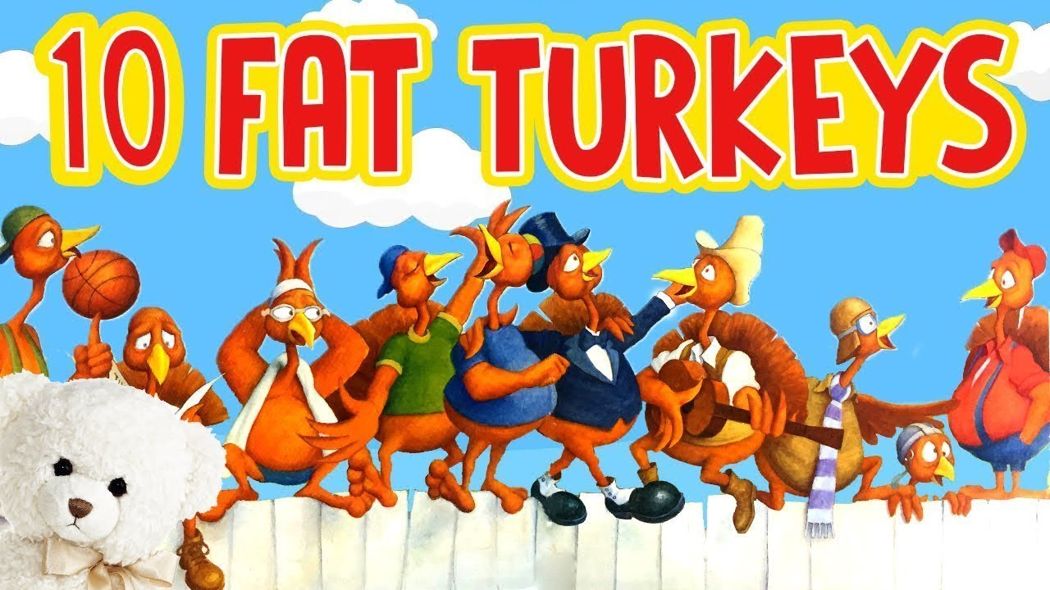
Counting Books
https://www.youtube.com/watch?v=punN6VfS-To

Slide 9
What do you see?

Slide 10
What do you see?

Slide 11
What do you see?

Slide 12
What do you see?

Slide 13
What do you see?

Slide 14
What do you see?
Notes:
Doubles +1
(4+4) +1

Slide 15
What do you see?
Notes:
Doubles +1
(4+4) +1

Slide 16
What do you see?
Notes:
4+5

Slide 17
What do you see?
Notes:
6+3

Slide 18
Dot Cards
How could you use these with your students?
What mathematical is being done here?

Slide 19
9
4 + 4 + 1
4 + 1 + 4
4 + 5
6 + 3
1+1+1+1+1+1+1+1+1

Slide 20
5-frame

Slide 21
5-frame

Slide 22
5-frame

Slide 23
5-frame

Slide 24
5-frame

Slide 25
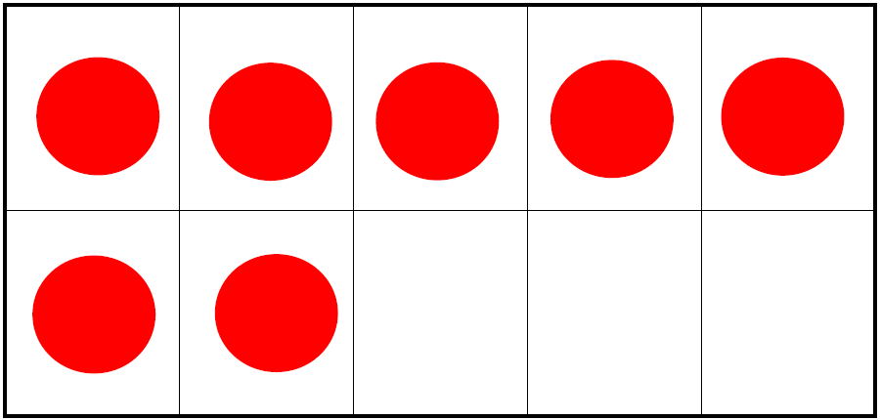
10-frame

Slide 26
10-frame

Slide 27
10-frame

Slide 28
10-frame

Slide 29
10-frame
Notes:
Hold up different amounts
Use #7
-thumbs up when you know how many
-how many?
-how do you know?
Standards pages: Forefront/background?

Slide 30
10-frame

Slide 31
5 and 10-frames
How could you use these with your students?
What math is being done here?

Slide 32
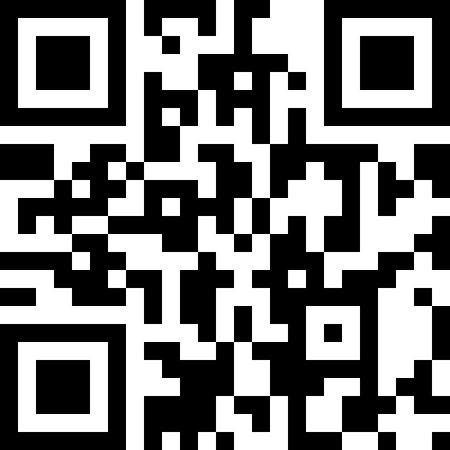
https://flipgrid.com/make7

Slide 33
Flipgrid
How could you use this tool with your students?

Slide 34
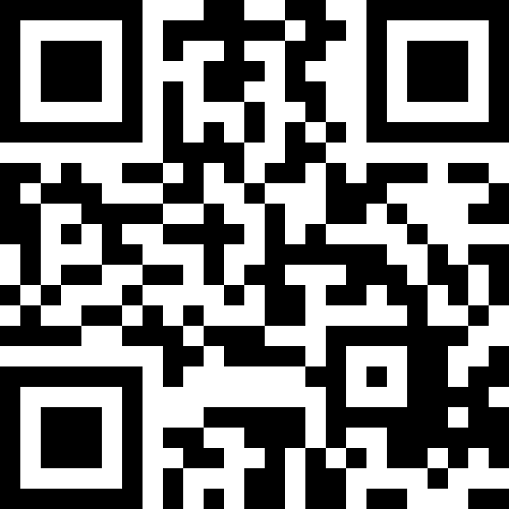
https://flipgrid.com/duecksquare

Slide 35
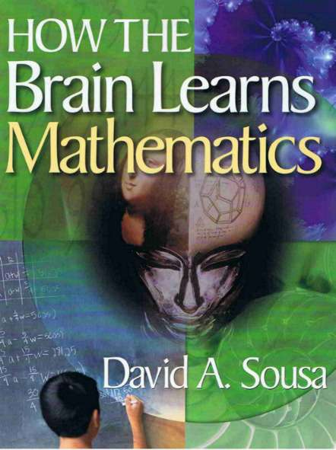
How the brain learns
Because number is sense is so critical to success in learning mathematics, five stepping-stones have been identified that allow teachers to assess a child’s understanding of number sense
Notes:
As we click though these 5-stepping stones, think about a child that is in this stage

Slide 36
How the brain learns
1. Children have not yet developed number sense beyond the innate notions of numerosity. They have no sense of relative quantity and may not know the difference between ‘less than’ and ‘more than’ or ‘fewer’ and ‘greater’.

Slide 37
How the brain learns
2. Children are starting to acquire number sense. They can understand terms such as ‘lots of,’ ‘six’, and ‘nine’ and are beginning to understand the concepts of ‘less than’ and ‘more than’. They also understand lesser or greater amounts but do not yet have basic computation skills

Slide 38
How the brain learns
3. Children fully understand ‘less than’ and ‘more than’. They have a concept of computation and may use their fingers or objects to apply the ‘count up from one’ strategy to solve problems. Errors occur when children are calculating numbers higher than 5, because this requires using the fingers on both hands.

Slide 39
How the brain learns
4. Children are now relying on the ‘count up’ or ‘counting on’ process instead of the ‘counting all’ process they used at the previous level. They understand the conceptual reality of numbers in that they do not have to count to 5 to know that 5 exists. Assuming they can count accurately, children at this level are able to solve any digit problem.

Slide 40
How the brain learns
5. Children demonstrate retrieval strategies for solving problems. They have already automated addition facts and are acquiring basic subtraction facts.

Slide 41
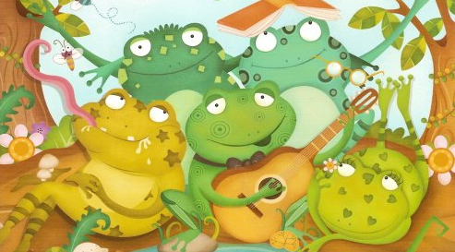
Speckled Frogs
Five green and speckled frogs sat on a speckled log Eating some most delicious bugs -- YUM YUM! One jumped into the pool where it was nice and cool Then there were four green and speckled frogs.
Notes:
Stop after each one and write out 5=?+?
Standards pages: Forefront/background?

Slide 42
Speckled Frogs
+
+
https://www.dailymail.co.uk/sciencetech/article-6872301/Scientists-want-cut-toes-dead-frogs.html
+
+
Notes:
Stop after each one and write out 5=?+?

Slide 43
10-frame
Explain what this symbol means:
=
Notes:
Standards pages: Forefront/background?
Have them do the sponge activity
10 is 4 and 6
Leads to…
12 + 17
Leads to…
19 + 19
Leads to …
57 + 68
Leads to…
Distributive property
Practice doing this in small groups???

Slide 44
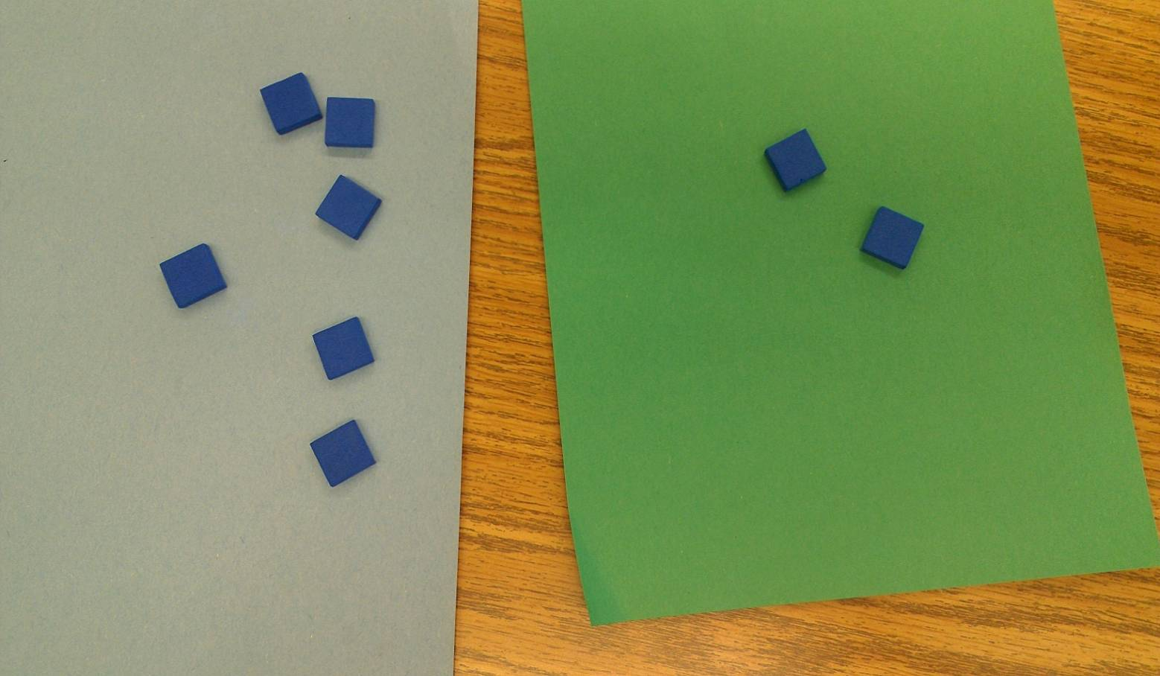
Decomposing Numbers
Notes:
Do this with construction paper and white boards

Slide 45
Adding it up
4+5 vs 6+7

Slide 46
Adding it Up
Solve in more than one way:
17 + 16
Notes:
Standards pages: Forefront/background?
Have them do the sponge activity
10 is 4 and 6
Leads to…
12 + 17
Leads to…
19 + 19
Leads to …
57 + 68
Leads to…
Distributive property
Practice doing this in small groups???

Slide 47
Adding it Up
Solve in more than one way:
22 + 18
Notes:
Standards pages: Forefront/background?
Have them do the sponge activity
10 is 4 and 6
Leads to…
12 + 17
Leads to…
19 + 19
Leads to …
57 + 68
Leads to…
Distributive property
Practice doing this in small groups???

Slide 48
Adding it Up
Solve in more than one way:
35 + 17
Notes:
Standards pages: Forefront/background?
Have them do the sponge activity
10 is 4 and 6
Leads to…
12 + 17
Leads to…
19 + 19
Leads to …
57 + 68
Leads to…
Distributive property
Practice doing this in small groups???

Slide 49
Provide Multiple Means of Action & Expression
5: Provide options for expression and communication
5.1 Use multiple media for communication
5.2 Use multiple tools for construction and composition
5.3 Build fluencies with graduated levels of support for practice and performance

Slide 50
Provide Multiple Means of Engagement
7: Provide options for recruiting interest
7.1 Optimize individual choice and autonomy
7.2 Optimize relevance, value, and authenticity
7.3 Minimize threats and distractions

Slide 51
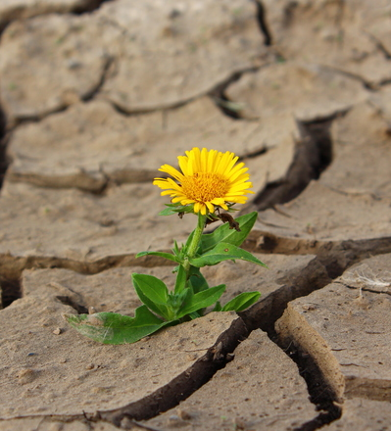
SMP #1 Make sense of problems and persevere in solving them.
When presented with a problem, make a plan, carry out the plan, and evaluate its success.

Slide 52
SMP #7 Look for and make use of structure.
See and understand how numbers and spaces are organized and put together as parts and wholes.

Slide 53
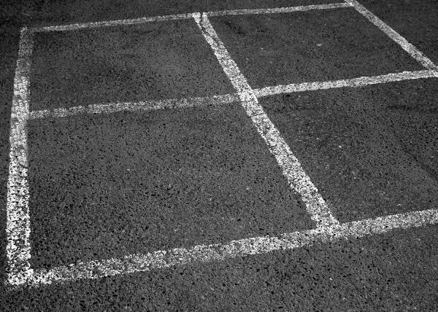
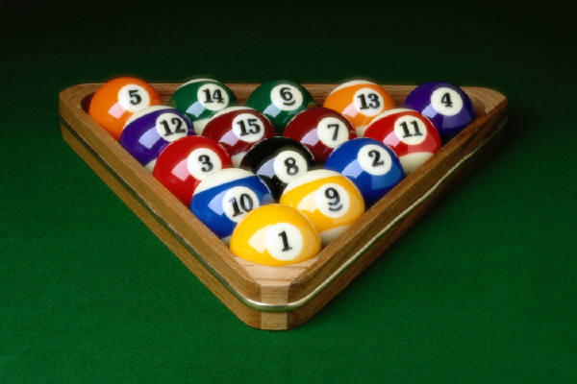
Think about...
Notes:
What is “square” – fits in with what you are already doing?
What came to you from a new angle?
What ‘closed the circle” for you (completed an understanding)?

Slide 54
Math for Preschool
Jon Dueck • jdueck@fcoe.org

