Slide 1
Mobius Mysteries
SCOTT NIELSEN
PK-12 Coordinator
scott@aimscenter.org
AILEEN RIZO
Associate Director
aileen@aimscenter.org
Notes:
Providing effective professional development has become more challenging given the current COVID-19 pandemic. Although there are many attempts to provide online professional learning opportunities for educators, participants in these sessions are not always engaged in meaningful, active learning. To address these challenges, we have been using video conferencing technology paired with tangible materials to engage a cohort of remote online early childhood educators in professional development in early mathematics education.

Slide 2
Materials Needed:
1 in. strips of paper cut from 8x11 size long way
Scissors
Tape
Pencil/pen
Notes:
Introduction - a bit about the AIMS Center and our current work

Slide 3
Let’s make a Mobius Strip

Slide 4
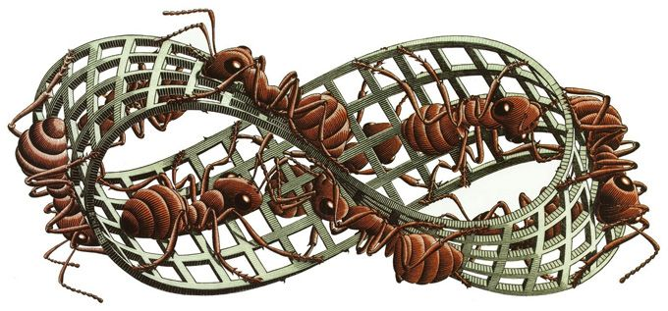

Slide 5
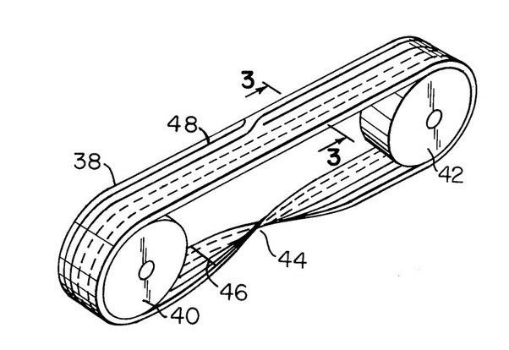

Slide 6
Let’s continue to explore

Slide 7
Potential of STEM Activities
1
2
3
4
Engage the learner with tangible materials
Utilize the power of prediction
Provide opportunities for problem solving
Extend and encourage future exploration

Slide 8
THANK YOU!
SCOTT NIELSEN AILEEN RIZO
PK-12 Coordinator Associate Director
Scott@AIMScenter.org Aileen@AIMScenter.org
RESOURCES
AIMSCENTER.ORG

